Slide 1

A.3(E)
determine the effects on the graph of the parent function f(x) = x
when f(x) is replaced by af(x), f(x) + d, f(x – c), f(bx) for specific values of a, b, c, and d

Slide 2
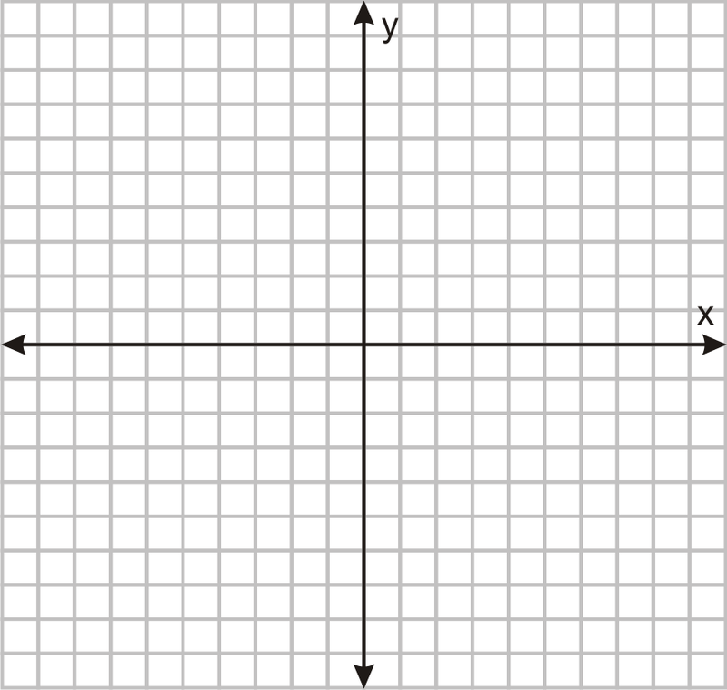
Fluency Practice
Label the slope and y-intercept in the equation: y=3x-5
Graph the equation.
What does a line with a positive slope look like? What does a line with a negative slope look like?

Slide 3
Problem Solving Strategies
Intervene’s Problem Solving Strategies:
Step 1: Show what you know
Step 2: Solve and Check
Step 3: Eliminate and Justify

Slide 4
Lesson
Key Vocabulary
Linear function
Slope
Y-intercept
Slope-Intercept form
Coefficient
Translation
Reflection
 | Effect | Equation Ex.
y=ax | Steeper/ Less steep | y=2x y=1/3 x
y=-ax | Reflection | y= -x
y=(x-h) | Horizontal translation right | y=(x-5)
y=(x+h) | Horizontal translation left | y=(x+5)
y=x+k | Vertical translation up | y=x+3
y=x-k | Vertical translation down | y=x-5

Slide 6
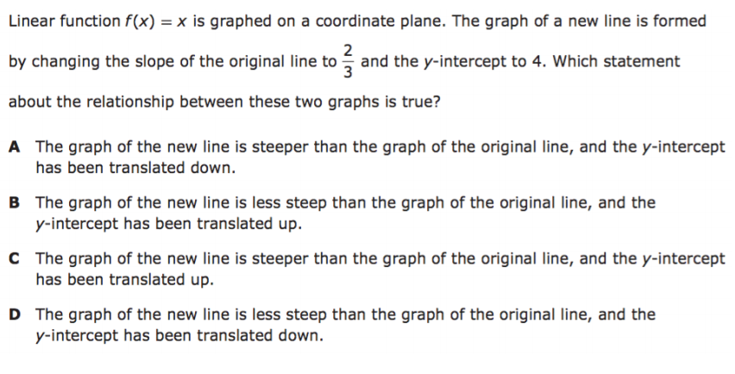
I Do

Slide 7
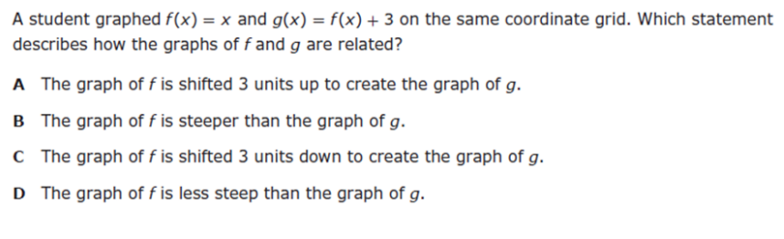
We Do – Student 1

Slide 8
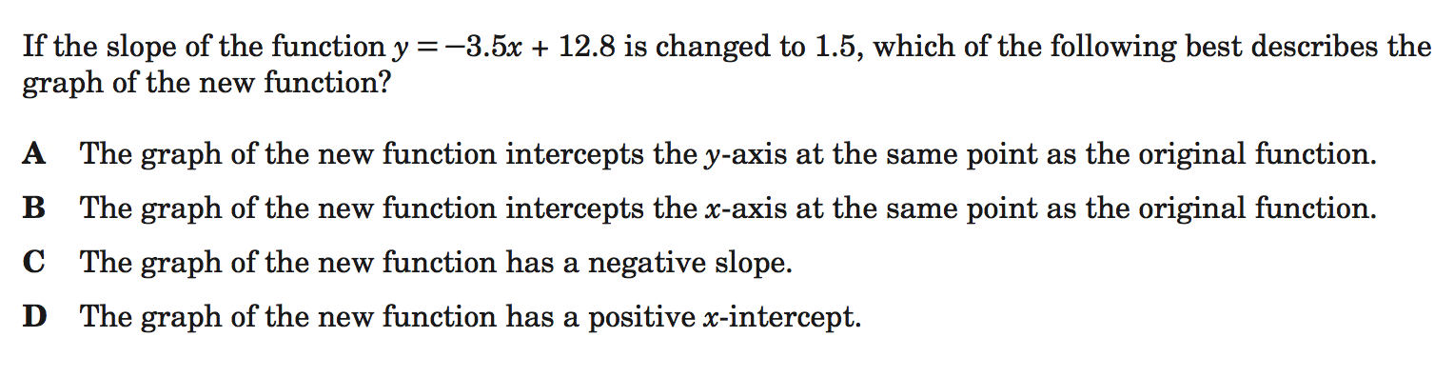
We do - Student 2

Slide 9
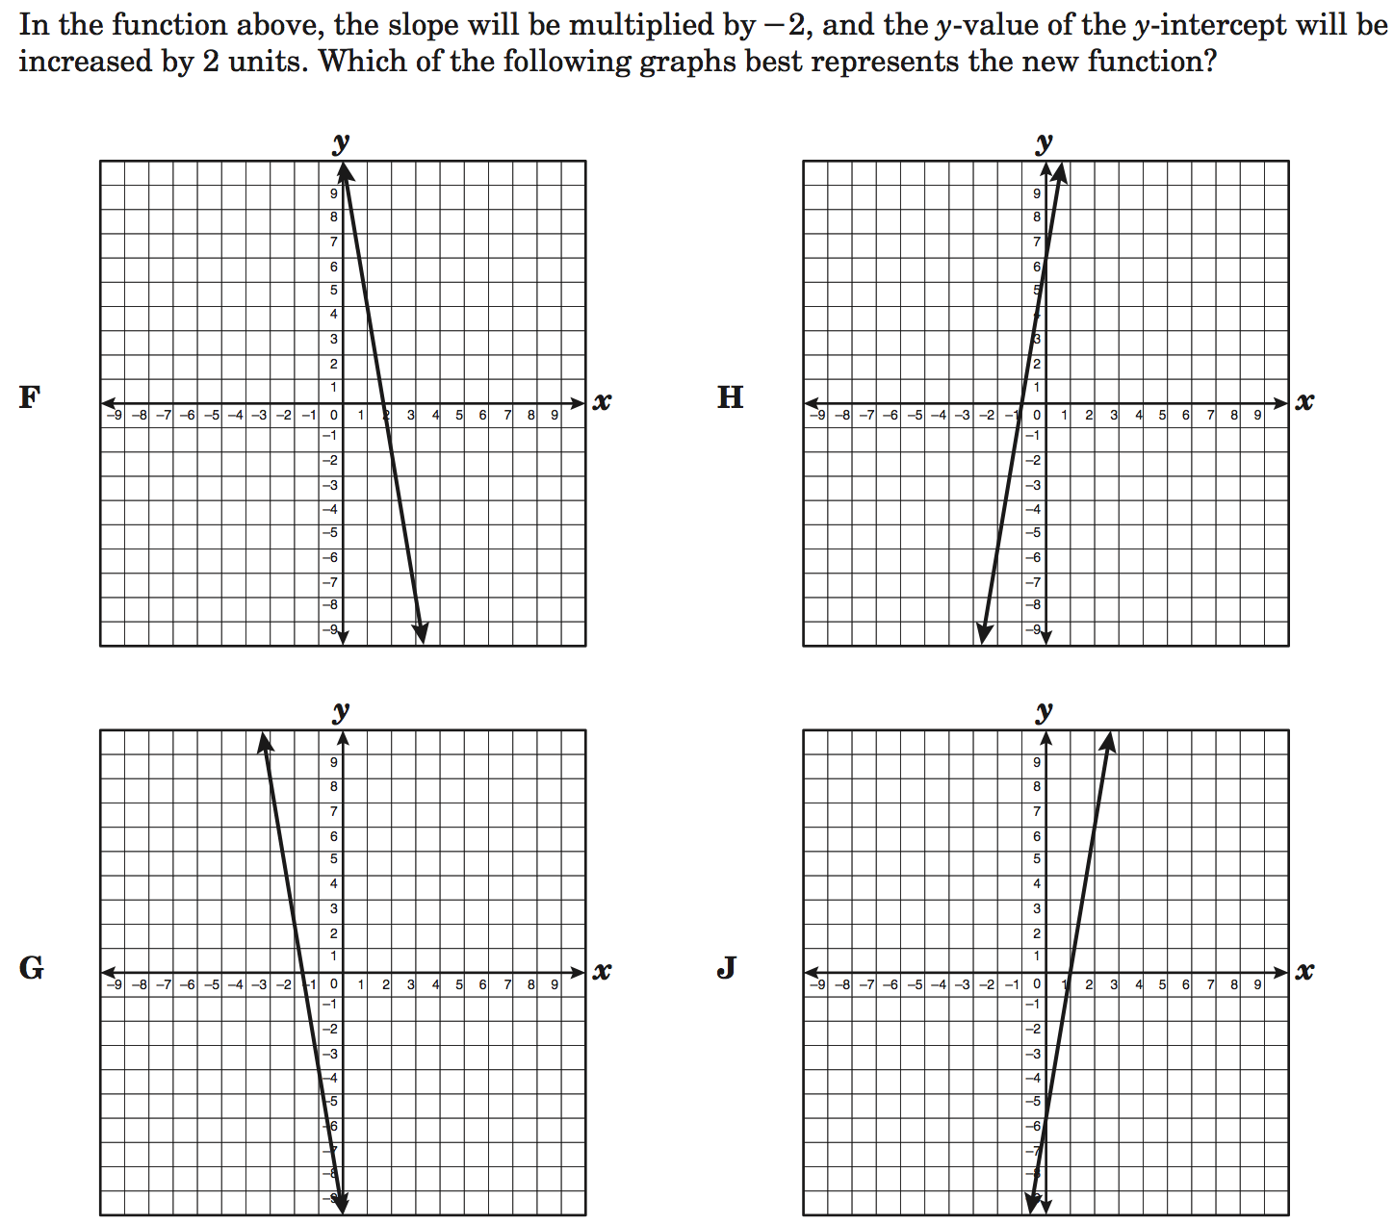
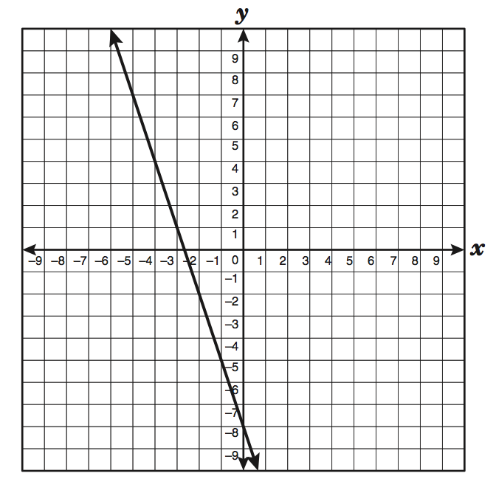
We do - Student 3

Slide 10
We Do

Slide 11
Debrief
 | Effect | Equation Ex.
y=ax | Steeper/ Less steep | y=2x y=1/3 x
y=-ax | Reflection | y= -x
y=(x-h) | Horizontal translation right | y=(x-5)
y=(x+h) | Horizontal translation left | y=(x+5)
y=x+k | Vertical translation up | y=x+3
y=x-k | Vertical translation down | y=x-5

