Slide 1

A.3(F)
graph systems of two linear equations in two variables on the coordinate plane and determine the solutions if they exist

Slide 2
Fluency Practice
x | f₁(x) | f₂(x)
-3 | -6 | -3
1 | -2 | 0
5 | 2 | 3
9 | 6 | 6
What point is the same for both lines in the table to the right?
Explain how to graph y=4x-2
Rewrite this equation into slope-intercept form:
2x – 3y =15

Slide 3
Problem Solving Strategies
Intervene’s Problem Solving Strategies:
Step 1: Show what you know
Step 2: Solve and Check
Step 3: Eliminate and Justify

Slide 4
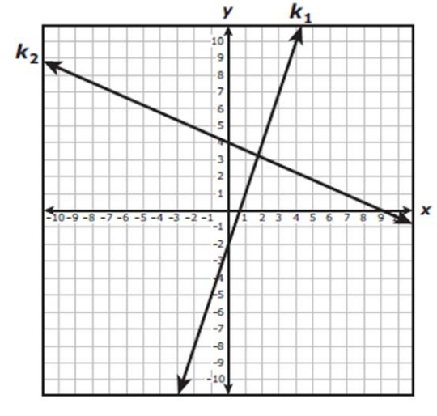
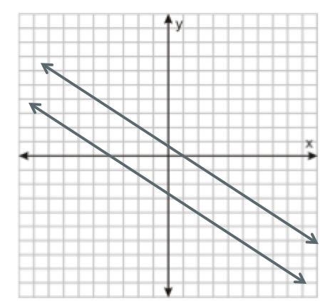
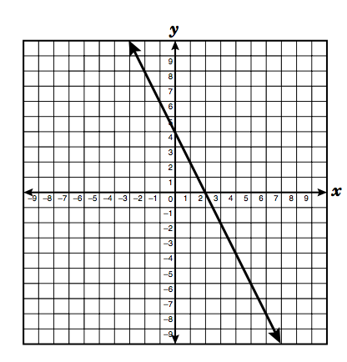
Lesson
Key Vocabulary
Linear function System of equations Solution
Parallel lines No Solution Coinciding
Infinitely many solutions
Types of Graphs | Solution | Graph
Intersecting lines | One point (x,y)
Parallel lines | No solution
Coinciding lines | Infinitely many solutions

Slide 5
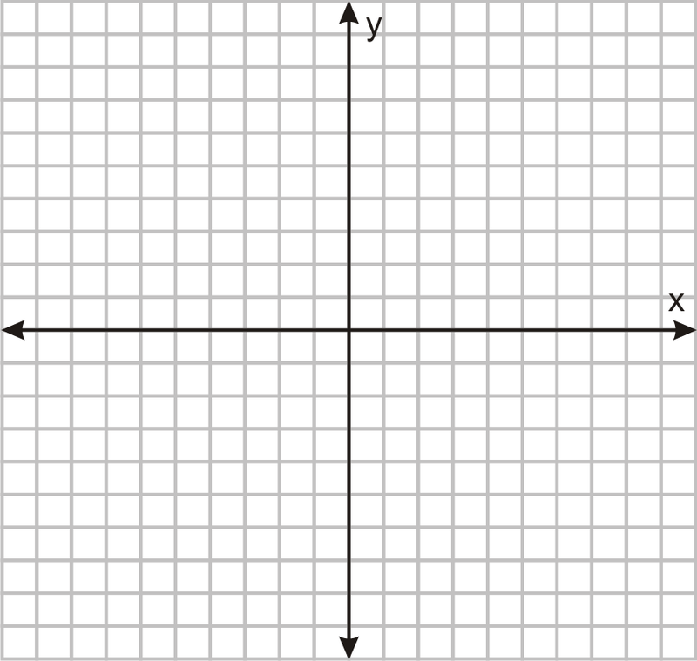

Slide 6
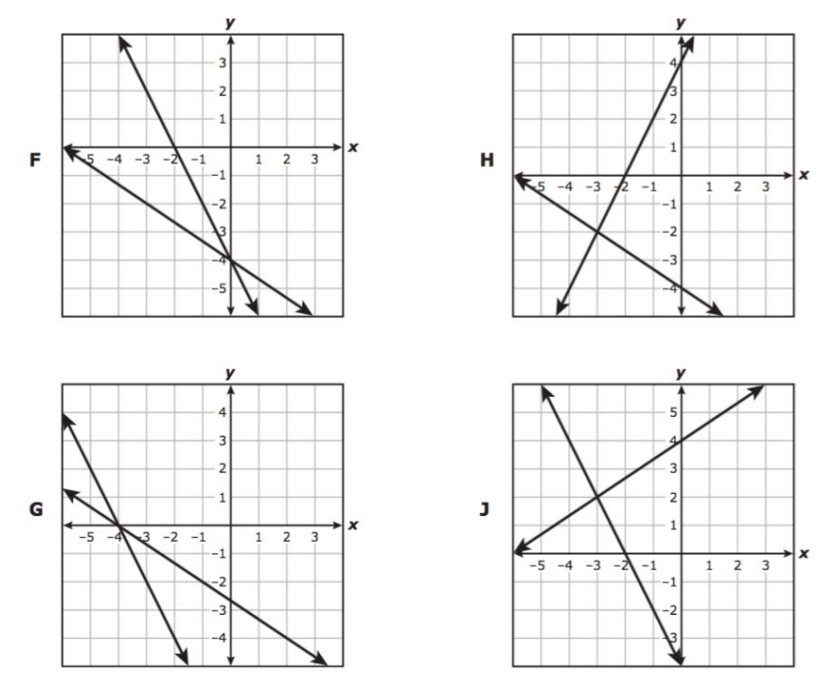

I Do

Slide 7
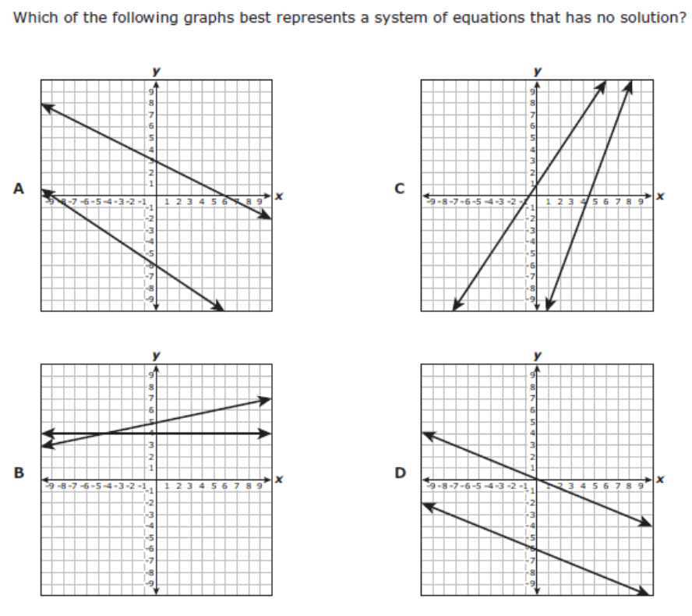
We Do – Student 1

Slide 8
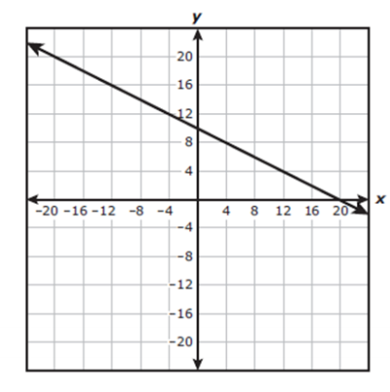
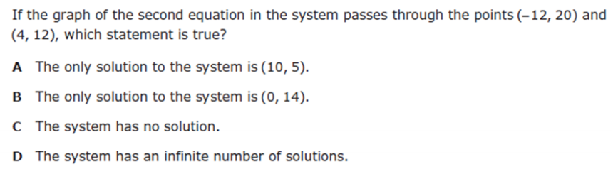
We do - Student 2

Slide 9
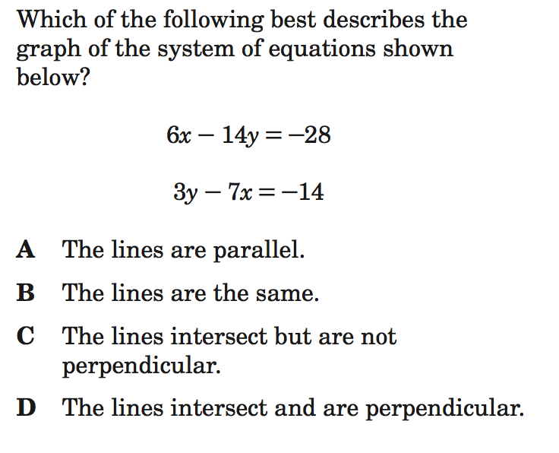
We do - Student 3

Slide 10
We Do

Slide 11
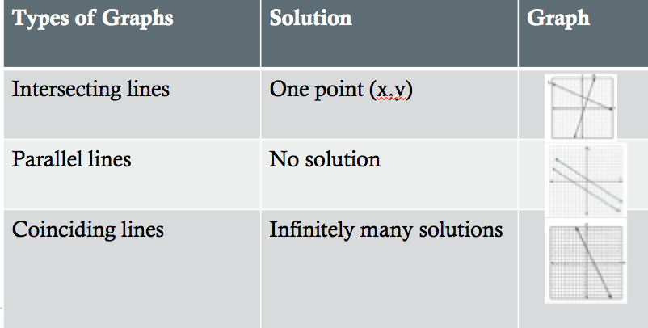
Debrief

