Slide 1

A.5(A)
solve linear equations in one variable, including those for which the application of the distributive property is necessary and for which variables are included on both sides

Slide 2
Fluency Practice [5 min]
What is -2 x -5?
What does distribute mean?
What does P.E.M.D.A.S. stand for?

Slide 3
Problem Solving Strategies
Intervene’s Problem Solving Strategies:
Step 1: Show what you know
Step 2: Solve and Check
Step 3: Eliminate and Justify

Slide 4
Lesson
Key Vocabulary
Distribute
Solution
Value
Coefficient
Steps to solving equation (PEMDAS backwards)
Distribute
Join like terms (on the same side of the equal sign)
Add/Subtract
Multiply/Divide

Slide 5
Balance the equation
=

Slide 6
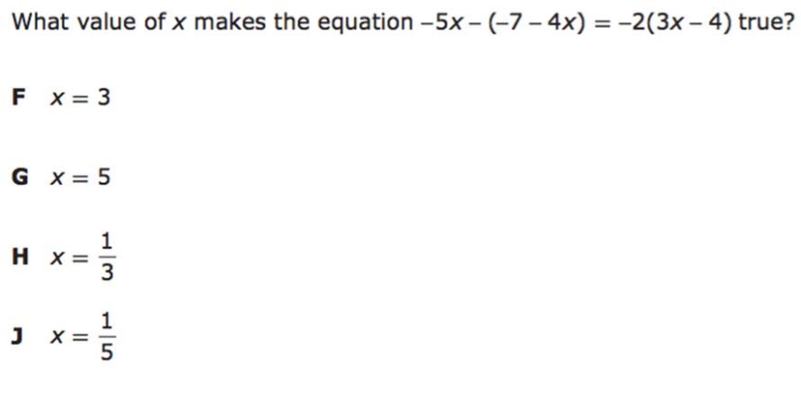
I Do [5 minutes]

Slide 7
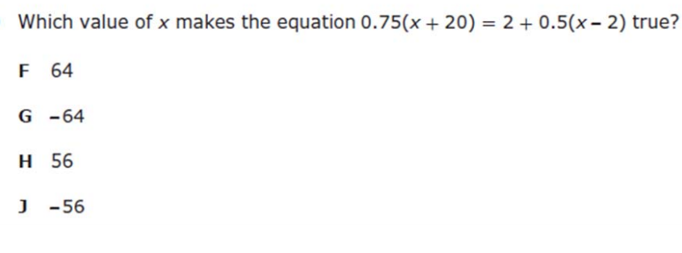
We Do – Student 1 [5 minutes]

Slide 8
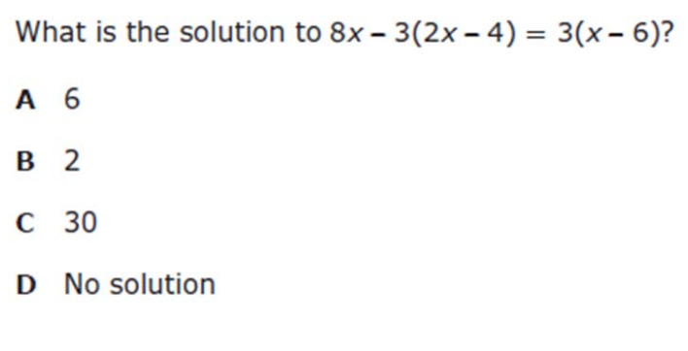
We do - Student 2 [5 minutes]

Slide 9
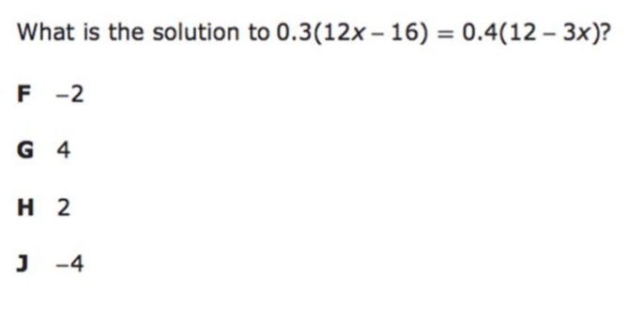
We do - Student 3 [5 minutes]

Slide 10
We Do [5 minutes]

Slide 11
Debrief [2 minutes]
Balance the equation
=

Slide 12
You Do [1 minute to explain]
Instructions for Content Dev:
Nothing to do here
Instructions for Tutor:
Have students click on the Quiz tab above (on their screen)
Instruct students to take the quiz on this objective, and remind to use their problem solving strategies

