Slide 1

A.5(B)
solve linear inequalities in one variable, including those for which the application of the distributive property is necessary and for which variables are included on both sides

Slide 2
Fluency Practice
Solve the following equation: 3x-5(x+2)=14
What do the following symbols mean:
< < > >
What does PEMDAS mean?

Slide 3
Problem Solving Strategies
Intervene’s Problem Solving Strategies:
Step 1: Show what you know
Step 2: Solve and Check
Step 3: Eliminate and Justify

Slide 4
Lesson
Key Vocabulary
Linear inequality
Distribute
Less than
Less than or equal to
Greater than
Greater than or equal to
Inequality Name | Inequality symbol
Less than | <
Less than or equal to | <
Greater than | >
Greater than or equal to | >

Slide 5
Balance the equation

Slide 6
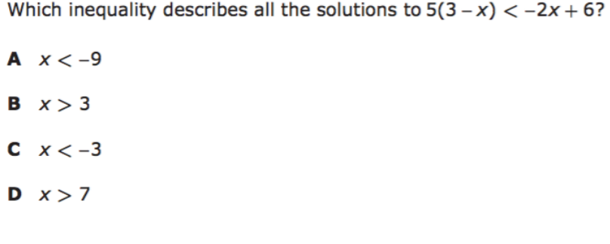
I Do

Slide 7
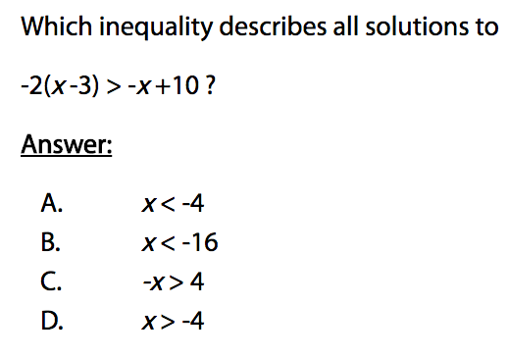
We Do – Student 1

Slide 8
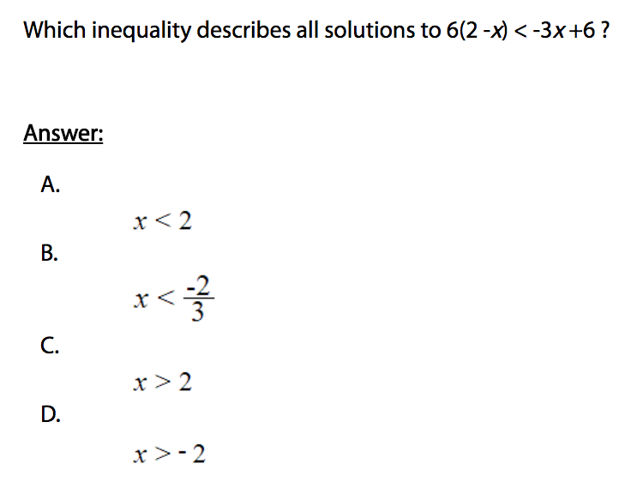
We do - Student 2

Slide 9
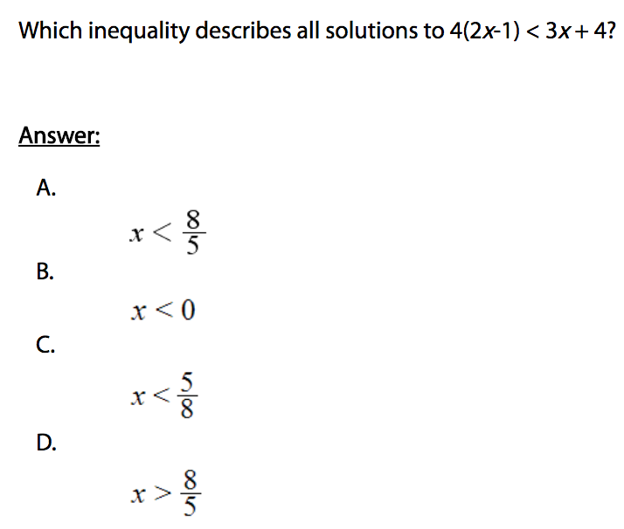
We do - Student 3

Slide 10
We Do

Slide 11
Debrief
Balance the equation
Inequality Name | Inequality symbol
Less than | <
Less than or equal to | <
Greater than | >
Greater than or equal to | >

