Slide 1

A.5(C)
solve systems of two linear equations with two variables for mathematical and real-world problems

Slide 2
Fluency Practice [5 min]
What does the word intersect mean?
What are parallel lines?
What point do the following tables have in common?
Table 1 Table 2
x | y
-1 | 5
0 | 7
1 | 9
3 | 11
x | y
1 | 9
2 | 14
3 | 19
4 | 24

Slide 3
Problem Solving Strategies
Intervene’s Problem Solving Strategies:
Step 1: Show what you know
Step 2: Solve and Check
Step 3: Eliminate and Justify

Slide 4
Lesson
Key Vocabulary
Linear function
Slope
Y-intercept
Solution
Intersection
Parallel lines
No solution
Coinciding lines
Methods to solving systems of linear equations
Graphing
Substitution
Elimination
Types of systems of equations
Intersecting lines
Parallel lines
Coinciding (same) line

Slide 5
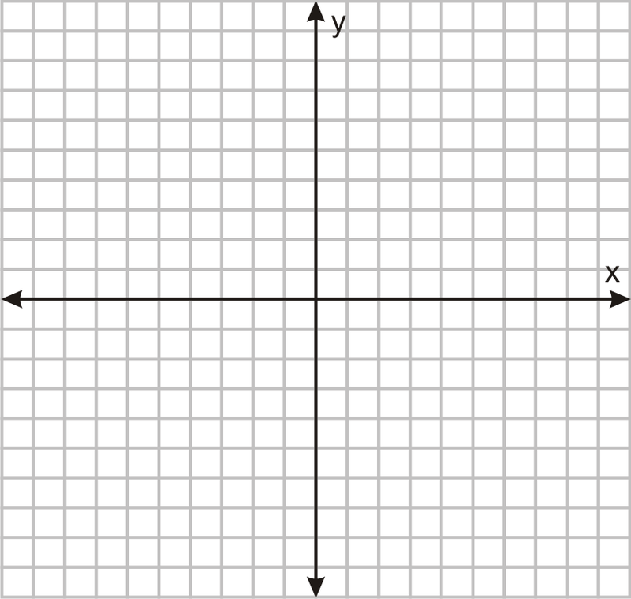

Slide 6
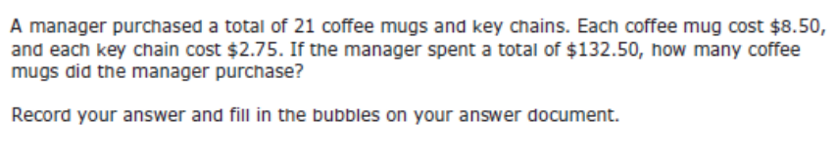
I Do [5 minutes]

Slide 7
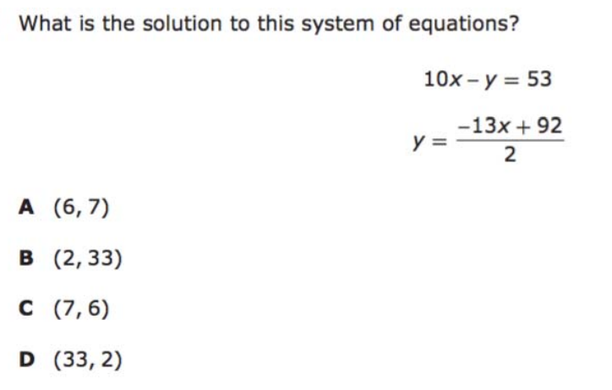
We Do – Student 1 [5 minutes]

Slide 8
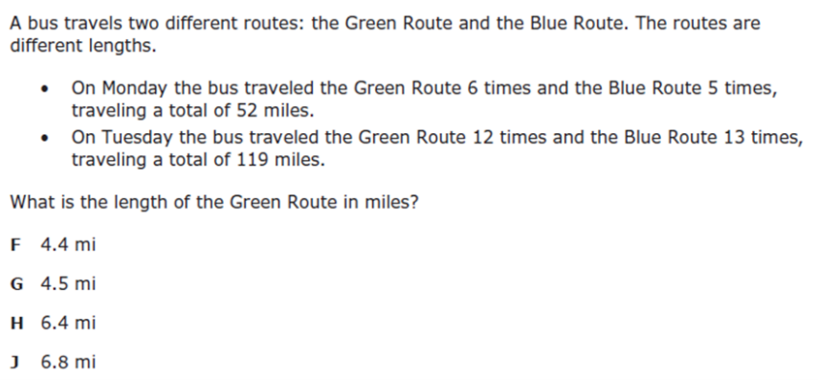
We do - Student 2 [5 minutes]

Slide 9
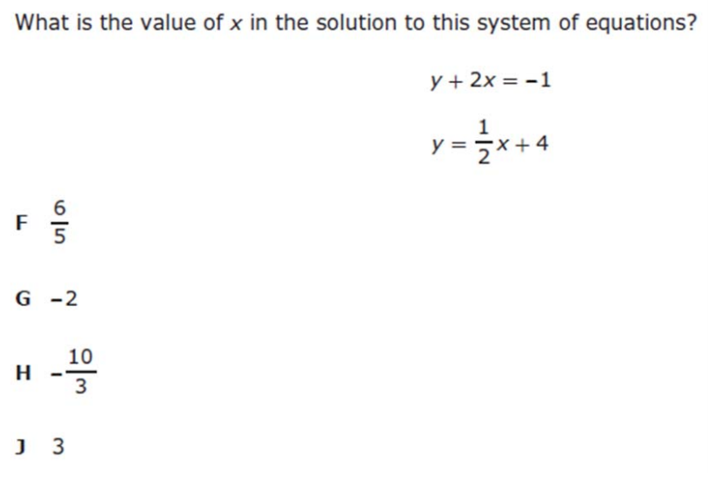
We do - Student 3 [5 minutes]

Slide 10
We Do [5 minutes]

Slide 11
Debrief [2 minutes]
Methods to solving systems of linear equations
Graphing
Substitution
Elimination
Types of systems of equations
Intersecting lines
Parallel lines
Coinciding (same) line

Slide 12
You Do [1 minute to explain]
Instructions for Content Dev:
Nothing to do here
Instructions for Tutor:
Have students click on the Quiz tab above (on their screen)
Instruct students to take the quiz on this objective, and remind to use their problem solving strategies

