Slide 1

A.6(A)
determine the domain and range of quadratic functions and represent the domain and range using inequalities

Slide 2
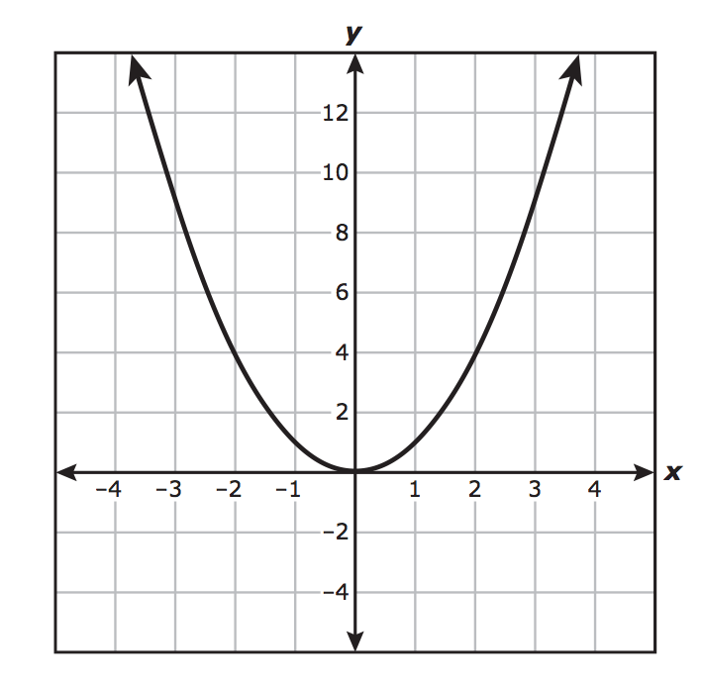
Fluency Practice [5 min]
What do the arrows on the ends of the parabola mean?
What do the following symbols mean:
< < > >
Label the vertex and axis of symmetry on the parabola shown above.

Slide 3
Problem Solving Strategies
Intervene’s Problem Solving Strategies:
Step 1: Show what you know
Step 2: Solve and Check
Step 3: Eliminate and Justify

Slide 4

Lesson
Key Vocabulary
Quadratic function
Domain
Range
Inequalities
Vertex
Axis of Symmetry
All Real Numbers ( )

Slide 5
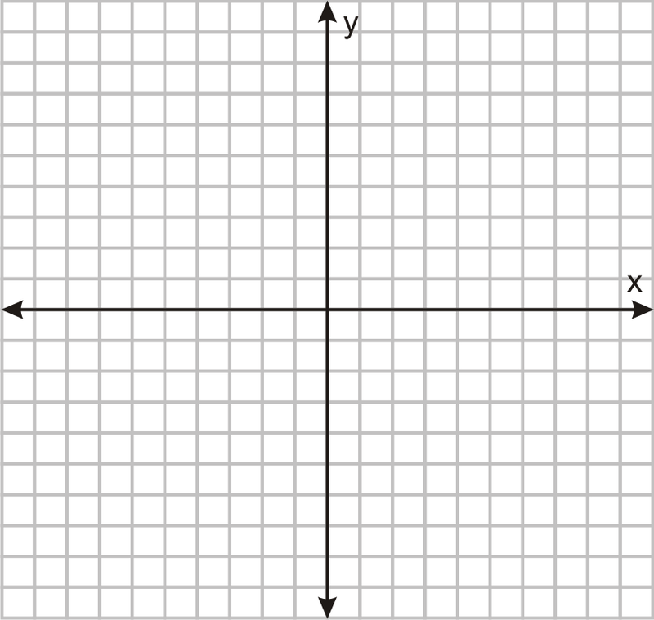

Slide 6
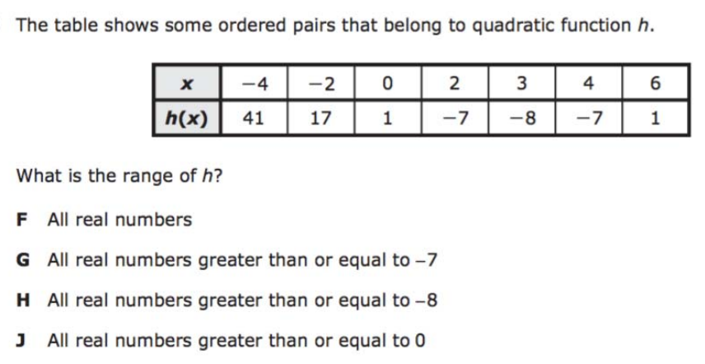
I Do [5 minutes]

Slide 7
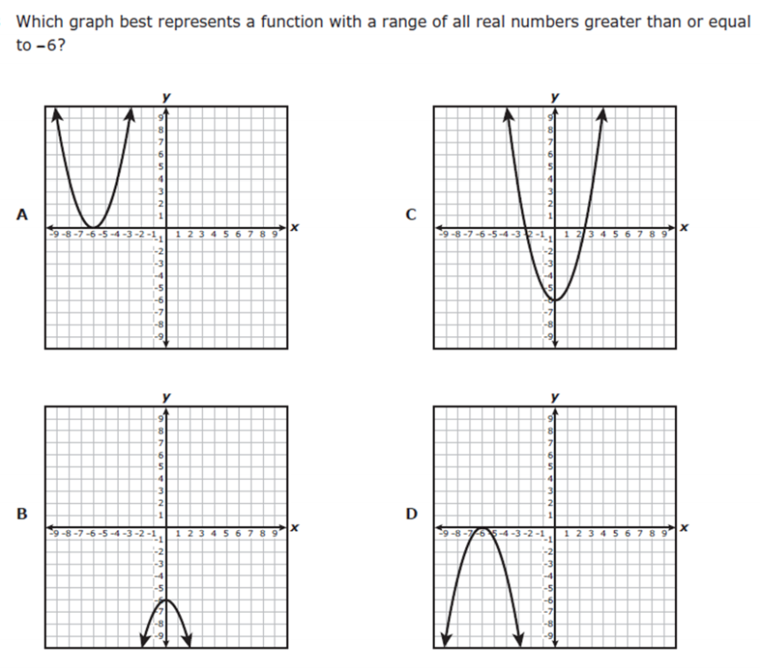
We Do – Student 1 [5 minutes]

Slide 8
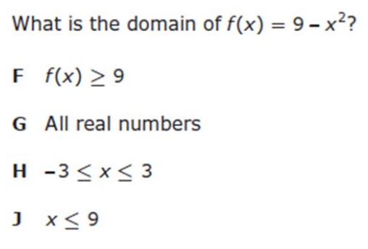
We do - Student 2 [5 minutes]

Slide 9
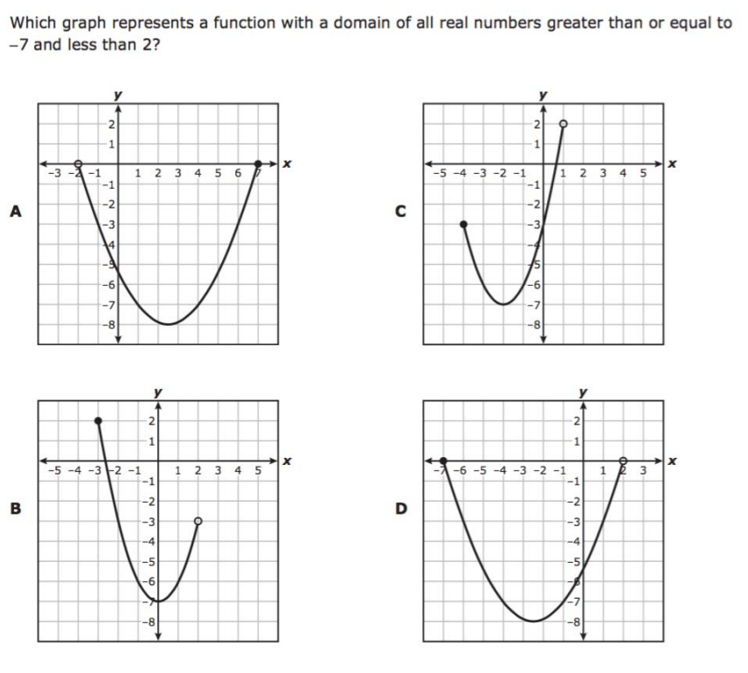
We do - Student 3 [5 minutes]

Slide 10
We Do [5 minutes]

Slide 11
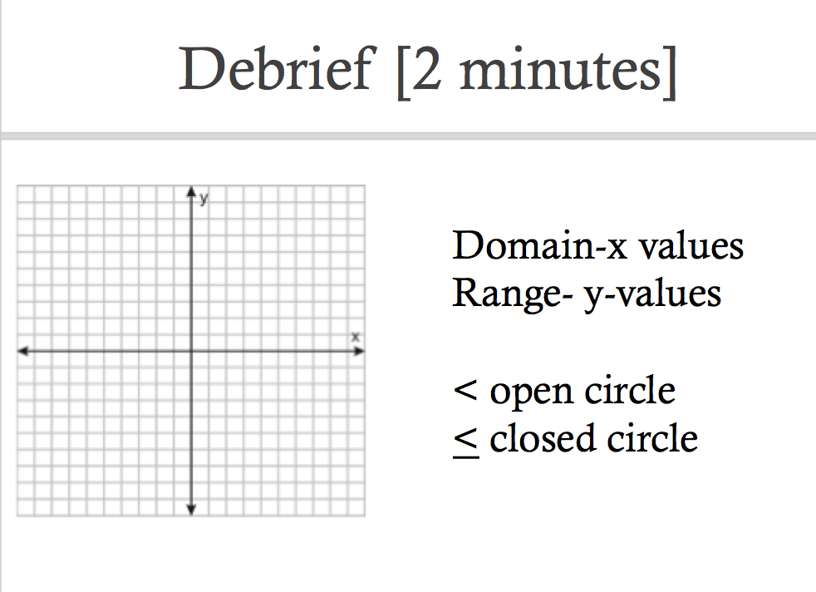
If a quadratic continues in both directions,
Its domain will be all real numbers R

Slide 12
You Do [1 minute to explain]
Instructions for Content Dev:
Nothing to do here
Instructions for Tutor:
Have students click on the Quiz tab above (on their screen)
Instruct students to take the quiz on this objective, and remind to use their problem solving strategies

