Slide 1

A.6(B)
write equations of quadratic functions given the vertex and another point on the graph, write the equation in vertex form
(f(x) = a(x – h)² + k), and rewrite the equation from vertex form to standard form (f(x) = ax² + bx + c)

Slide 2
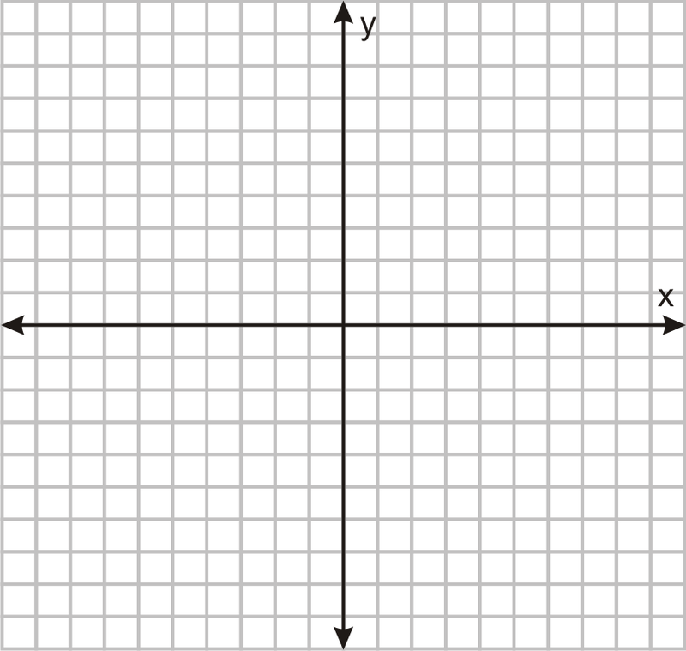
Fluency Practice
Label the vertex on the parabola to the right.
Solve the equation:
2(x-5)=14
What effect does a negative coefficient have on a quadratic equation? For example: y= -2x²-7

Slide 3
Problem Solving Strategies
Intervene’s Problem Solving Strategies:
Step 1: Show what you know
Step 2: Solve and Check
Step 3: Eliminate and Justify

Slide 4
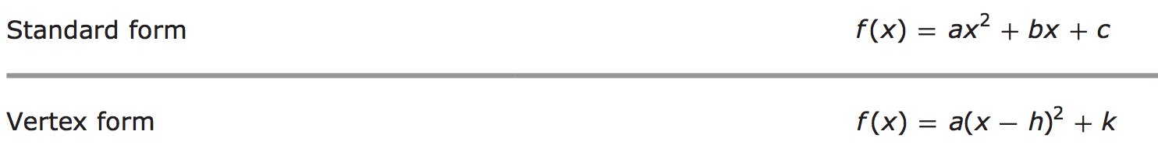
Lesson
Key Vocabulary
Quadratic function
Parabola
Vertex
Vertex form
Standard form
Vertex (h,k)

Slide 6
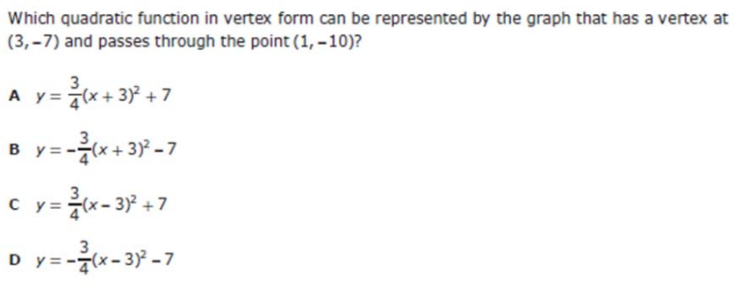
I Do

Slide 7
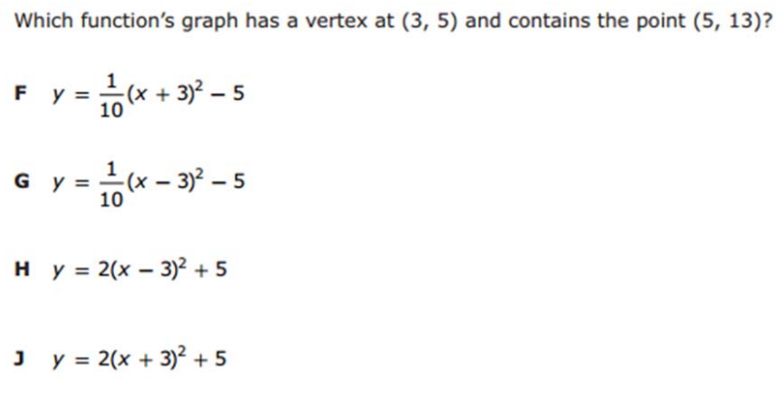
We Do – Student 1

Slide 8
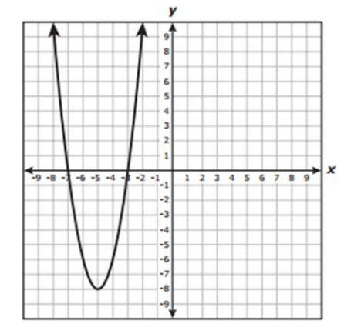
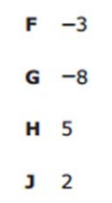
We do - Student 2

Slide 9
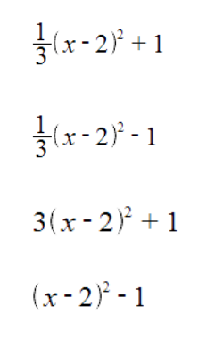
We do - Student 3
A.
B.
C.
D.

Slide 10
We Do

Slide 11
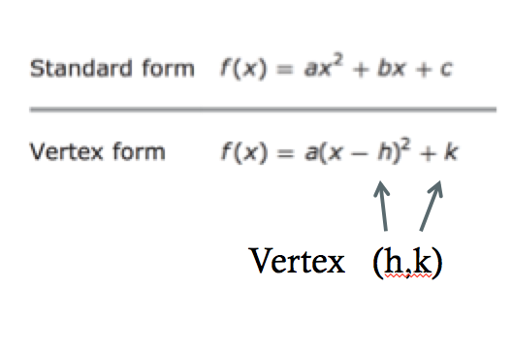
Debrief

