Slide 1

A.7(A)
graph quadratic functions on the coordinate plane and use the graph to identify key attributes, if possible, including x-intercept, y-intercept, zeros, maximum value, minimum values, vertex, and the equation of the axis of symmetry

Slide 2
Fluency Practice [5 min]
What does the word maximum mean?
What does the word minimum mean?
Draw a line of symmetry on the star shown below.
Label a vertex on the cube shown to the right.

Slide 3
Problem Solving Strategies
Intervene’s Problem Solving Strategies:
Step 1: Show what you know
Step 2: Solve and Check
Step 3: Eliminate and Justify

Slide 4
Lesson
Key Vocabulary
Quadratic Function
Parabola
Y-intercept
X-intercept
Zeros
Solutions
Axis of Symmetry
Vertex
Maximum
Minimum

Slide 5
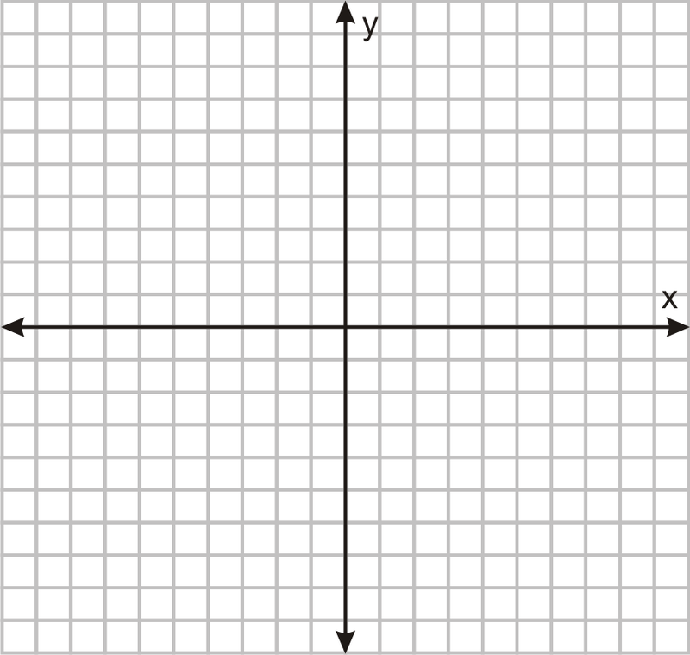

Slide 6
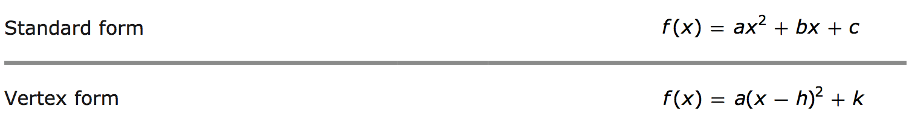

Slide 7
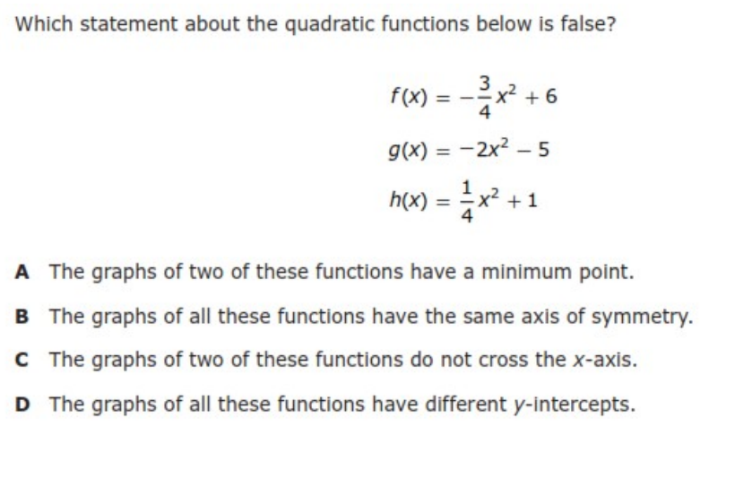
I Do [5 minutes]

Slide 8
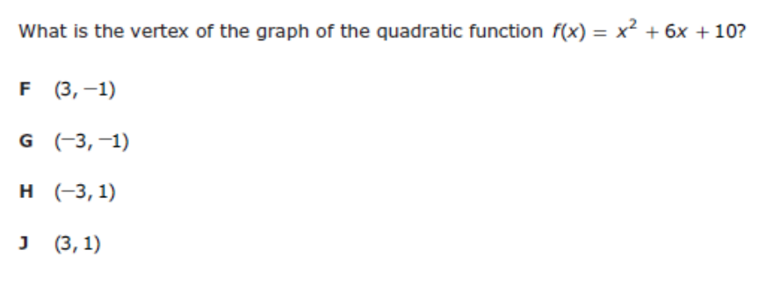
We Do – Student 1 [5 minutes]

Slide 9
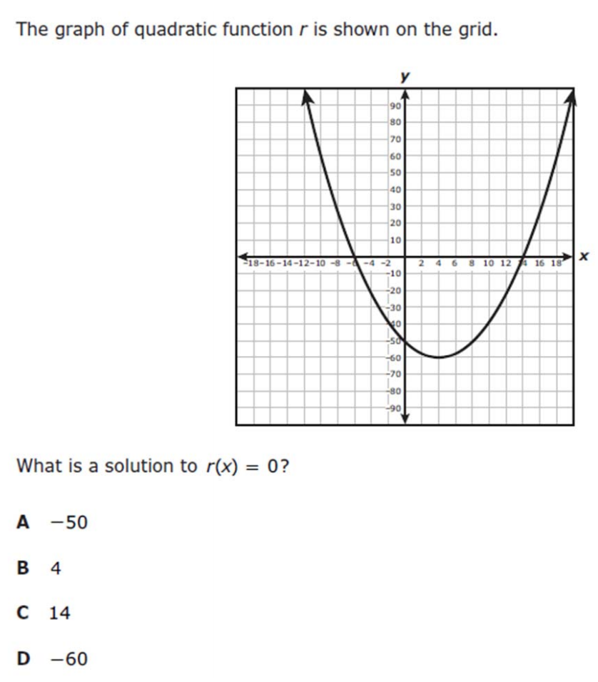
We do - Student 2 [5 minutes]

Slide 10
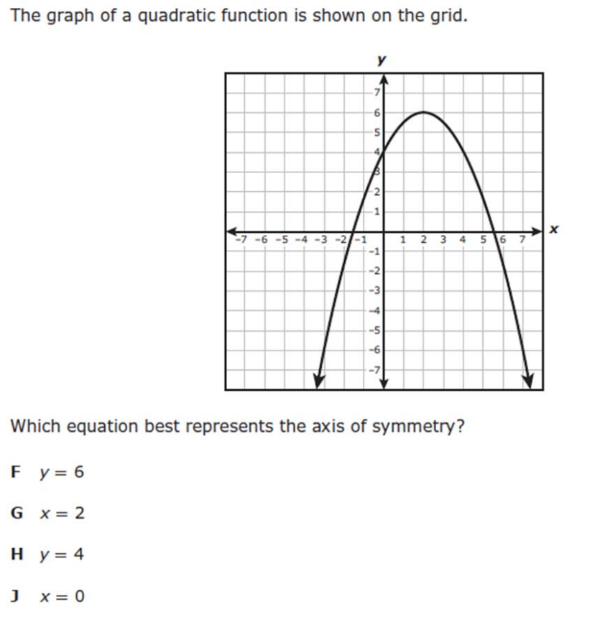
We do - Student 3 [5 minutes]

Slide 11
We Do [5 minutes]

Slide 12
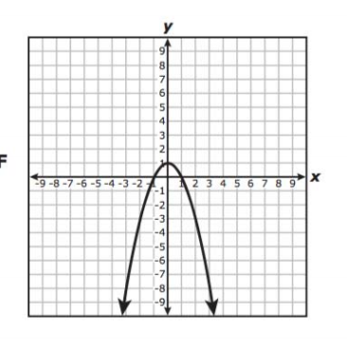
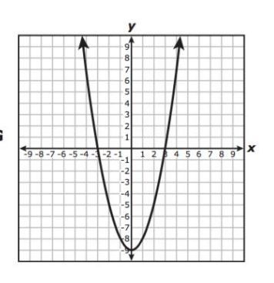
Debrief [2 minutes]
Maximum Minimum
Vertex
Axis of Symmetry

Slide 13
You Do [1 minute to explain]
Instructions for Content Dev:
Nothing to do here
Instructions for Tutor:
Have students click on the Quiz tab above (on their screen)
Instruct students to take the quiz on this objective, and remind to use their problem solving strategies

