Slide 1

A.7(B)
describe the relationship between the linear factors of quadratic expressions and the zeros of their associated quadratic functions

Slide 2
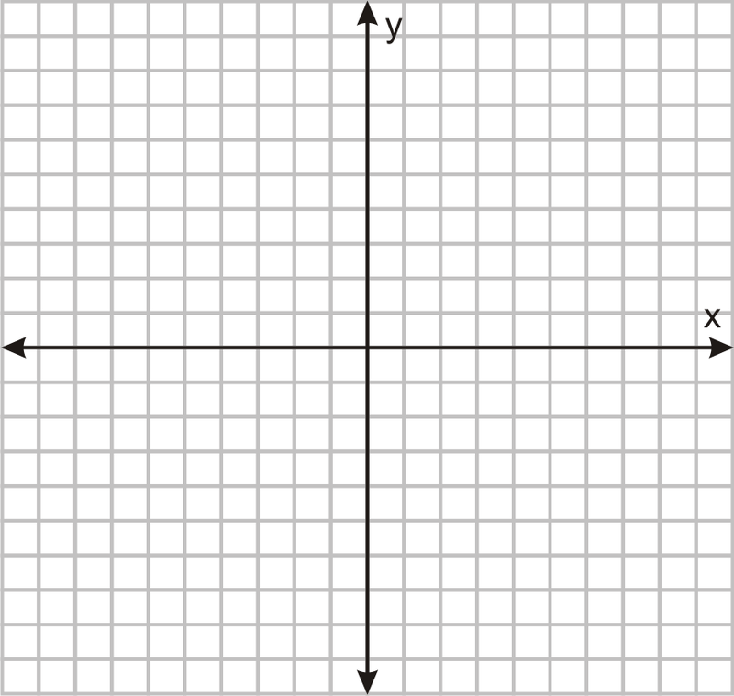
Fluency Practice
Solve the equation: 2x-7=0
Label the x-intercepts in the graph.
Multiply (x+4)(2x-3)

Slide 3
Problem Solving Strategies
Intervene’s Problem Solving Strategies:
Step 1: Show what you know
Step 2: Solve and Check
Step 3: Eliminate and Justify

Slide 4
Lesson
Key Vocabulary
Quadratic function
X-intercepts
Zeros
Roots
Solutions
Factor
Distribute

Slide 6
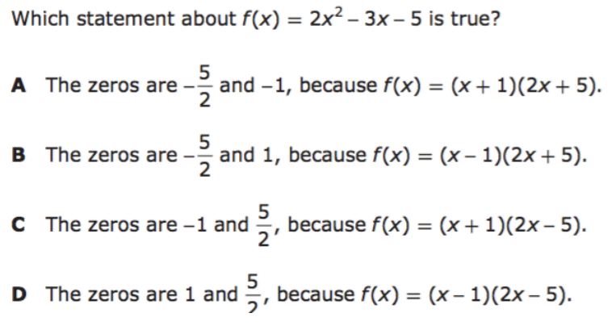
I Do

Slide 7
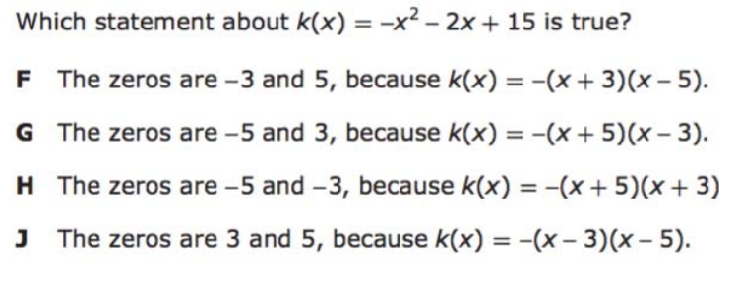
We Do – Student 1

Slide 8
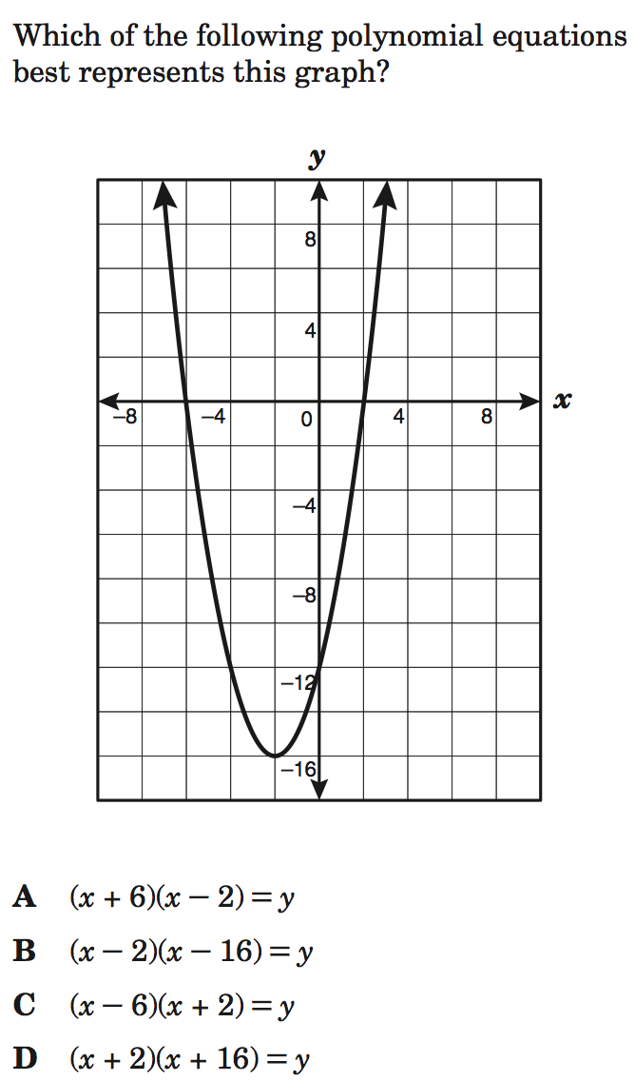
We do - Student 2

Slide 9
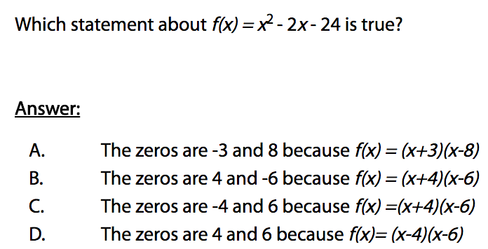
We do - Student 3

Slide 10
We Do

Slide 11
Debrief
Other names for
x-intercepts:
Zeros
Roots
Solutions

