Slide 1

A.7(C)
determine the effects on the graph of the parent function f(x) = x² when f(x) is replaced by af(x), f(x) + d, f(x – c), f(bx) for specific values of a, b, c, and d

Slide 2
Fluency Practice [5 min]
How does changing the equation of a line from y=2x-5 to
y= -2x+7 affect the graph?
Draw a vertical line. Draw a horizontal line.
What does the word “translation” mean? What does “reflection” mean?

Slide 3
Problem Solving Strategies
Intervene’s Problem Solving Strategies:
Step 1: Show what you know
Step 2: Solve and Check
Step 3: Eliminate and Justify

Slide 4


Lesson
Key Vocabulary
Quadratic function
Coefficient
Translation
Refletion
Stretch
Shrink
Narrow
Wide
 | Effect | Equation Ex.
y=ax² | Vertical stretch/shrink | y=2x² y=1/3 x²
y=-ax² | Reflect across x-axis | y= -x²
y=(bx)² | Horizontal stretch/shrink | y=(2x)² y=(2/3x)²
y=(x-h)² | Horizontal translation right | y=(x-5)²
y=(x+h)² | Horizontal translation left | y=(x+5)²
y=x²+k | Vertical translation up | y=x²+3
y=x²-k | Vertical translation down | y=x²-5

Slide 5
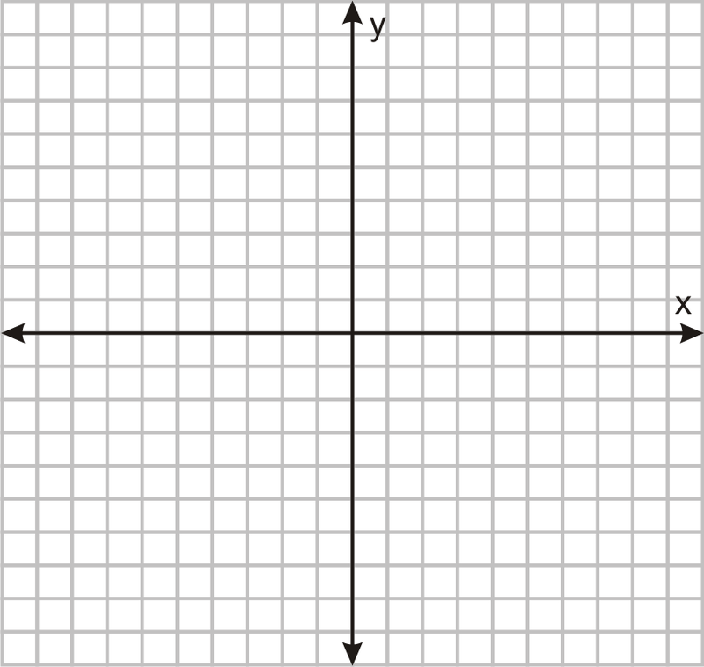

Slide 6
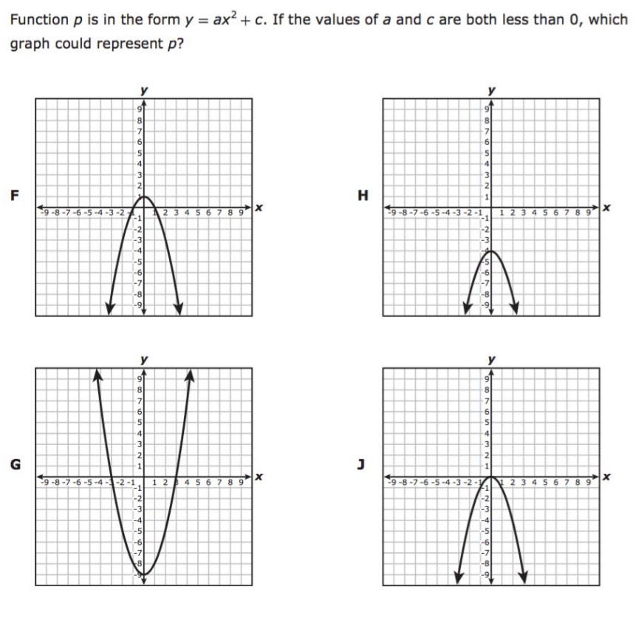
I Do [5 minutes]

Slide 7
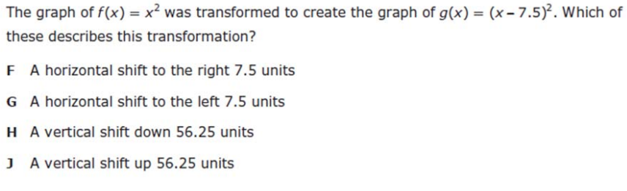
We Do – Student 1 [5 minutes]

Slide 8
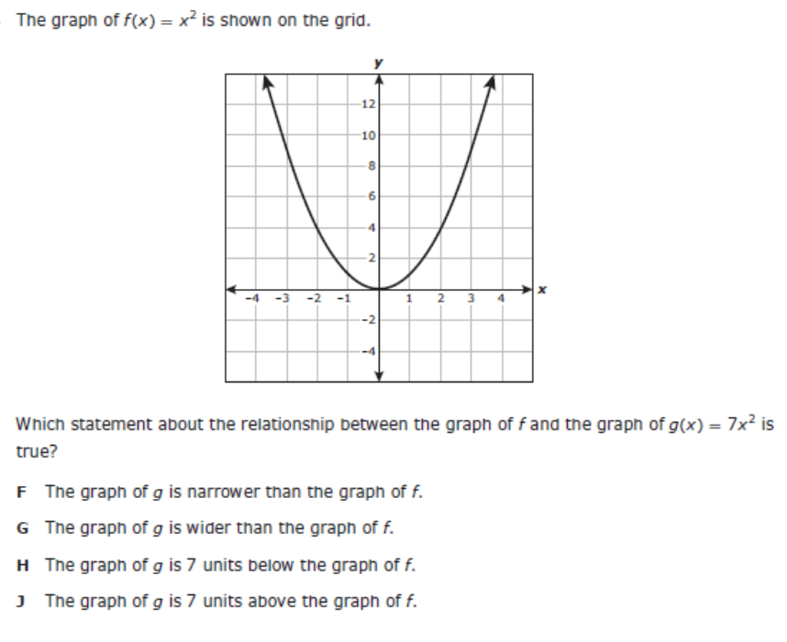
We do - Student 2 [5 minutes]

Slide 9
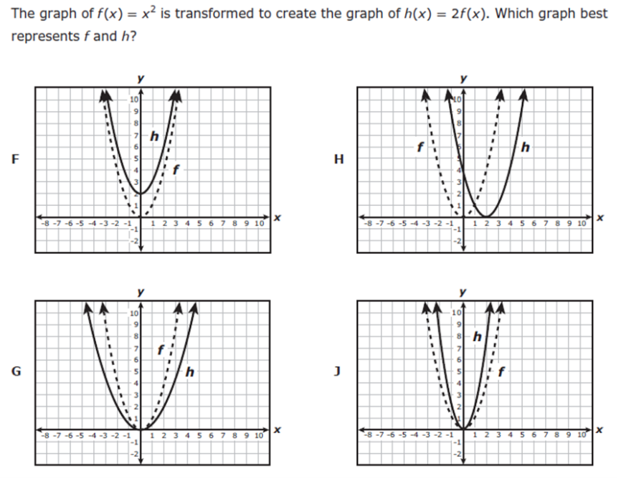
We do - Student 3 [5 minutes]

Slide 10
We Do [5 minutes]

Slide 11
Debrief [2 minutes]
 | Effect | Equation Ex.
y=ax² | Vertical stretch/shrink | y=2x² y=1/3 x²
y=-ax² | Reflect across x-axis | y= -x²
y=(bx)² | Horizontal stretch/shrink | y=(2x)² y=(2/3x)²
y=(x-h)² | Horizontal translation right | y=(x-5)²
y=(x+h)² | Horizontal translation left | y=(x+5)²
y=x²+k | Vertical translation up | y=x²+3
y=x²-k | Vertical translation down | y=x²-5

Slide 12
You Do [1 minute to explain]
Instructions for Content Dev:
Nothing to do here
Instructions for Tutor:
Have students click on the Quiz tab above (on their screen)
Instruct students to take the quiz on this objective, and remind to use their problem solving strategies

