Slide 1

A.8(A)
solve quadratic equations having real solutions by factoring, taking square roots, completing the square, and applying the quadratic formula

Slide 2


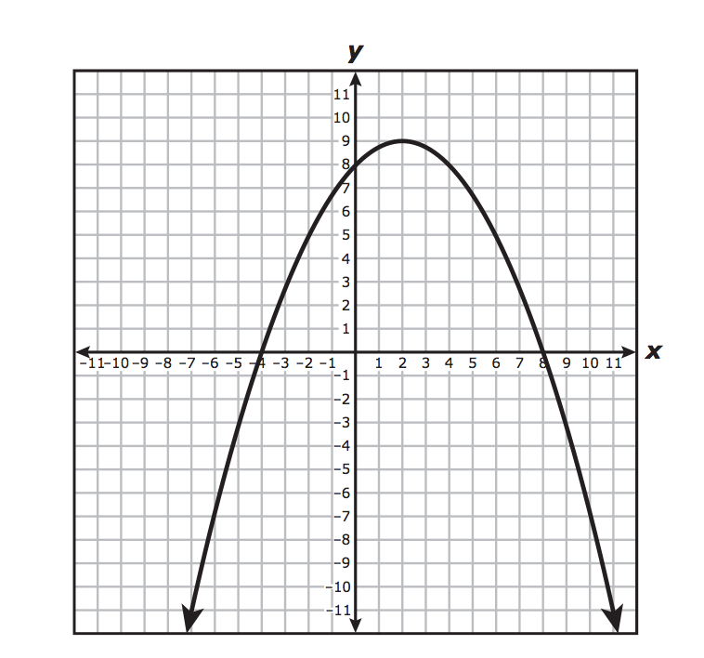


Fluency Practice [5 min]
Solve the following linear equation:
How many x-intercepts does the parabola in the graph below have?
Simplify the radical
Label a, b, and c in the parabola

Slide 3
Problem Solving Strategies
Intervene’s Problem Solving Strategies:
Step 1: Show what you know
Step 2: Solve and Check
Step 3: Eliminate and Justify

Slide 4
Lesson
Key Vocabulary
Quadratic function
X-intercepts
Solutions
Quadratic formula
Coefficient
Ways to solve quadratic functions
Quadratic formula
Completing the Square
Taking the square root
Factoring

Slide 5
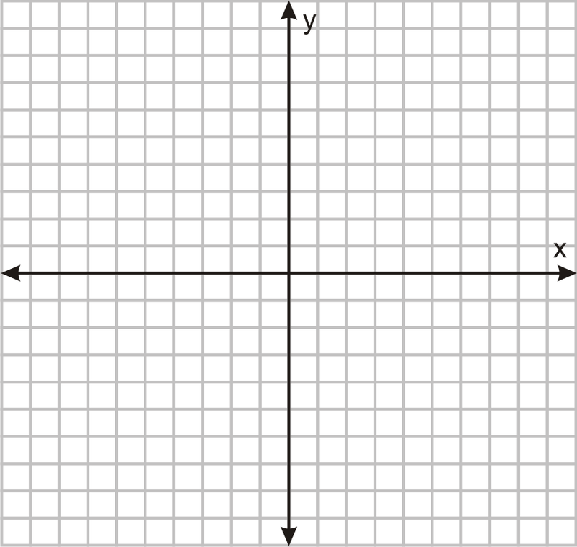

Slide 6

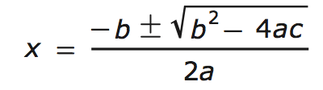

Slide 7
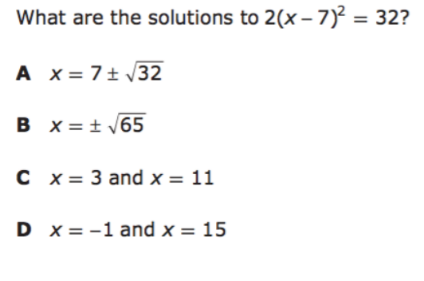
I Do [5 minutes]

Slide 8
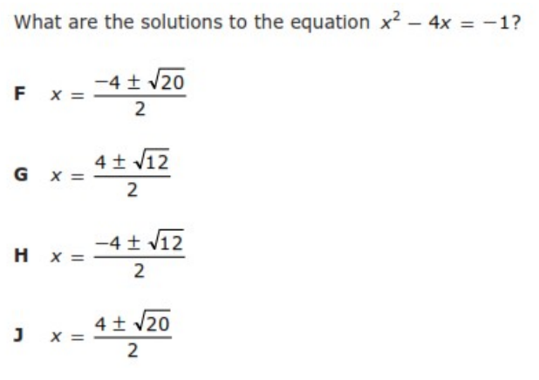
We Do – Student 1 [5 minutes]

Slide 9
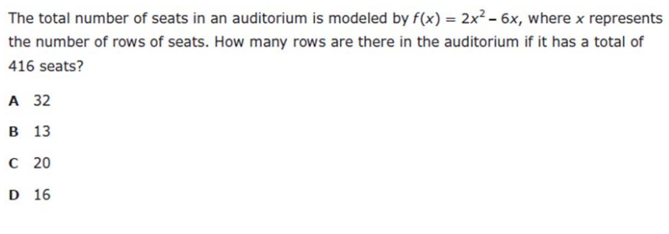
We do - Student 2 [5 minutes]

Slide 10
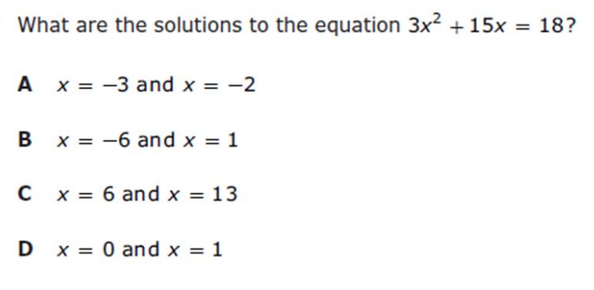
We do - Student 3 [5 minutes]

Slide 11
We Do [5 minutes]

Slide 12
Debrief [2 minutes]
Ways to solve quadratic functions
Quadratic formula
Completing the Square
Taking the square root
Factoring

Slide 13
You Do [1 minute to explain]
Instructions for Content Dev:
Nothing to do here
Instructions for Tutor:
Have students click on the Quiz tab above (on their screen)
Instruct students to take the quiz on this objective, and remind to use their problem solving strategies

