Slide 1

A.9(A)
determine the domain and range of exponential functions of the form f(x) = ab^{x} and represent the domain and range using inequalities

Slide 2
Fluency Practice
What do the following symbols mean: < < > >
Fill in the following table with the y values that correspond to the exponential equation y=2^{x}
What does domain mean? What does range mean?
x | -2 | -1 | 0 | 1 | 2
y

Slide 3
Problem Solving Strategies
Intervene’s Problem Solving Strategies:
Step 1: Show what you know
Step 2: Solve and Check
Step 3: Eliminate and Justify

Slide 4
Lesson
Key Vocabulary
Exponential function
Domain
Range
Inequality
Asymptote
Growth
Decay
All real numbers

Slide 5
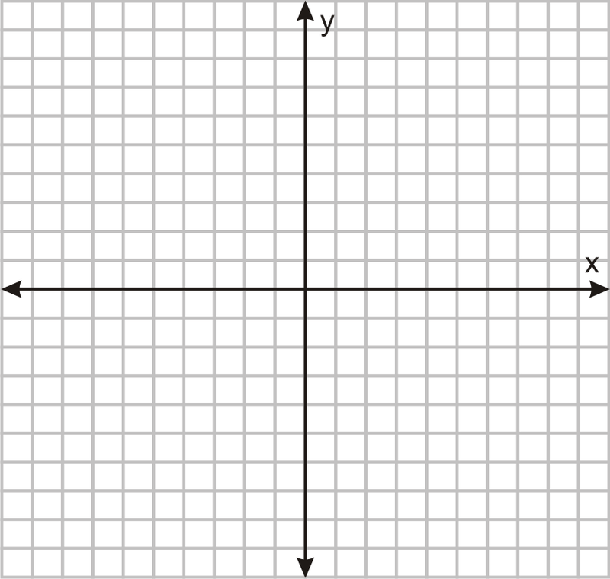

Slide 6
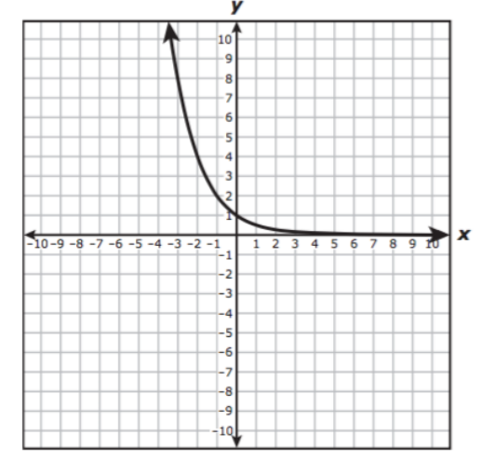
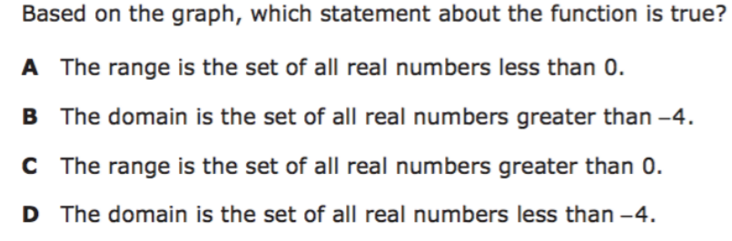
I Do

Slide 7
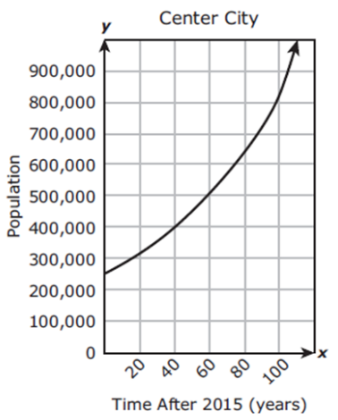
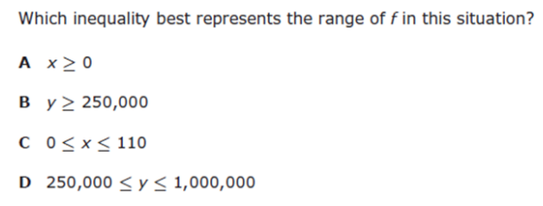
We Do

Slide 8
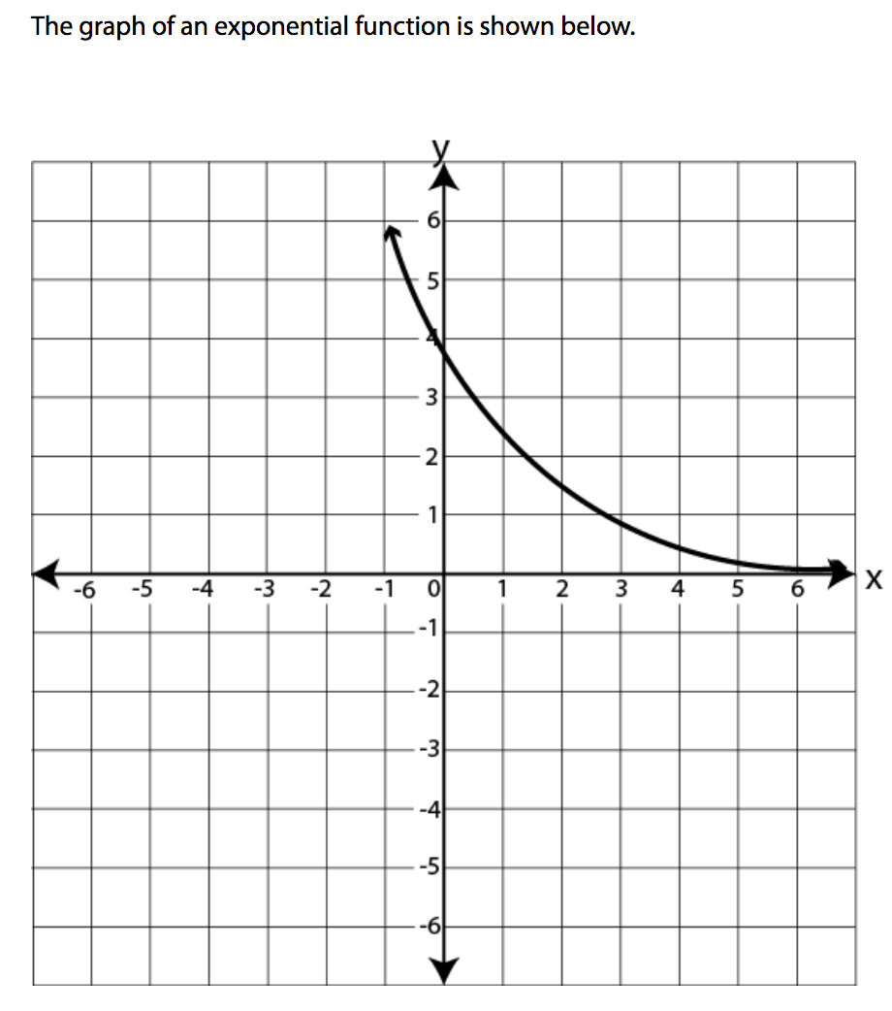
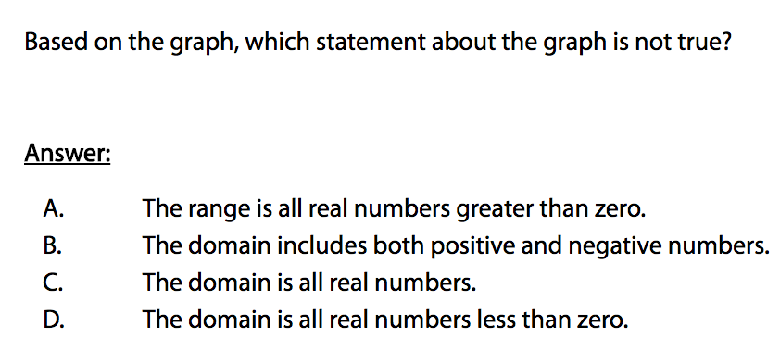
We do - Student 2

Slide 9
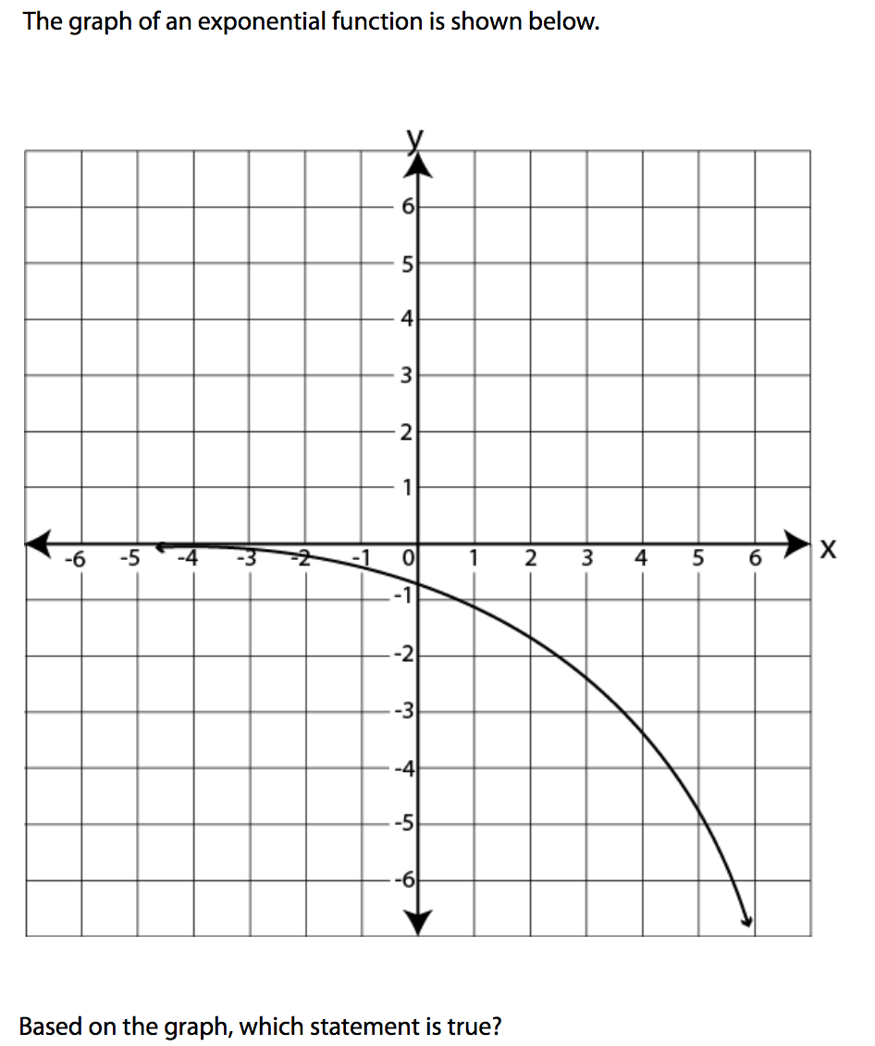
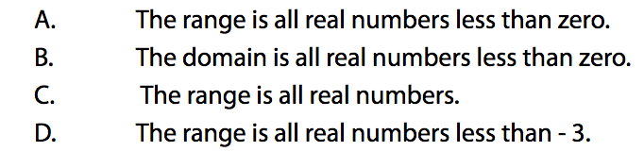
We do - Student 3

Slide 10
We Do

Slide 11
Debrief
Domain-x values
Range- y-values
**The inequalities will never be equal
because the asymptote won’t let the
y values be equal

