Slide 1

A.9(B)
interpret the meaning of the values of a and b in exponential functions of the form f(x) = ab^{x} in real-world problems

Slide 2
Fluency Practice
x | y
-4 | 1
-2 | 2
0 | 4
2 | 8
Identify the y-intercept in the table to the right?
Is the table to the right a linear function? How can you tell?
Rewrite 65% as a decimal.

Slide 3
Problem Solving Strategies
Intervene’s Problem Solving Strategies:
Step 1: Show what you know
Step 2: Solve and Check
Step 3: Eliminate and Justify

Slide 4
Lesson
Key Vocabulary
Exponential function
Growth
Decay
Asymptote
Y-intercept
y=a(b)^{x}
⬆
Y-intercept If 0<b<1—decay
If b>1—growth


Slide 5
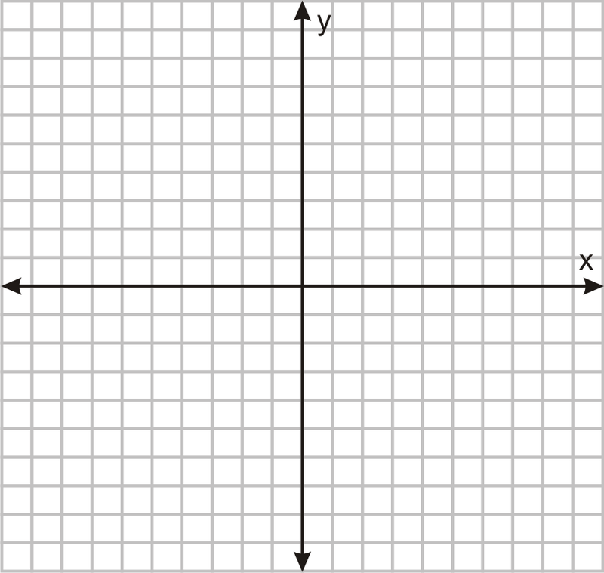

Slide 6
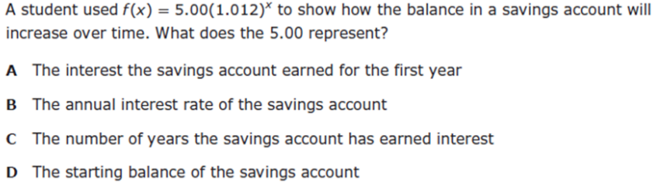
I Do

Slide 7
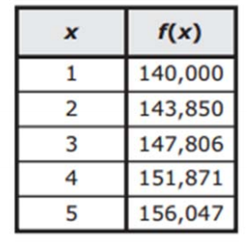
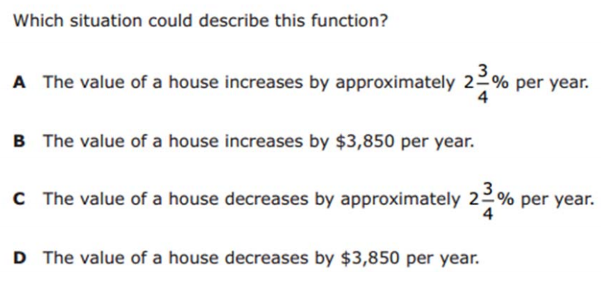
We Do – Student 1

Slide 8
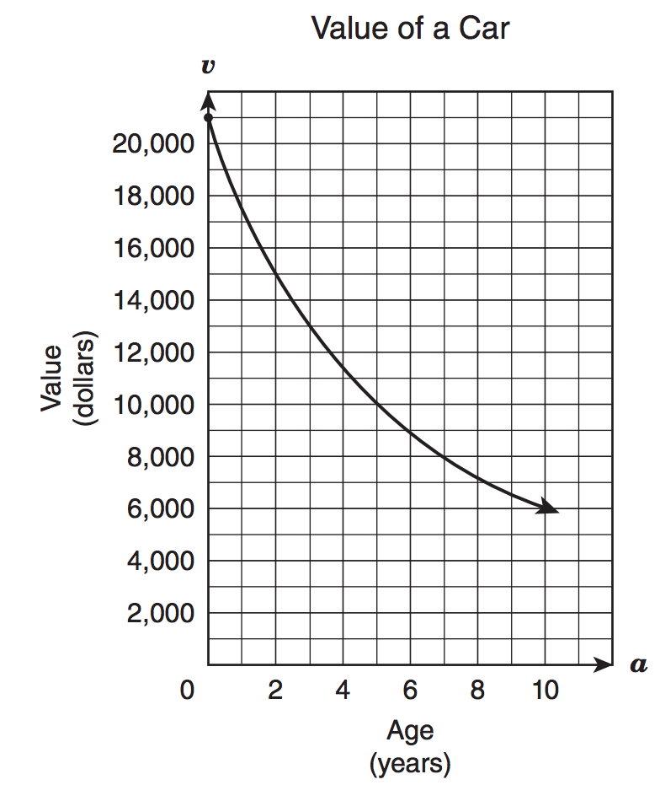
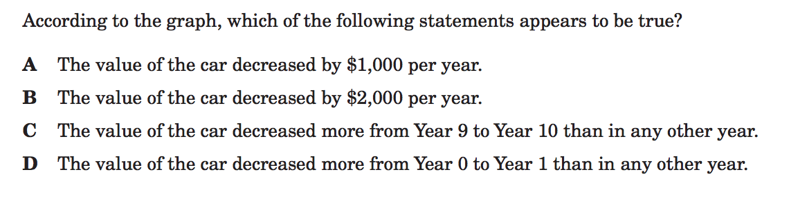
We do - Student 2

Slide 9
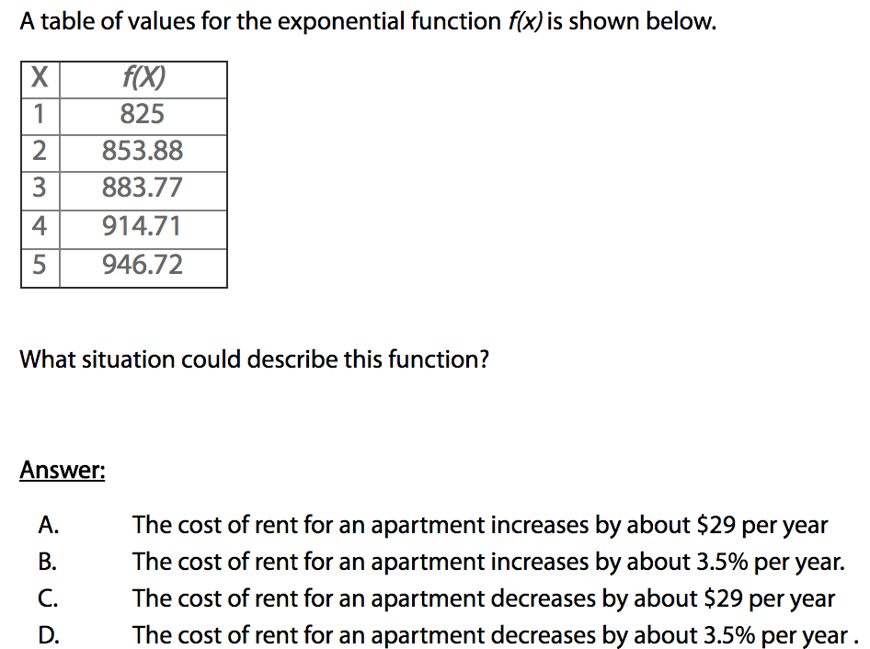
We do - Student 3

Slide 10
We Do

Slide 11
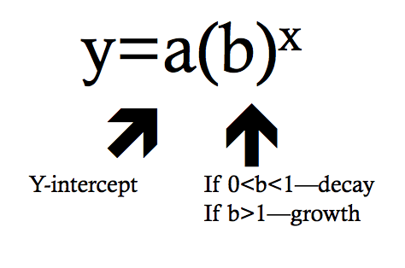
Debrief

