Slide 1

A.9(C)
write exponential functions in the form f(x) = ab^{x} (where b is a rational number) to describe problems arising from mathematical and real-world situations, including growth and decay

Slide 2
Fluency Practice [5 min]
What is the coefficient of x in the equation y=x-5
Rewrite 12% as a decimal.
Rewrite 7% as a decimal.
If x=4, what is the y-value in the equation y=-2x-3?

Slide 3
Problem Solving Strategies
Intervene’s Problem Solving Strategies:
Step 1: Show what you know
Step 2: Solve and Check
Step 3: Eliminate and Justify

Slide 4
Lesson
Key Vocabulary
Exponential function
Growth
Decay
Y-intercept
Asymptote
Coefficient
Exponent
Exponential function y=a(b)^{x}
a=y-intercept (starting point)
b>1 is growth
0<b<1 is decay

Slide 5
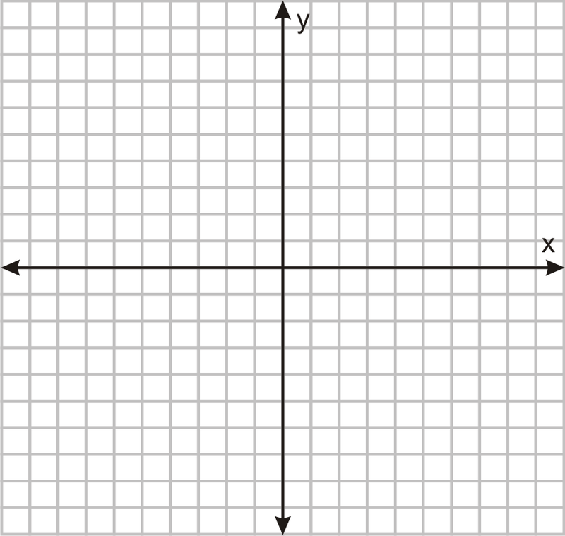

Slide 6
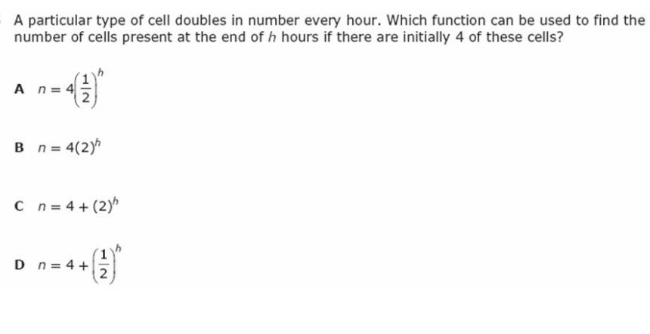
I Do [5 minutes]

Slide 7
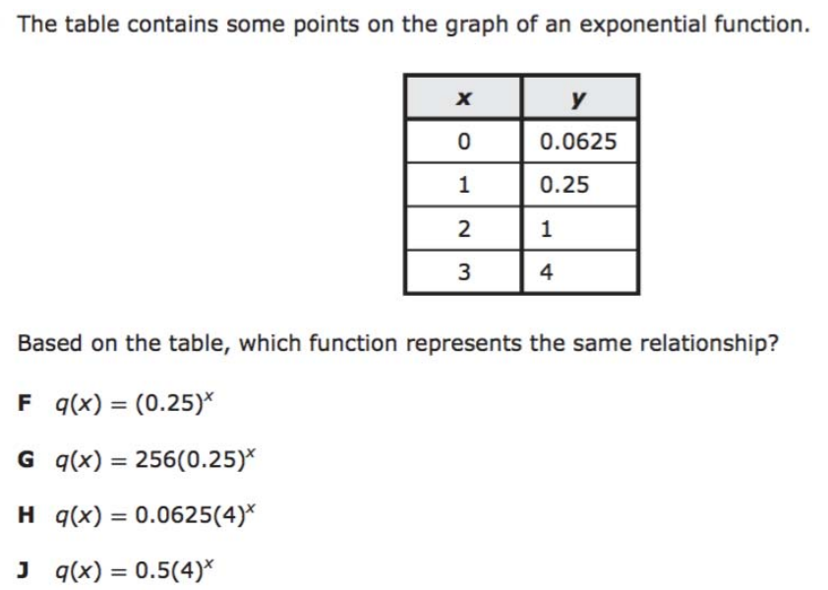
We Do – Student 1 [5 minutes]

Slide 8
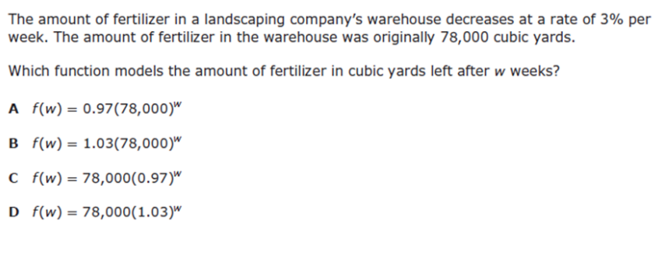
We do - Student 2 [5 minutes]

Slide 9
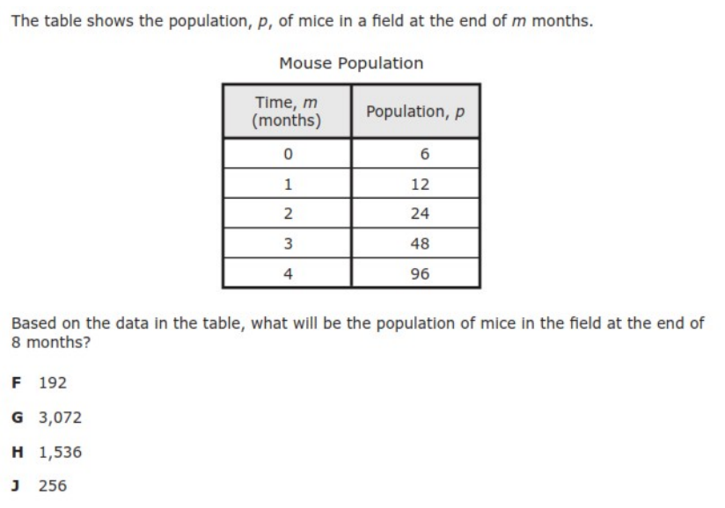
We do - Student 3 [5 minutes]

Slide 10
We Do [5 minutes]

Slide 11
Debrief [2 minutes]
Exponential function y=a(b)^{x}
a=y-intercept (starting point)
b>1 is growth
0<b<1 is decay

Slide 12
You Do [1 minute to explain]
Instructions for Content Dev:
Nothing to do here
Instructions for Tutor:
Have students click on the Quiz tab above (on their screen)
Instruct students to take the quiz on this objective, and remind to use their problem solving strategies

