Slide 1

A.9(D)
graph exponential functions that model growth and decay and identify key features, including y-intercept and asymptote, in mathematical and real-world problems

Slide 2
Fluency Practice [5 min]
Convert 74% to a decimal.
What is an exponent?
What key words help you to identify the y-intercept in a word problem?

Slide 3
Problem Solving Strategies
Intervene’s Problem Solving Strategies:
Step 1: Show what you know
Step 2: Solve and Check
Step 3: Eliminate and Justify

Slide 4
Lesson
Key Vocabulary
Exponential function
Growth
Decay
Y-intercept
Asymptote
Coefficient
Exponent
Exponential function y=a(b)^{x}
a=y-intercept (starting point)
b>1 is growth
0<b<1 is decay

Slide 5
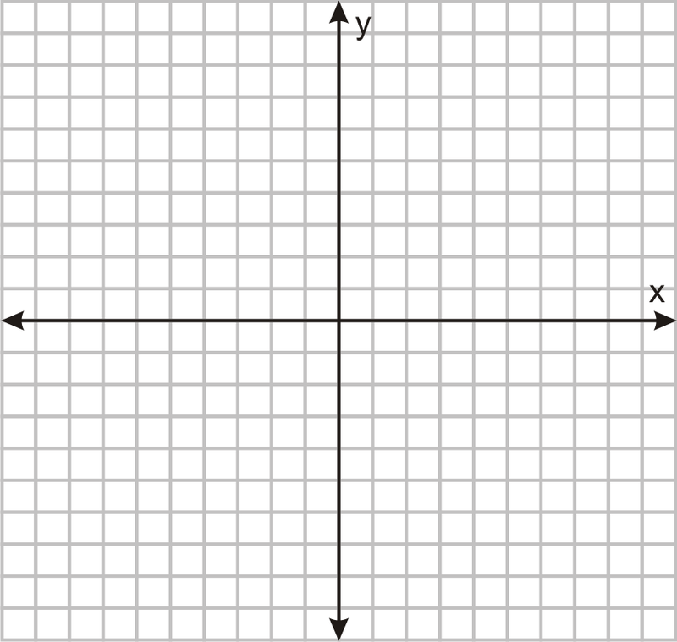

Slide 6
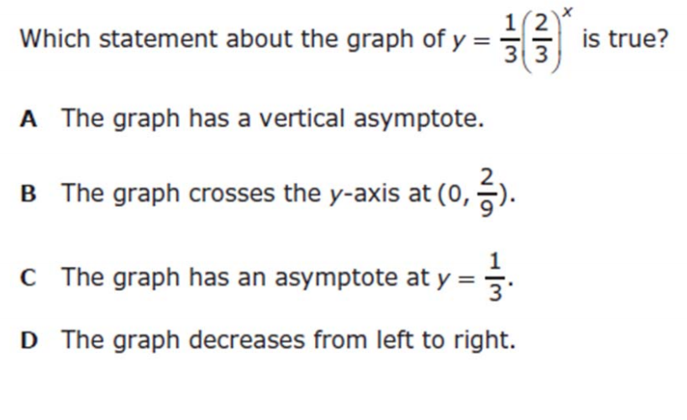
I Do [5 minutes]

Slide 7
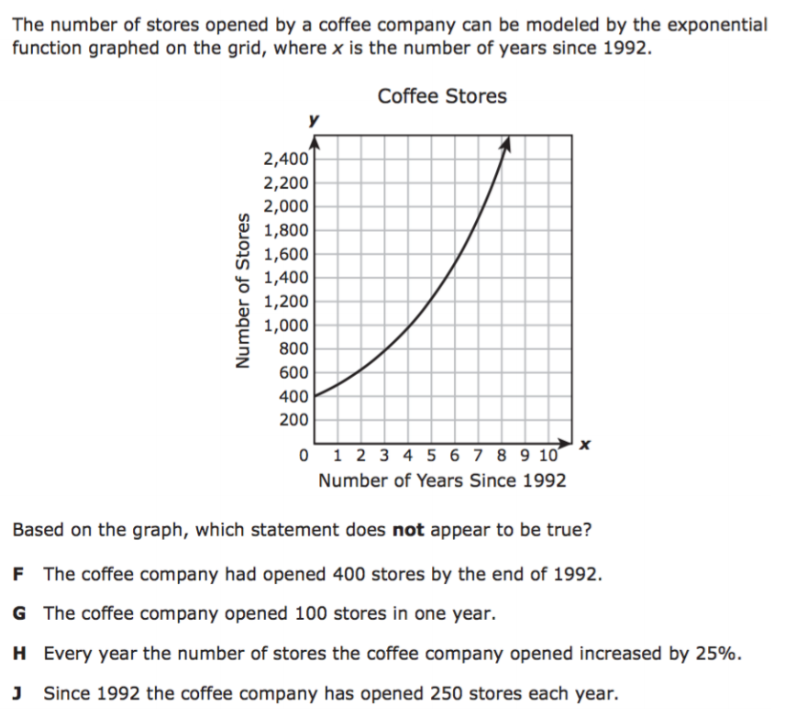
We Do – Student 1 [5 minutes]

Slide 8
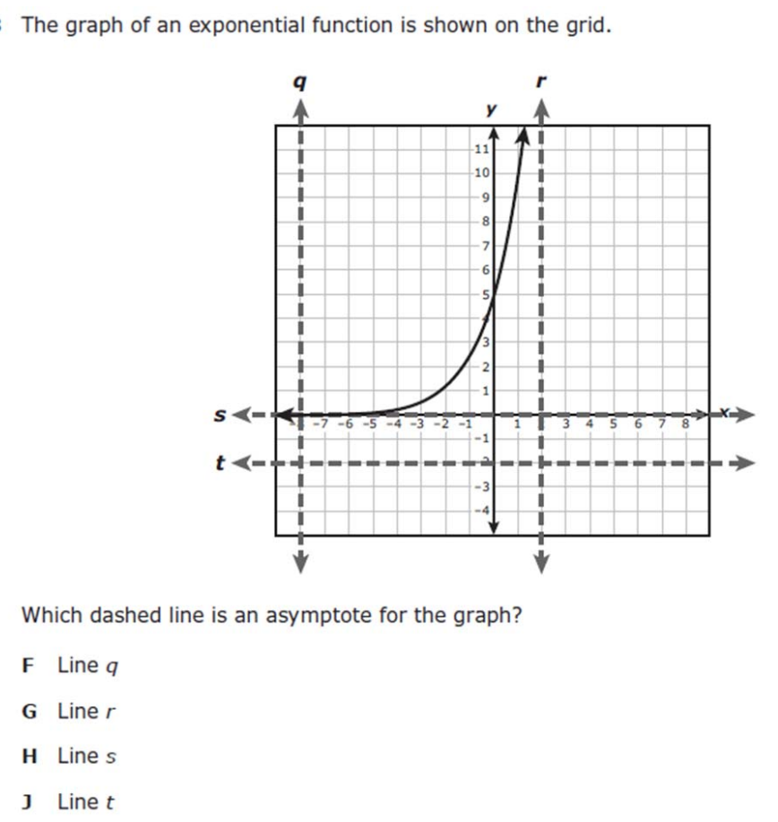
We do - Student 2 [5 minutes]

Slide 9
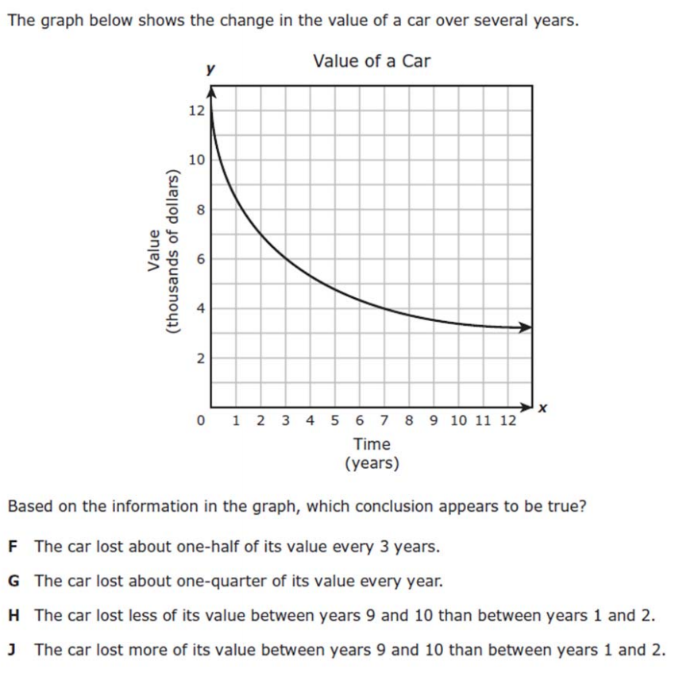
We do - Student 3 [5 minutes]

Slide 10
We Do [5 minutes]

Slide 11
Debrief [2 minutes]
Exponential function y=a(b)^{x}
a=y-intercept (starting point)
b>1 is growth
0<b<1 is decay

Slide 12
You Do [1 minute to explain]
Instructions for Content Dev:
Nothing to do here
Instructions for Tutor:
Have students click on the Quiz tab above (on their screen)
Instruct students to take the quiz on this objective, and remind to use their problem solving strategies

