Slide 1

3.3 (F)
Represent equivalent fractions with denominators of 2, 3, 4, 6, and 8 using a variety of objects and pictorial models, including number lines
<1 min

Slide 2
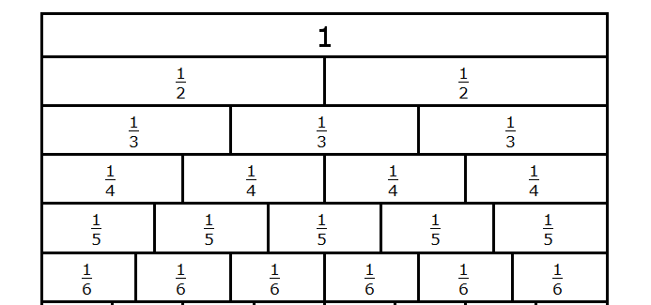
Fluency Practice
Shade in 1/2 , 2/4, and 3/6
What do you notice about the amount of shading in each?
2 min

Slide 3
Problem Solving Strategies
Step 1: Show what you know
If there’s a vocabulary word you know, write or draw something to show you know it.
Step 2: Solve and Check
Add to check your subtraction, etc
Step 3: Eliminate and Justify
Don’t just cross answers out and pick your favorite choice.
SHOW why a choice is wrong.
<3 min

Slide 4
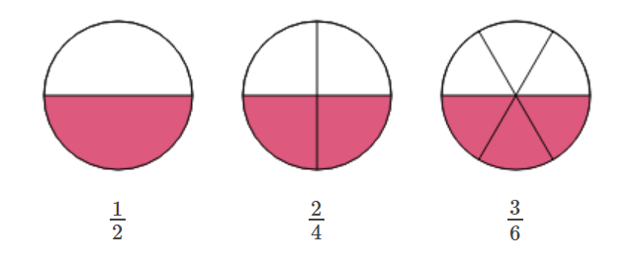
Lesson
Equivalent fractions are fractions that are equal
The following are all equivalent
1 min
This is half
This is also half because 2 is half of 4
This is also half because 3 is half of 6

Slide 5
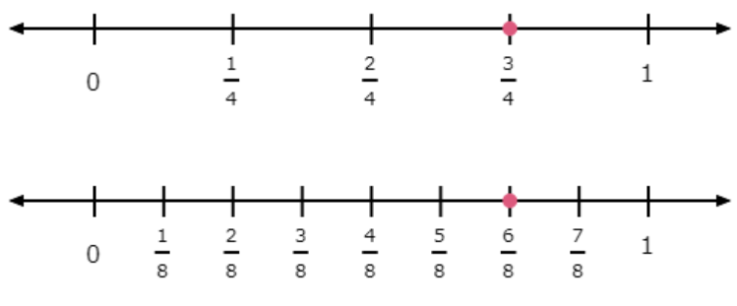
Example 2
You can also use number lines to find equivalent fractions:
3/4 and 6/8 are both the same distance from 0 on the number line. They are equivalent fractions

Slide 6
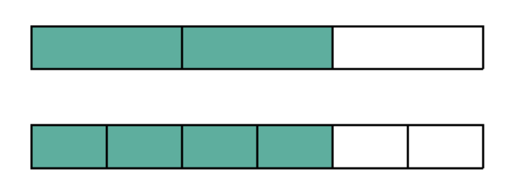
Hint
Look for figure/number lines where the shading is equivalent or where the point is in a similar spot
Example:
2/3
4/6

Slide 7
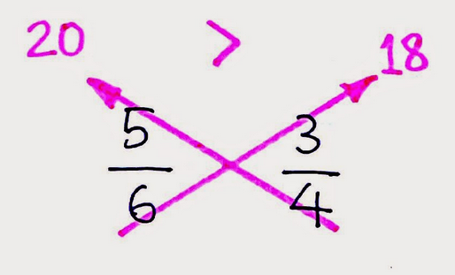
Here’s a trick Cross multiply to see which fraction is bigger
Use it to CHECK your work!
5 x 4 =
6 x 3 =

Slide 8
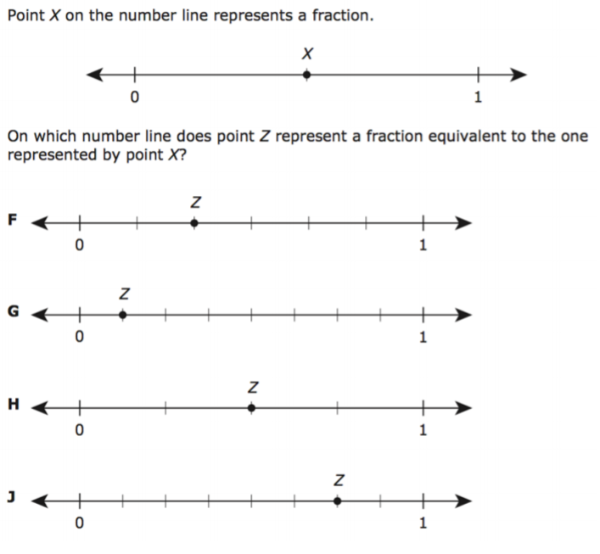
I Do
Make sure you are lining up the 0 and the 1 on the number lines. This example does not have them lined up, so you can’t just compare points
<5 min
Notes:
h

Slide 9
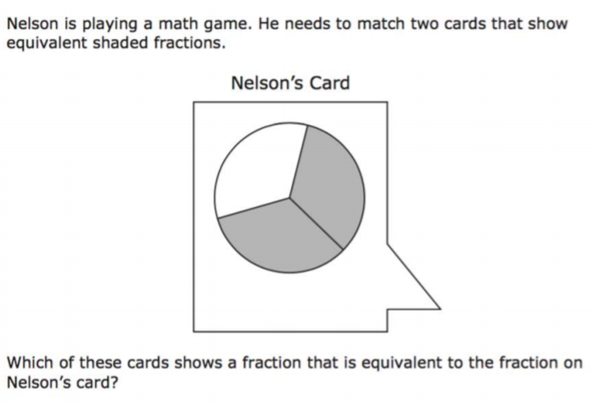
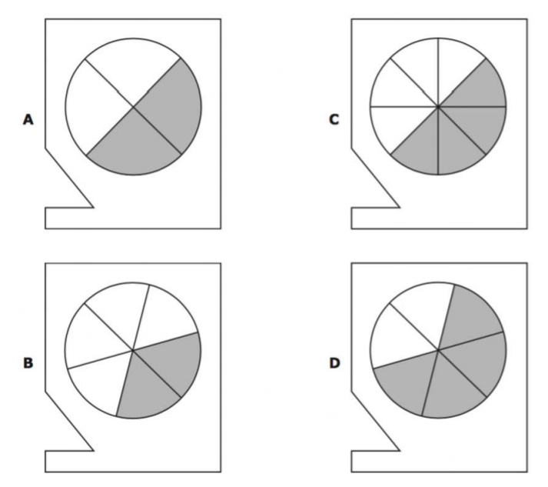
We do - Question 1
<5 min
Notes:
d

Slide 10
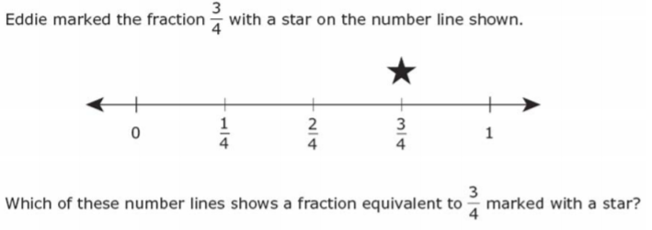
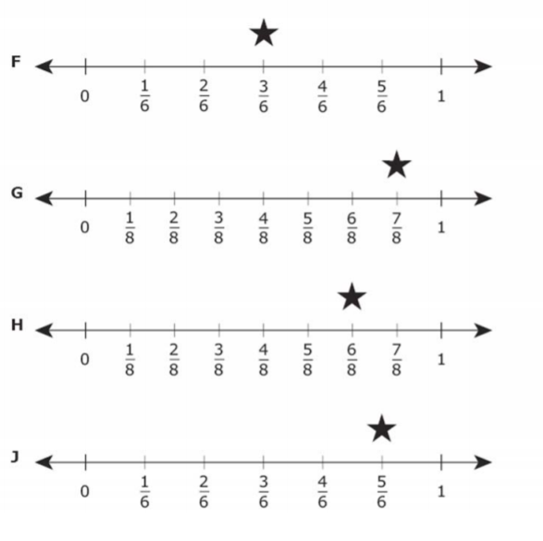
We Do – Question 2
<5 min
Notes:
h

Slide 11
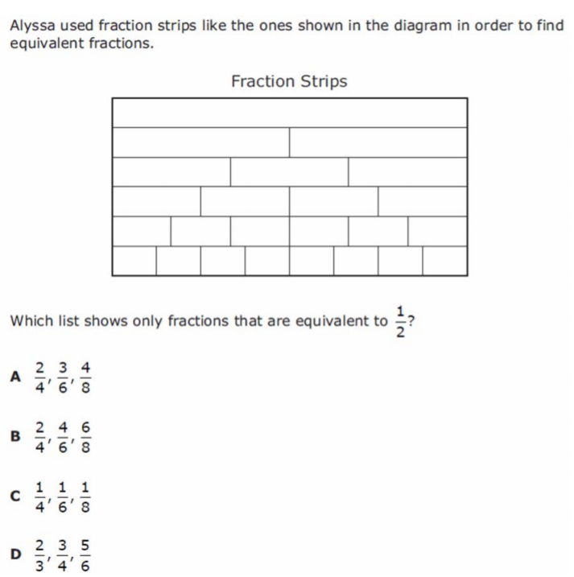
We do - Question 3
<5 min

Slide 12
Debrief
Equivalent fractions are fractions that are equal to the same value.
Fractions can be modeled with number lines and other diagrams in order to find equivalent fractions
1 min

Slide 13
You Do
Go back to Intervene to take your quiz!

