Slide 1

3.4(A)
solve with fluency one-step and two-step problems involving
addition and subtraction within 1,000 using strategies based on
place value, properties of operations, and the relationship
between addition and subtraction
<1 min

Slide 2
Fluency Lesson (if necessary)
Subtraction Regrouping
Hundreds
Tens
Ones
135
- 82
3 min

Slide 3
Fluency Practice
Subtracting across Zeros
Hundreds
Tens
Ones
100
- 82
3 min

Slide 4
Fluency Lesson (if necessary)
“Carrying Over” when adding
Hundreds
Tens
Ones
135
+ 82
3 min

Slide 5
Problem Solving Strategies
Step 1: Show what you know
If there’s a vocabulary word you know, write or draw something to show you know it.
Step 2: Solve and Check
Add to check your subtraction, etc
Step 3: Eliminate and Justify
Don’t just cross answers out and pick your favorite choice.
SHOW why a choice is wrong.
<3 min

Slide 6
Problem Solving Lesson
if you find an issue with fluency, go straight to the fluency sections of lesson
Ask 2 questions to know which operation to choose:
Am I looking for a bigger number?
Are there groups?
 | Getting Bigger (in all, total, combined) | Getting Smaller (how many more, difference)
Groups (each, an, every, per) | Multiply (x) | Divide ( / )
No Groups | Add (+) | Subtract ( - )
2 min

Slide 7
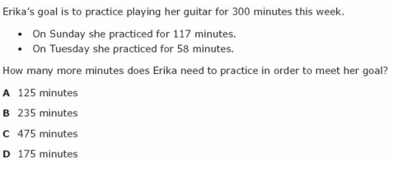
I Do
5 min

Slide 8
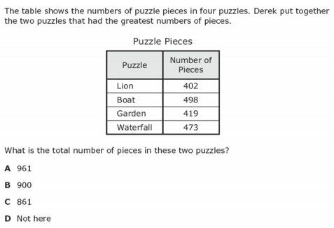
We Do – Student 1
5 min

Slide 9
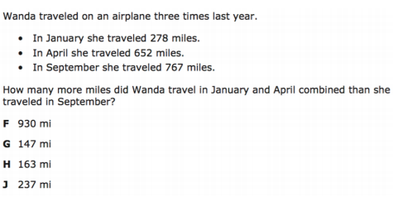
We do - Student 2
5 min

Slide 10

We do - Student 3
5 min

Slide 11
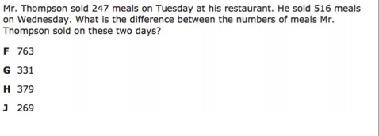
We do – Student 4
5 min

Slide 12
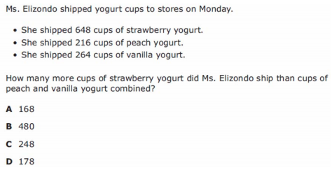
We Do – Student 5
5 min

Slide 13
Debrief
Strip Diagrams help you visualize (See) word problems better. They are organized in boxes or groups and can add onto each other
Equations have equal signs and help you take a word problem that is written in any language and turn it into math language
In order to be successful in word problems, you need to know what words in English translate to in MATH:
Subtract: You’re comparing two numbers. How many more ____ than blank
sum means to add
2 min

Slide 14
You Do
Click Here to Take Your Quiz!

Slide 15
EXTRA SLIDES FOLLOW
In case you need them

Slide 16
Problem Solving Lesson
John has 16 boxes. He puts 24 bars of soap in each box. How many bars of soap does he have altogether?
When to multiply in word problems
Groups AND The number we’re looking for is bigger.
Groups: Each, an, every, per
Bigger: In all, total, combined, sum
When to divide in word problems
No Groups AND The number we’re looking for is smaller
Groups: Each, an, every, per
Smaller:The difference, how much more, compare, what’s left?
YES Grouping involved
We’re looking for a bigger number
MULTIPLY
John has 162 bars of soap. He puts an equal number of bars of soap into each of 9 boxes. How many bars of soap will be in each box? (asking for just one box)
YES Grouping involved
We’re looking for a smaller number
DIVIDE
5 min

Slide 17
Problem Solving Lesson
John rode his bike 3,452 feet on Monday and 5,439 feet on Tuesday. How many feet did John ride his bike on Monday and Tuesday?
When to add in word problems
No Groups AND The number we’re looking for is bigger.
In all, total, combined, sum
When to subtract in word problems
No Groups AND The number we’re looking for is smaller
The difference, how much more, compare, what’s left?
No Grouping involved
We’re looking for a bigger number
ADD
John rode his bike 3,452 feet on Monday and 5,439 feet on Tuesday. How many more feet did John ride his bike on Tuesday than Monday?
No Grouping involved
We’re looking for a smaller number
SUBTRACT
5 min

Slide 18
Fluency Lesson (if necessary)
2x1 digit multiplication
35
x 8
42
x 6
3 min

Slide 19
Fluency Lesson (if necessary)
2x2 digit multiplication
35
x 11
35
x 18
3 min

Slide 20


Fluency Lesson (if necessary)
Long Division
3 min

