Slide 1

4.2(B)
Represent the value of the digit in whole numbers through 1,000,000,000 and decimals to the hundredths using expanded notation and numerals

Slide 2
Fluency Practice
Name the place for each of the underlined digits:
1,234,562.34
What is the value of those digits?
What’s the difference between the place of a digit and its value?

Slide 3
Problem Solving Strategies
Intervene’s Problem Solving Strategies:
Step 1: Show what you know
Step 2: Solve and Check
Step 3: Eliminate and Justify

Slide 4
Lesson [2- 5 minutes]
Key Vocabulary
Place
Value
Expanded form, standard form, word form
Decimal

Slide 5
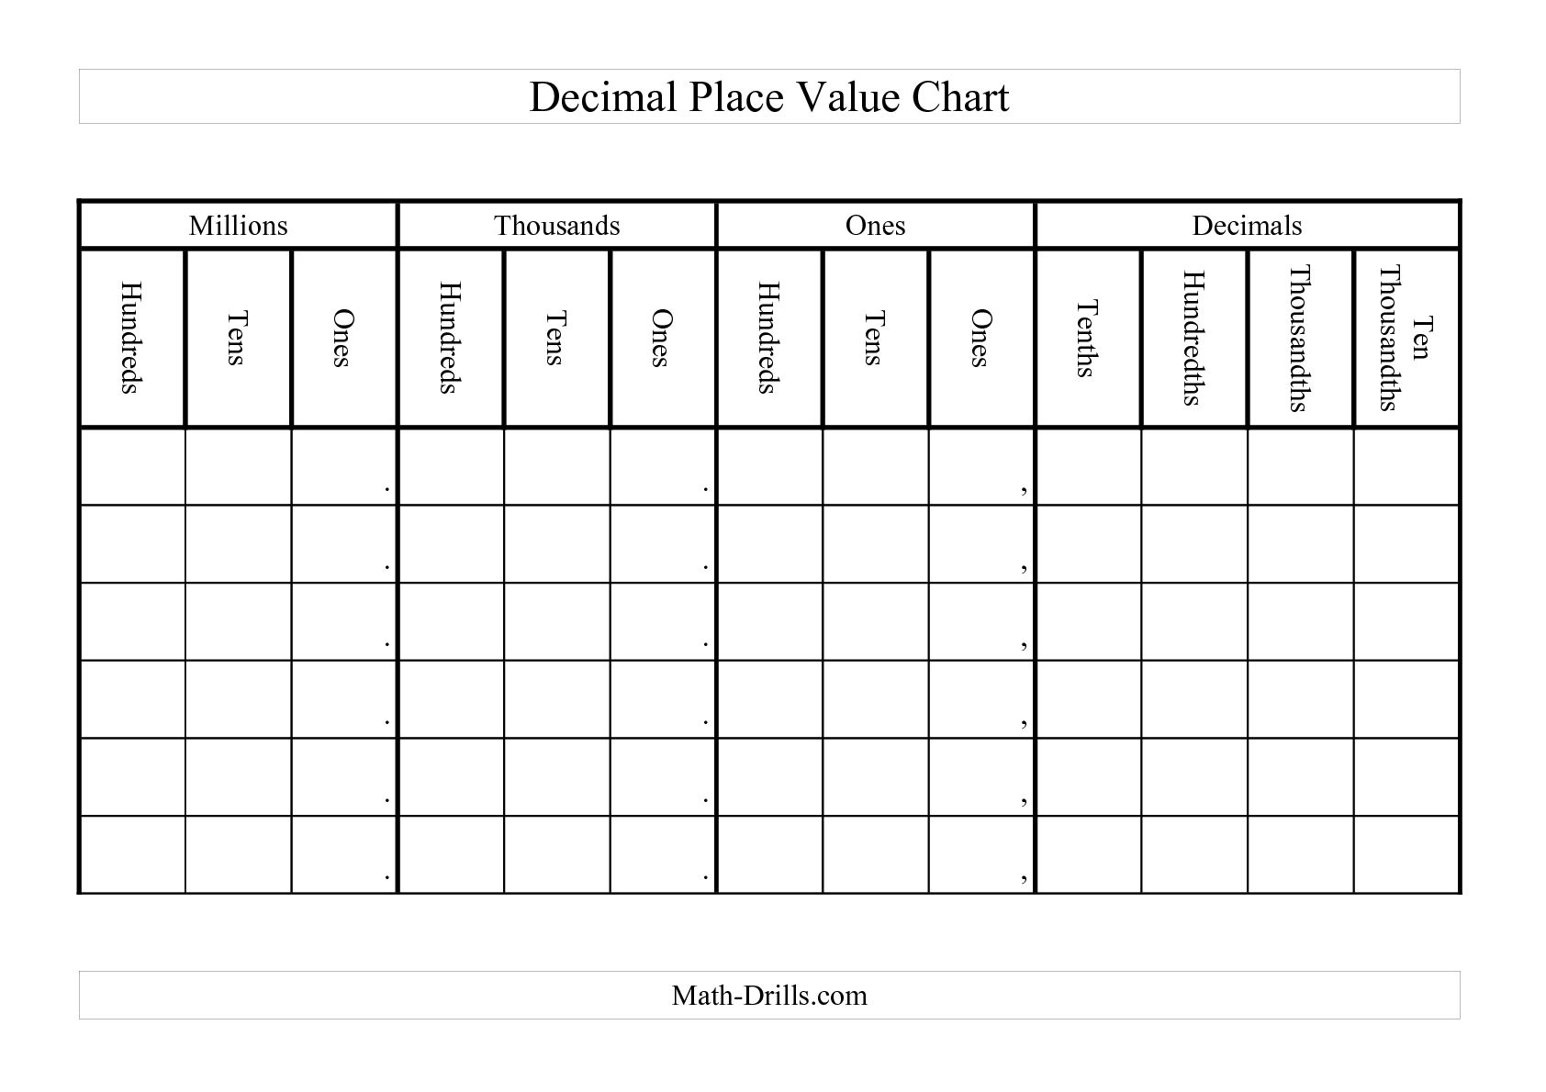

Slide 6
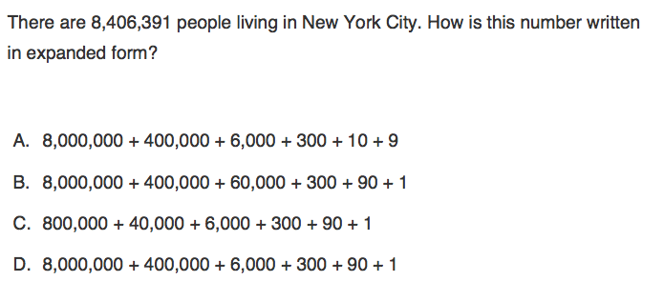
I Do

Slide 7
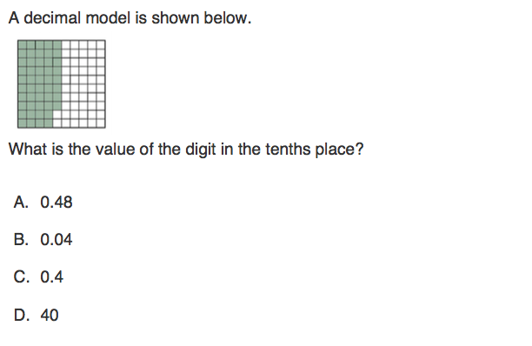
We Do – Student 1

Slide 8
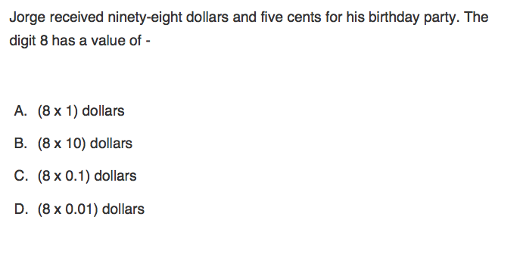
We do - Student 2

Slide 9
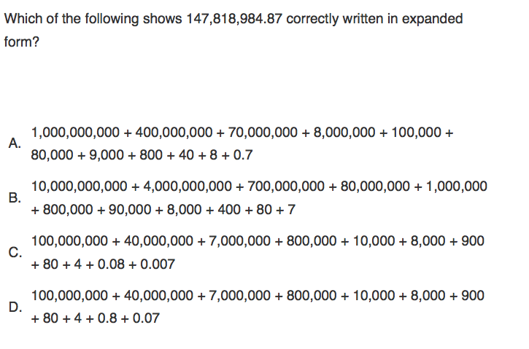
We do - Student 3

Slide 10
Debrief

Slide 11
You Do

