Slide 1

4.2(G)
Relate decimals to fractions that name tenths and hundredths
Intro: 2 minutes
Explain the TEKS

Slide 2


Fluency Practice [5-10 min]
1. How much of the figure is shaded?
How can we say this-
As a fraction?
As a decimal?
2. What is 12 $\frac{6}{10}$written as a decimal?
3. What decimal is equivalent to 9$\frac{12}{100}$?

Slide 3
Problem Solving Strategies [explain in 2 minutes]
Intervene’s Problem Solving Strategies:
Step 1: Show what you know
Step 2: Solve and Check
Step 3: Eliminate and Justify

Slide 4
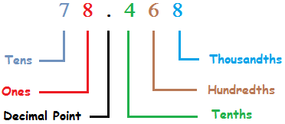

Lesson [2- 5 minutes]
Ones, tens, hundreds places
Decimals
Fractions
Equivalent $\frac{7}{10}$=.7 $\frac{7}{100}$=.07
Mixed number 14$\frac{2}{100}$=14. 02
Numerator
Denominator

Slide 5
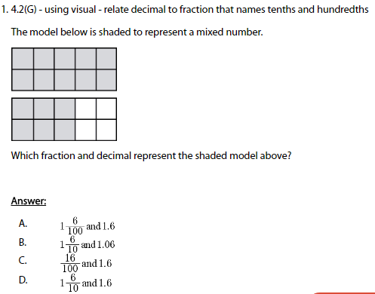
I Do [5 minutes]

Slide 6
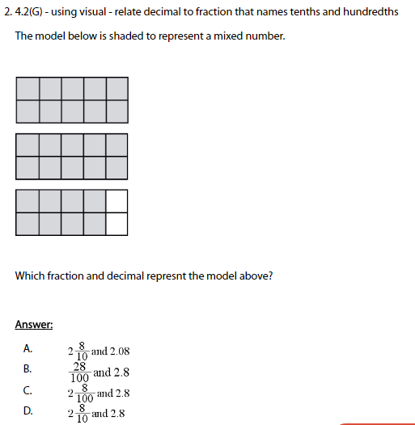
We Do – Student 1 [5 minutes]

Slide 7
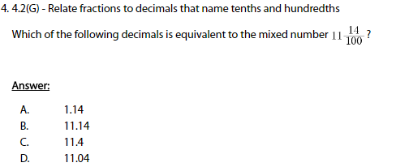
We do - Student 2 [5 minutes]

Slide 8
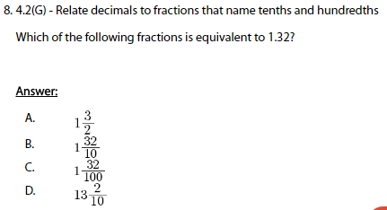
We do - Student 3 [5 minutes]

Slide 9
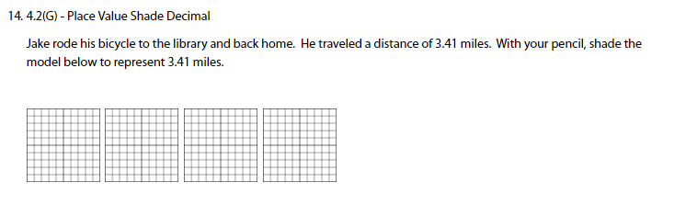
We do - Student 4 [5 minutes]

Slide 10
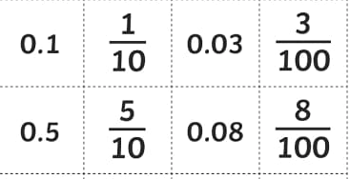

Debrief [2 minutes]
Tenths and hundredths places
Mixed number equivalents
13.08=
14$\frac{7}{10}$=

Slide 11
You Do [1 minute to explain]
Instructions for Content Dev:
Nothing to do here
Instructions for Tutor:
Have students click on the Quiz tab above (on their screen)
Instruct students to take the quiz on this objective, and remind to use their problem solving strategies

