Slide 1

4.3(D)
compare two fractions with different numerators and
different denominators and represent the comparison
using the symbols >, =, or <
<1 min

Slide 2
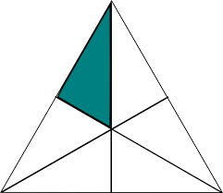

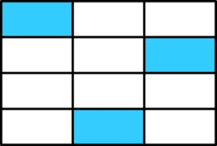
Fluency Practice
Identify the shaded fractions in the models below:
1.
2.
3.
2 min

Slide 3
Problem Solving Strategies
Intervene’s Problem Solving Strategies:
Step 1: Show what you know
Step 2: Solve and Check
Step 3: Eliminate and Justify
<2 min

Slide 4

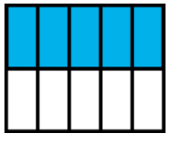
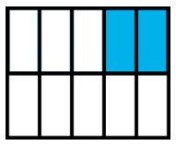
Lesson
Numerator – number of taken (usually shaded) pieces in the whole
Denominator – number of equal parts in 1 whole
Compare
Greater than >
Less than <
2 min

Slide 5
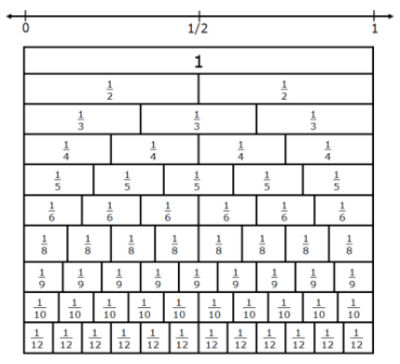
If comparing the same size whole, when the denominators gets bigger, the piece gets smaller, because “you’re sharing the whole with more people”
Do you notice that 1/2 is actually shaded more than 1/4?
1/2
1/4
Do you see patterns in the denominator and size of each unit fraction?
1/10
3 min

Slide 6
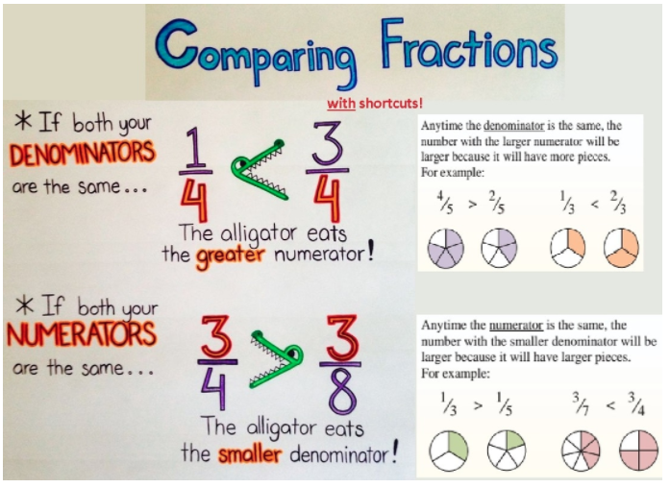
3 min
4 min

Slide 7

Ways to Compare
<
Draw the fractions – make sure the wholes are the same size.
Estimate relative to half. If 4/8 is
half, then six eighths
is greater than half.
If 3/6 is half,
then 1/6 is less than half
Chunky X’s to check your work (it’s a shortcut to compare fractions)
8
36
4 min

Slide 8
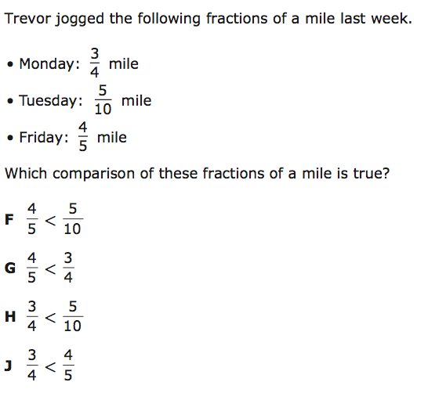
I Do
5 min

Slide 9
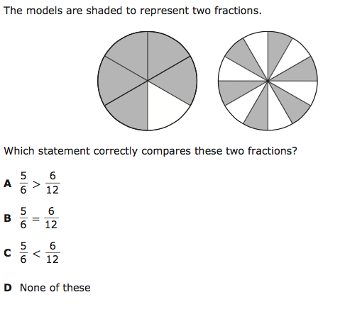
We Do – Student 1
5 min

Slide 10
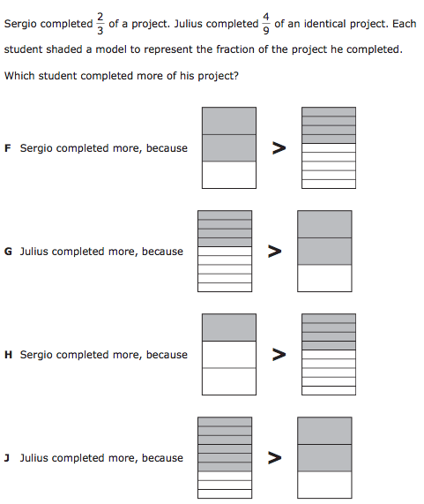
We do - Student 2
5 min

Slide 11
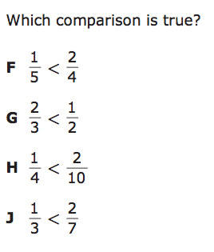
We do - Student 3
5 min

Slide 12
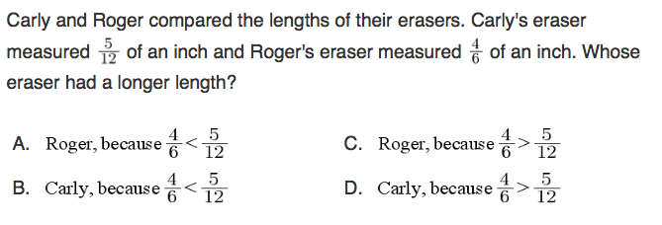
We do – Student 4
5 min

Slide 13
We do – Student 5
5 min

Slide 14
Debrief
Numerator – number of taken (usually shaded) pieces in the whole
Denominator – number of equal parts in 1 whole
Compare
Greater than >
Less than <
1 min

Slide 15
You Do
Click Here to Take Your Quiz!

