Slide 1

4.3(E)
represent and solve addition and subtraction of fractions
with equal denominators using objects and pictorial
models that build to the number line and properties of
operations
<1 min

Slide 2
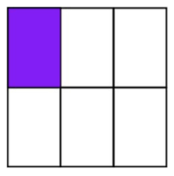


Fluency Practice
Add or Subtract the Fractions for #1 and #2
What is the shaded fraction for #3?
1.
2.
3.
2 min

Slide 3
Problem Solving Strategies
Intervene’s Problem Solving Strategies:
Step 1: Show what you know
Step 2: Solve and Check
Step 3: Eliminate and Justify
<2 min

Slide 4
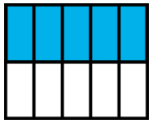
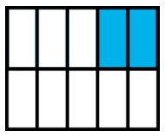
Lesson
Rob ate 5/10 of a sandwich and John ate 2/10 of a sandwich. How much did they eat in all?
Numerator – number of taken (usually shaded) pieces in the whole
Denominator – number of equal parts in 1 whole
When to add fractions
In all, total, combined, sum
When to subtract fractions
The difference, how much more, compare, what’s left?
+
Rob ate 5/10 of a sandwich and John ate 2/10 of a sandwich. How much more did Rob eat than John?
-
5 min

Slide 5
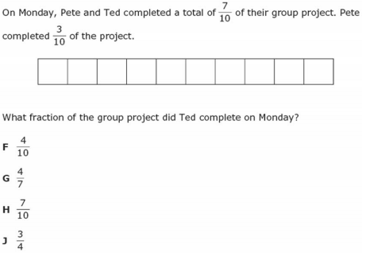
I Do
5 min

Slide 6
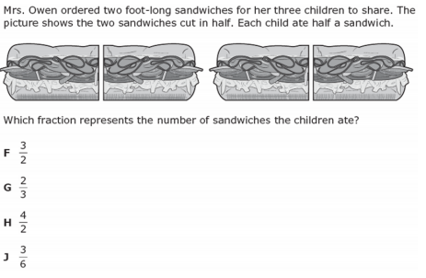
We Do – Student 1
5 min

Slide 7
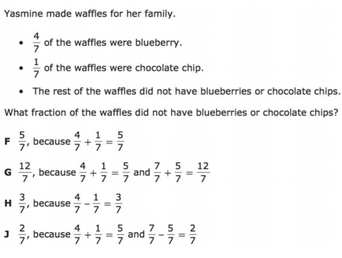
We do - Student 2
5 min

Slide 8
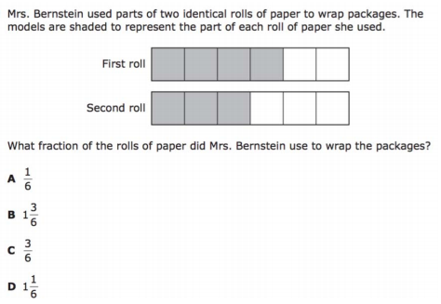
We do - Student 3
5 min

Slide 9
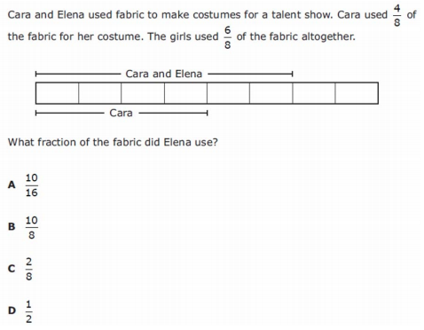
5 min

Slide 10
We do – Student 5
5 min

Slide 11
Debrief
Rob ate 5/10 of a sandwich and John ate 2/10 of a sandwich. How much did they eat in all?
Numerator – number of taken (usually shaded) pieces in the whole
Denominator – number of equal parts in 1 whole
When to add fractions
In all, total, combined, sum
When to subtract fractions
The difference, how much more, compare, what’s left?
+
Rob ate 5/10 of a sandwich and John ate 2/10 of a sandwich. How much more did Rob eat than John?
-
5 min

Slide 12
You Do
Click Here to Take Your Quiz!

