Slide 1

4.4(A)
add and subtract whole numbers and decimals to the
hundredths place using the standard algorithm
<1 min

Slide 2
Fluency Practice
Add or Subtract Whole Numbers for #1 and #2
Subtract Decimals for #3
1.
2.
3.
3,000
- 485
3,385
+ 185
3.04
- 0.72
2 min

Slide 3
Problem Solving Strategies
Intervene’s Problem Solving Strategies:
Step 1: Show what you know
Step 2: Solve and Check
Step 3: Eliminate and Justify
<2 min

Slide 4
Problem Solving Lesson
if you find an issue with fluency, go straight to the fluency sections of lesson
Ask 2 questions to know which operation to choose:
Am I looking for a bigger number?
Are there groups?
 | Getting Bigger (in all, total, combined) | Getting Smaller (how many more, difference)
Groups (each, an, every, per) | Multiply (x) | Divide ( / )
No Groups | Add (+) | Subtract ( - )
2 min

Slide 5
Problem Solving Lesson
John rode his bike 3,452 feet on Monday and 5,439 feet on Tuesday. How many feet did John ride his bike on Monday and Tuesday?
When to add in word problems
No Groups AND The number we’re looking for is bigger.
In all, total, combined, sum
When to subtract in word problems
No Groups AND The number we’re looking for is smaller
The difference, how much more, compare, what’s left?
No Grouping involved
We’re looking for a bigger number
ADD
John rode his bike 3,452 feet on Monday and 5,439 feet on Tuesday. How many more feet did John ride his bike on Tuesday than Monday?
No Grouping involved
We’re looking for a smaller number
SUBTRACT
5 min

Slide 6
Examples
John rode his bike 3,452 feet on Monday and 5,439 feet on Tuesday. How many feet did John ride his bike on Monday and Tuesday?
No Grouping involved
We’re looking for a bigger number
ADD
John rode his bike 3,452 feet on Monday and 5,439 feet on Tuesday. How many more feet did John ride his bike on Tuesday than Monday?
No Grouping involved
We’re looking for a smaller number
SUBTRACT

Slide 7
Fluency Lesson (if necessary)
When adding or subtracting, always line up by the place values!
Ones
Tenths
Hundredths
1.35 – 0.6
3 min

Slide 8
Fluency Lesson (if necessary)
“Carrying Over” when adding
Hundreds
Tens
Ones
135
+ 82
3 min

Slide 9
Fluency Lesson (if necessary)
Subtracting across Zeros
Hundreds
Tens
Ones
100
- 82
3 min

Slide 10
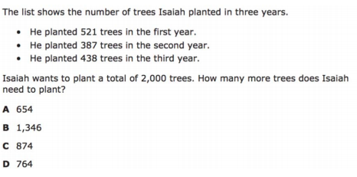
I Do
5 min

Slide 11
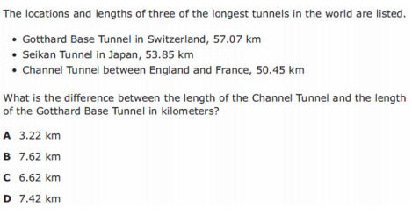
We Do – Student 1
if you find an issue with fluency, move quickly to the fluency parts of the problems
5 min

Slide 12
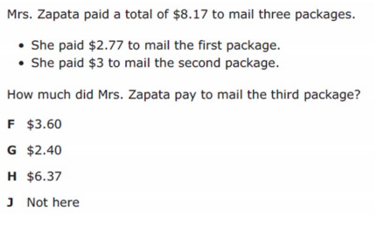
We do - Student 2
5 min

Slide 13
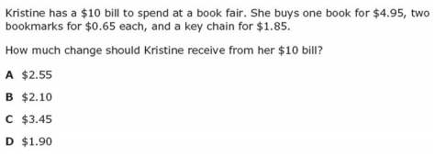
We do - Student 3
5 min

Slide 14
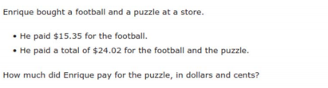
We do – Student 4
5 min

Slide 15
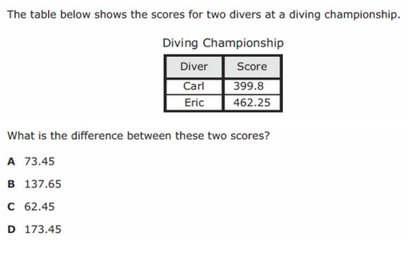
We do – Student 5
5 min

Slide 16
Debrief
Ask 2 questions to know which operation to choose:
Am I looking for a bigger number?
Are there groups?
 | Getting Bigger (in all, total, combined) | Getting Smaller (how many more, difference)
Groups (each, an, every, per) | Multiply (x) | Divide ( / )
No Groups | Add (+) | Subtract ( - )
2 min

Slide 17
You Do
Click Here to Take Your Quiz!

