Slide 1

4.4(H)
solve with fluency one- and two-step problems involving
multiplication and division, including interpreting
remainders
<1 min

Slide 2


Fluency Practice
Multiply on Number 1
Divide on Numbers 2 and 3
1.
2.
3.
28
x 34
2 min

Slide 3
Problem Solving Strategies
Intervene’s Problem Solving Strategies:
Step 1: Show what you know
Step 2: Solve and Check
Step 3: Eliminate and Justify
<2 min

Slide 4
Problem Solving Lesson
if you find an issue with fluency, go straight to the fluency sections of lesson
Ask 2 questions to know which operation to choose:
Am I looking for a bigger number?
Are there groups?
 | Getting Bigger (in all, total, combined) | Getting Smaller (how many more, difference)
Groups (each, an, every, per) | Multiply (x) | Divide ( / )
No Groups | Add (+) | Subtract ( - )
2 min

Slide 5
Problem Solving Lesson
John has 16 boxes. He puts 24 bars of soap in each box. How many bars of soap does he have altogether?
When to multiply in word problems
Groups AND The number we’re looking for is bigger.
Groups: Each, an, every, per
Bigger: In all, total, combined, sum
When to divide in word problems
No Groups AND The number we’re looking for is smaller
Groups: Each, an, every, per
Smaller:The difference, how much more, compare, what’s left?
YES Grouping involved
We’re looking for a bigger number
MULTIPLY
John has 162 bars of soap. He puts an equal number of bars of soap into each of 9 boxes. How many bars of soap will be in each box? (asking for just one box)
YES Grouping involved
We’re looking for a smaller number
DIVIDE
5 min

Slide 6
Fluency Lesson (if necessary)
2x1 digit multiplication
35
x 8
42
x 6
3 min

Slide 7
Fluency Lesson (if necessary)
2x2 digit multiplication
35
x 11
35
x 18
3 min

Slide 8


Fluency Lesson (if necessary)
Long Division
3 min

Slide 9
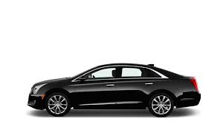

What is a Remainder?
Let’s say there are 5 students going on a field trip. Only 2 students can fit in each car. How many cars would you need?
If there were only 2 cars available, one student would remain (or be left over). You’d have to get a 3rd car to fit everyone, even though it won’t be full!

Slide 10
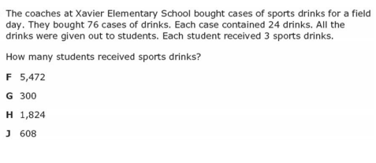
I Do
5 min

Slide 11
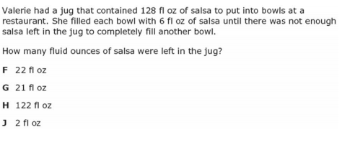
We Do – Student 1
if you find an issue with fluency, go straight to the fluency parts of the problems for all
5 min

Slide 12
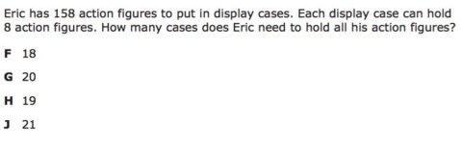
We do - Student 2
5 min

Slide 13
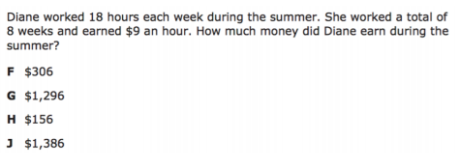
We do - Student 3
5 min

Slide 14
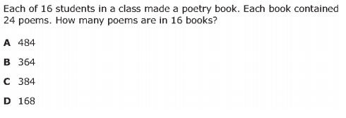
We do – Student 4
5 min

Slide 15
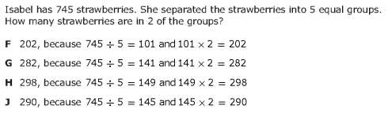
We do – Student 5
5 min

Slide 16
Debrief
Ask 2 questions to know which operation to choose:
Am I looking for a bigger number?
Are there groups?
 | Getting Bigger (in all, total, combined) | Getting Smaller (how many more, difference)
Groups (each, an, every, per) | Multiply (x) | Divide ( / )
No Groups | Add (+) | Subtract ( - )
2 min

Slide 17
What is a Remainder?
Let’s say there are 5 students going on a field trip. Only 2 students can fit in each car. How many cars would you need?
If there were only 2 cars available, one student would remain (or be left over). You’d have to get a 3rd car to fit everyone, even though it won’t be full!

Slide 18
You Do
Click Here to Take Your Quiz!

