Slide 1

4.5(A)
represent multi-step problems involving the four
operations with whole numbers using strip diagrams and
equations with a letter standing for the unknown quantity
<1 min

Slide 2
Fluency Practice
Multiply on Number 1
Take the product you found on Number 1 and subtract by 143 for number 2
1.
2.
25
x 54
4 min

Slide 3
Problem Solving Strategies
Intervene’s Problem Solving Strategies:
Step 1: Show what you know
Step 2: Solve and Check
Step 3: Eliminate and Justify
<2 min

Slide 4
Problem Solving Lesson
if you find an issue with fluency, go straight to the fluency sections of lesson
Ask 2 questions to know which operation to choose:
Am I looking for a bigger number?
Are there groups?
 | Getting Bigger (in all, total, combined) | Getting Smaller (how many more, difference)
Groups (each, an, every, per) | Multiply (x) | Divide ( / )
No Groups | Add (+) | Subtract ( - )
2 min

Slide 5
A Word Problem
Bob has 4 boxes of envelopes. Each box has 75 envelopes. He used 140 envelopes. How many envelopes are left?
The next few slides will show 2 different ways to represent the solution
With Strip Diagrams
With Equations

Slide 6
Using Strip Diagrams
Bob has 4 boxes of envelopes.
Each box has 75 envelopes.
75
75
75
75
75 + 75 + 75 + 75 OR
75 x 4 = 300
He used 140 envelopes
75
75
75
75
140

Slide 7
Using Strip Diagrams?
How many envelopes are left?
75
75
75
75
140
75
x 4
300
-140

Slide 8
Using Equations
Bob has 4 boxes of envelopes. Each box has 75 envelopes.
75 x 4
He used 140 envelopes.
75 x 4 - 140
How many envelopes are left, we’ll call that “L”?
L = 75 x 4 - 140

Slide 9
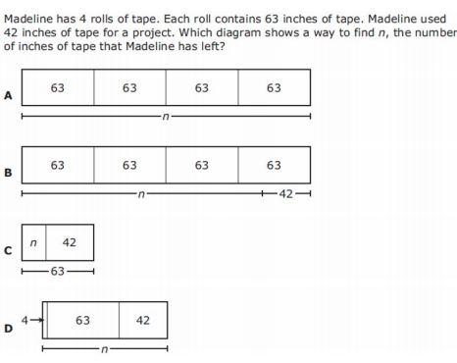
I Do
5 min

Slide 10
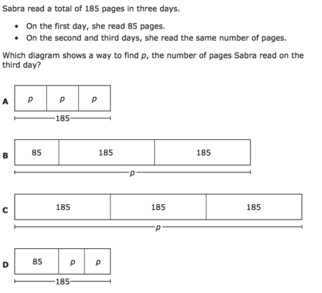
We Do – Student 1
5 min

Slide 11
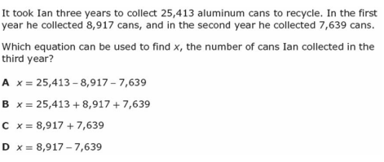
We do - Student 2
5 min

Slide 12
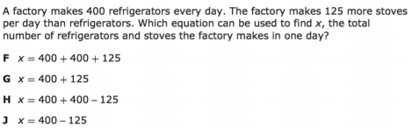
We do - Student 3
5 min

Slide 13
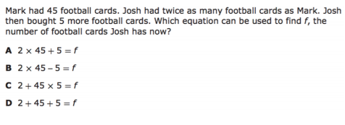
We do – Student 4
5 min

Slide 14
We Do – Student 5
5 min

Slide 15
Debrief
Strip Diagrams help you visualize (See) word problems better. They are organized in boxes or groups and can add onto each other
Equations have equal signs and help you take a word problem that is written in any language and turn it into math language
In order to be successful in word problems, you need to know what words in English translate to in MATH:
“twice” means ” x 2”
“each, an, every, per” are grouping words. Use them to multiply or divide
difference means to subtract
sum means to add
product means to multiple
quotient means to divide
2 min

Slide 16
You Do
Click Here to Take Your Quiz!

Slide 17
EXTRA SLIDES FOLLOW
In case you need them

Slide 18
Problem Solving Lesson
John has 16 boxes. He puts 24 bars of soap in each box. How many bars of soap does he have altogether?
When to multiply in word problems
Groups AND The number we’re looking for is bigger.
Groups: Each, an, every, per
Bigger: In all, total, combined, sum
When to divide in word problems
No Groups AND The number we’re looking for is smaller
Groups: Each, an, every, per
Smaller:The difference, how much more, compare, what’s left?
YES Grouping involved
We’re looking for a bigger number
MULTIPLY
John has 162 bars of soap. He puts an equal number of bars of soap into each of 9 boxes. How many bars of soap will be in each box? (asking for just one box)
YES Grouping involved
We’re looking for a smaller number
DIVIDE
5 min

Slide 19
Problem Solving Lesson
John rode his bike 3,452 feet on Monday and 5,439 feet on Tuesday. How many feet did John ride his bike on Monday and Tuesday?
When to add in word problems
No Groups AND The number we’re looking for is bigger.
In all, total, combined, sum
When to subtract in word problems
No Groups AND The number we’re looking for is smaller
The difference, how much more, compare, what’s left?
No Grouping involved
We’re looking for a bigger number
ADD
John rode his bike 3,452 feet on Monday and 5,439 feet on Tuesday. How many more feet did John ride his bike on Tuesday than Monday?
No Grouping involved
We’re looking for a smaller number
SUBTRACT
5 min

Slide 20
Fluency Lesson (if necessary)
2x1 digit multiplication
35
x 8
42
x 6
3 min

Slide 21
Fluency Lesson (if necessary)
2x2 digit multiplication
35
x 11
35
x 18
3 min

Slide 22


Fluency Lesson (if necessary)
Long Division
3 min

Slide 23
Fluency Lesson (if necessary)
Subtraction Regrouping
Hundreds
Tens
Ones
135
- 82
3 min

Slide 24
Fluency Lesson (if necessary)
“Carrying Over” when adding
Hundreds
Tens
Ones
135
+ 82
3 min

Slide 25
Fluency Lesson (if necessary)
Subtracting across Zeros
Hundreds
Tens
Ones
100
- 82
3 min

