Slide 1

4.5(B)
represent problems using an input-output table and
numerical expressions to generate a number pattern that
follows a given rule representing the relationship of the
values in the resulting sequence and their position in the
sequence
<1 min

Slide 2
Fluency Practice
Find the pattern and solve
1.
2.
7, 14, 21, __
56, 48, 40, ___
4 min

Slide 3
Problem Solving Strategies
Intervene’s Problem Solving Strategies:
Step 1: Show what you know
Step 2: Solve and Check
Step 3: Eliminate and Justify
<2 min

Slide 4
(Which Operation?) Lesson
Ask 2 questions to know which operation to choose:
Am I looking for a bigger number?
Are there groups?
 | Getting Bigger (in all, total, combined) | Getting Smaller (how many more, difference)
Groups (each, an, every, per) | Multiply (x) | Divide ( / )
No Groups | Add (+) | Subtract ( - )

Slide 5
Tables Lesson
groups – every means 1 hour
Hours | Money ($)
5 | 15
3 | 9
12 | 36
17 | ?
John makes 3 dollars for every hour he cuts grass.
How much money does he make in 17 hours?
getting bigger
bigger
2 min

Slide 6
Tables Lesson
Hours | Money ($)
5 | 15
3 | 9
12 | 36
17 | ?
17
x 3
x 3 =
x 3 =
x 3 =
x 3 =
2 min

Slide 7
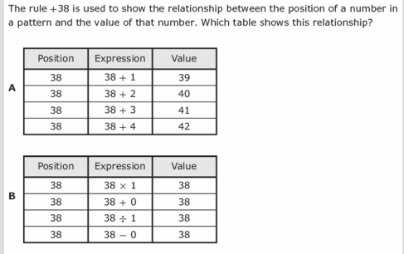
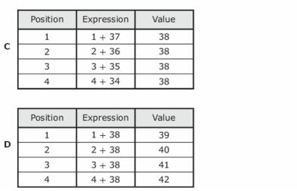
I Do
5 min

Slide 8
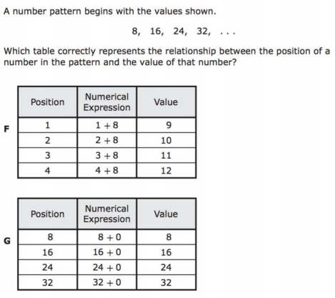
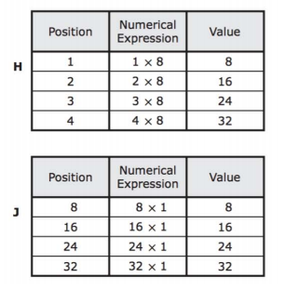
We Do – Student 1
5 min

Slide 9
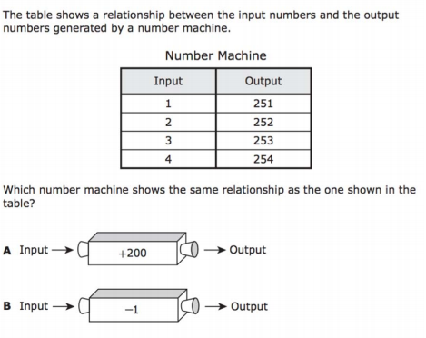
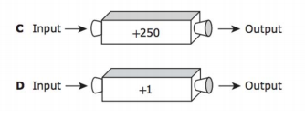
We do - Student 2
5 min

Slide 10
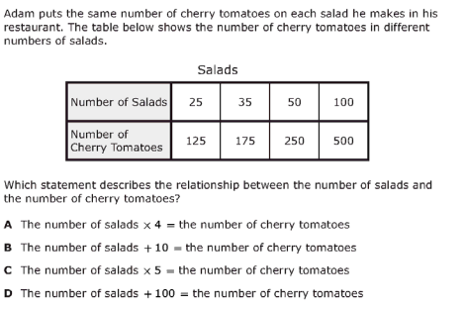
We do - Student 3
5 min

Slide 11
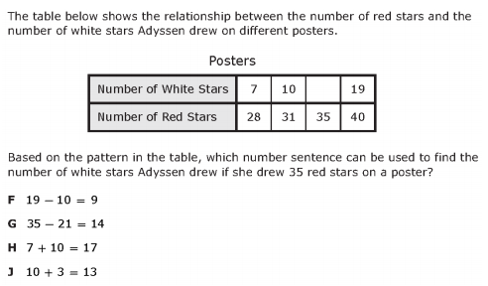
We do – Student 4
5 min

Slide 12
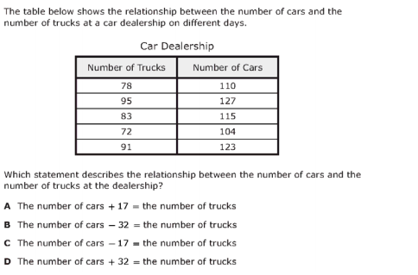
We Do – Student 5
5 min

Slide 13
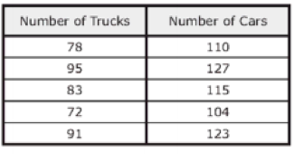

Debrief
Table Patterns can go
vertically or
horizontally
Use clues from the word problem to determine which operation to use
2 min

Slide 14
You Do
Click Here to Take Your Quiz!

Slide 15
EXTRA SLIDES FOLLOW
In case you need them

Slide 16
Problem Solving Lesson
John has 16 boxes. He puts 24 bars of soap in each box. How many bars of soap does he have altogether?
When to multiply in word problems
Groups AND The number we’re looking for is bigger.
Groups: Each, an, every, per
Bigger: In all, total, combined, sum
When to divide in word problems
No Groups AND The number we’re looking for is smaller
Groups: Each, an, every, per
Smaller:The difference, how much more, compare, what’s left?
YES Grouping involved
We’re looking for a bigger number
MULTIPLY
John has 162 bars of soap. He puts an equal number of bars of soap into each of 9 boxes. How many bars of soap will be in each box? (asking for just one box)
YES Grouping involved
We’re looking for a smaller number
DIVIDE
5 min

Slide 17
Problem Solving Lesson
John rode his bike 3,452 feet on Monday and 5,439 feet on Tuesday. How many feet did John ride his bike on Monday and Tuesday?
When to add in word problems
No Groups AND The number we’re looking for is bigger.
In all, total, combined, sum
When to subtract in word problems
No Groups AND The number we’re looking for is smaller
The difference, how much more, compare, what’s left?
No Grouping involved
We’re looking for a bigger number
ADD
John rode his bike 3,452 feet on Monday and 5,439 feet on Tuesday. How many more feet did John ride his bike on Tuesday than Monday?
No Grouping involved
We’re looking for a smaller number
SUBTRACT
5 min

Slide 18
Fluency Lesson (if necessary)
2x1 digit multiplication
35
x 8
42
x 6
3 min

Slide 19
Fluency Lesson (if necessary)
2x2 digit multiplication
35
x 11
35
x 18
3 min

Slide 20


Fluency Lesson (if necessary)
Long Division
3 min

Slide 21
Fluency Lesson (if necessary)
Subtraction Regrouping
Hundreds
Tens
Ones
135
- 82
3 min

Slide 22
Fluency Lesson (if necessary)
“Carrying Over” when adding
Hundreds
Tens
Ones
135
+ 82
3 min

Slide 23
Fluency Lesson (if necessary)
Subtracting across Zeros
Hundreds
Tens
Ones
100
- 82
3 min

