Slide 1

4.5(D)
solve problems related to perimeter and area of
rectangles where dimensions are whole numbers
<1 min

Slide 2
Fluency Practice
Find the perimeter on number 1
Find the area on number 2
1.
2.
5 feet
5 feet
15 feet
15 feet
4 min

Slide 3
Problem Solving Strategies
Intervene’s Problem Solving Strategies:
Step 1: Show what you know
Step 2: Solve and Check
Step 3: Eliminate and Justify
<2 min

Slide 4
Perimeter Lesson
Perimeter: the distance around a polygon.
You take the sides (ALL of them- even if the image doesn’t show all the sides) and add them up.
We know that in a rectangle, if one length is 10 inches, the other has to be 10 inches too. Same with the width
10 inches
5 inches
5 inches
10 inches
♬♬ “Perimeter goes around. Perimeter goes around. You add the sides and write it down, the perimeter goes around!”

Slide 5
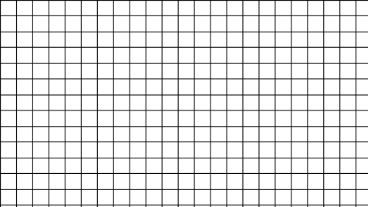

Area Lesson
Area = The number of square units INSIDE the shape.
tip:
Be sure to look at the key.
4 feet
Key:
= 1 sq. ft
8 feet
♬ “The Area fills the floor. The area fills the floor. One length, one width, you MULTIPLY. The area fills the floor.” ♬

Slide 6
The Additive Property of Area
What if the shape isn’t a rectangle?
You can break this figure into 2 rectangles.
Find the area of each rectangle.
Then add the two areas together.
Key
=1 sq unit

Slide 7
The Additive Property of Area
Key
=1 sq. unit
You can break this figure into 2 rectangles.
Find the area of each rectangle.
Then add the two areas together.
6 x 4 = 24 sq. units
2 x 7 = 14 sq. units
24 + 14 = 38 square units

Slide 8
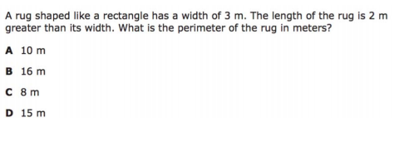
I Do
5 min

Slide 9
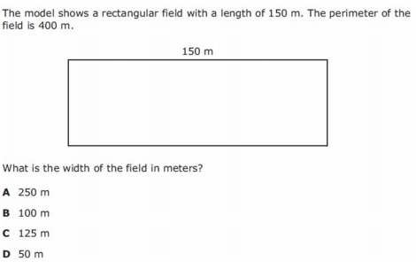
We Do – Student 1
5 min

Slide 10
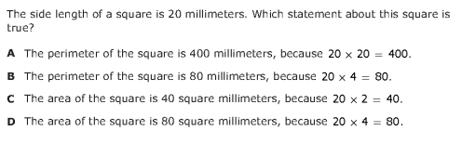
We do - Student 2
5 min

Slide 11
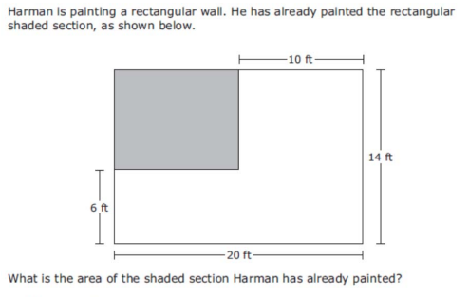
We do - Student 3
5 min

Slide 12
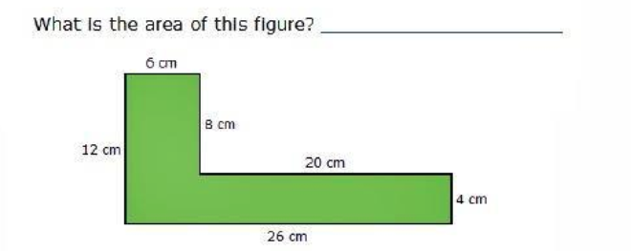
We do – Student 4
5 min

Slide 13
We Do – Student 5
5 min

Slide 14
Debrief: Perimeter and Area
Perimeter: the distance around a polygon.
You take the sides (ALL of them- even if the image doesn’t show all the sides) and add them up.
♬♬ “Perimeter goes around. Perimeter goes around. You add the sides and write it down, the perimeter goes around!”
Area: The number of square units INSIDE the shape.
Area = length x width
♬ “The Area fills the floor. The area fills the floor. One length, one width, you MULTIPLY. The area fills the floor.” ♬

Slide 15
You Do
Click Here to Take Your Quiz!

Slide 16
Fluency Lesson (if necessary)
2x1 digit multiplication
35
x 8
42
x 6
3 min

Slide 17
Fluency Lesson (if necessary)
2x2 digit multiplication
35
x 11
35
x 18
3 min

Slide 18
Fluency Lesson (if necessary)
Subtraction Regrouping
Hundreds
Tens
Ones
135
- 82
3 min

Slide 19
Fluency Lesson (if necessary)
“Carrying Over” when adding
Hundreds
Tens
Ones
135
+ 82
3 min

Slide 20
Fluency Lesson (if necessary)
Subtracting across Zeros
Hundreds
Tens
Ones
100
- 82
3 min

