Slide 1

4.6(D)
classify two-dimensional figures based on the presence or
absence of parallel or perpendicular lines or the presence
or absence of angles of a specified size
<1 min

Slide 2
Fluency Practice
Name the shapes shown below. Tell me one characteristic about each shape. How is each shape different or the same as the rest?
4 min

Slide 3
Problem Solving Strategies
Intervene’s Problem Solving Strategies:
Step 1: Show what you know
Step 2: Solve and Check
Step 3: Eliminate and Justify
<2 min

Slide 4
Shapes Lesson
Parallel sides: When opposite sides would never touch. They have the exact same slope.
Sides A and C are parallel to each other
Sides B and D are also parallel to each other
Parallelograms are 4 sided shapes (quadrilaterals) that have 2 sets of parallel sides just like the shape shown on the right
A
D
B
C
This shape is a quadrilateral. It has 4 sides. quadr = 4
This shape is also a rectangle because it is a quadrilateral with all right angles
2 min

Slide 5
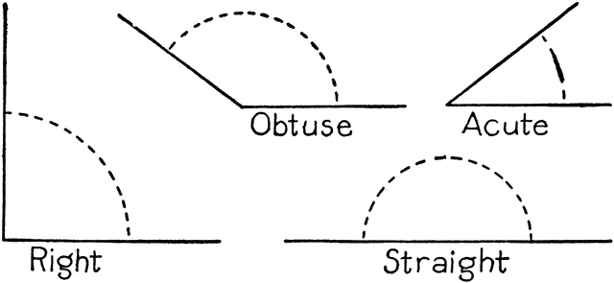
Shapes Lesson
Right angles: Angles that measure 90 degrees
Obtuse angles: Angles that measure greater than 90 and less than 180 degrees
Acute angles: Angles that measure less than 90 degrees
obtuse angles
all 4 angles of a rectangle are right angles
acute angles

Slide 6
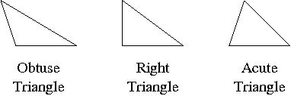
Types of Triangles
Every triangle MUST have at least 2 acute angles.
The third angle determines its name.
If the 3rd angle is obtuse, the triangle is called an obtuse triangle
If the 3rd angle is right, the triangle is called a right triangle
If the 3rd angle is acute, the triangle is called an acute triangle

Slide 7
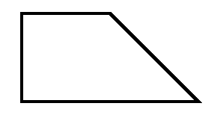
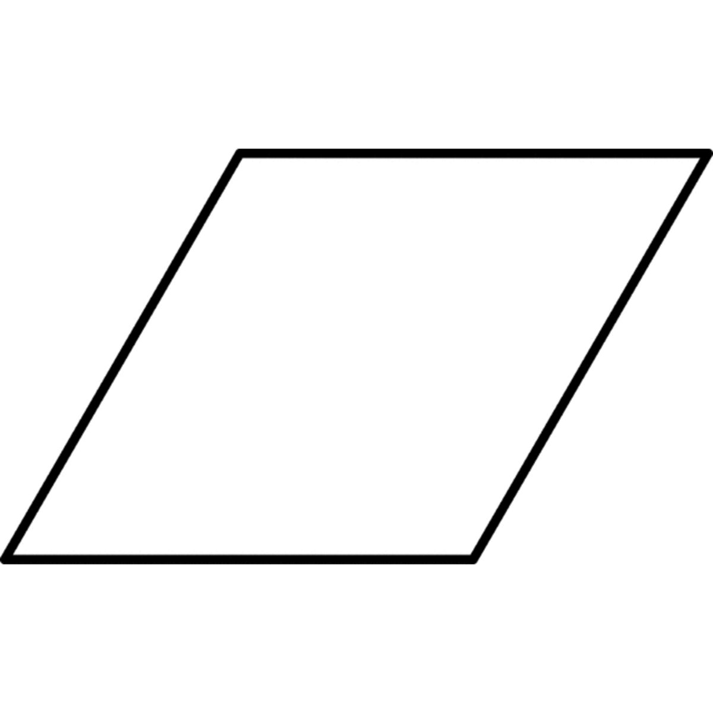
Types of Quadrilaterals
Quadrilaterals are 4 sided polygons (a polygon is a fancy word for a shape with 3 or more sides)
A trapezoid is a quadrilateral with only one set of parallel sides
A parallelogram is a quadrilateral with 2 sets of parallel sides
A rhombus is an equilateral parallelogram
A square is an equilateral rectangle
5
5
5
5
5
5
5
5

Slide 8
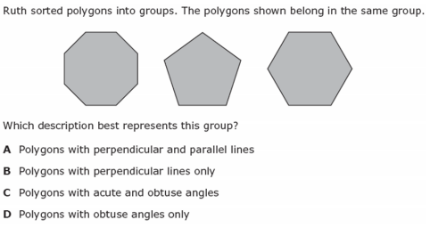
I Do
5 min

Slide 9
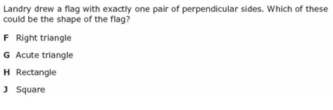
We Do – Student 1
5 min

Slide 10
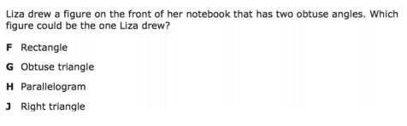
We do - Student 2
5 min

Slide 11
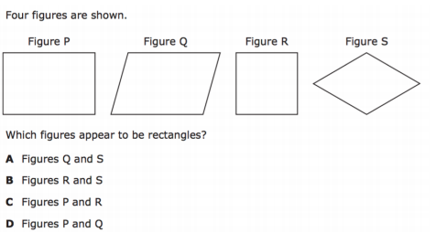
We do - Student 3
5 min

Slide 12
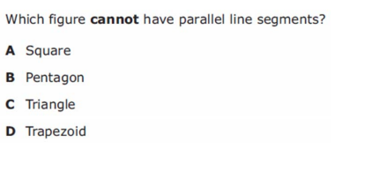
We do – Student 4
5 min

Slide 13
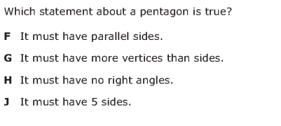
We Do – Student 5
5 min

Slide 14
Debrief
Triangle – a polygon with 3 sides
Quadrilateral – a polygon with 4 sides
Rectangle – a quadrilateral with all right angles
Square –equilateral rectangle
Trapezoid – a quadrilateral with ONLY one set of parallel sides.
Parallelogram – a quadrilateral with TWO sets of parallel sides
Rhombus – equilateral parallelogram
Pentagon – a polygon with 5 sides
Hexagon – a polygon with 6 sides
Octagon – a polygon with 8 sides
2 min

Slide 15
You Do
Click Here to Take Your Quiz!

