Slide 1

5.2 (B)
compare and order two decimals to thousandths and represent comparisons using the symbols >, <, or =
<1 min

Slide 2
Fluency Practice
Put these numbers in order from least to greatest: 10.01, 10.10, 10, 10.014
What do < and > represent?
Is 10.9 = 10.90? Why or why not?
What inequality represents the relationship between 9.45 and 9.87 ?
4 min

Slide 3
Problem Solving Strategies
Step 1: Show what you know
If there’s a vocabulary word you know, write or draw something to show you know it.
ex) perimeter (add all sides, goes around, etc)
Step 2: Solve and Check
Add to check your subtraction, etc
Step 3: Eliminate and Justify
Don’t just cross answers out and pick your favorite choice.
SHOW why a choice is wrong.
<3 min

Slide 4
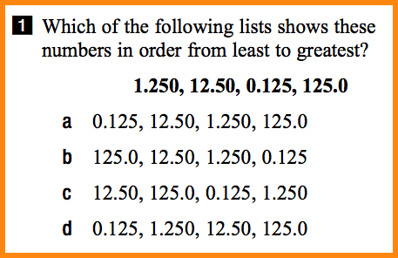
Lesson
Greater than
Less than
Equal to
Least to greatest
Greatest to least
1 min

Slide 5
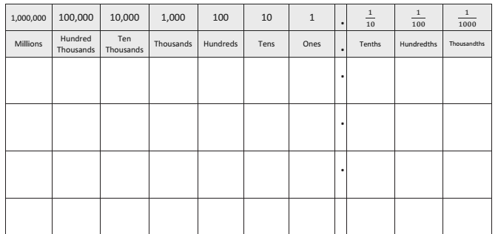
Line up the decimal points
Compare from left to right
<5 min

Slide 6
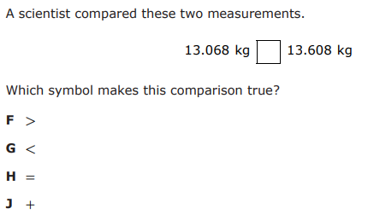
I Do
<5 min

Slide 7
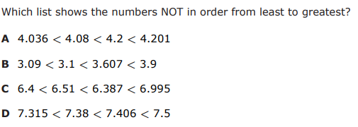
We Do – Student 1
<5 min

Slide 8
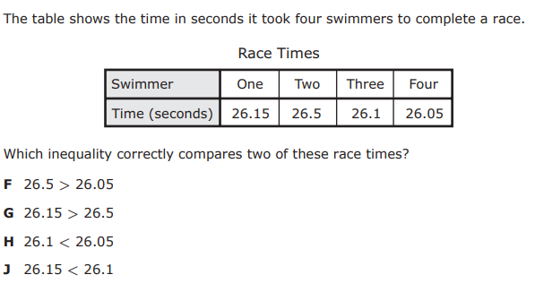
We do - Student 2
<5 min

Slide 9
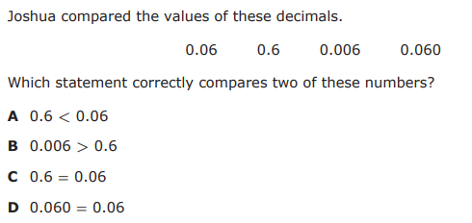
We do - Student 3
<5 min

Slide 10
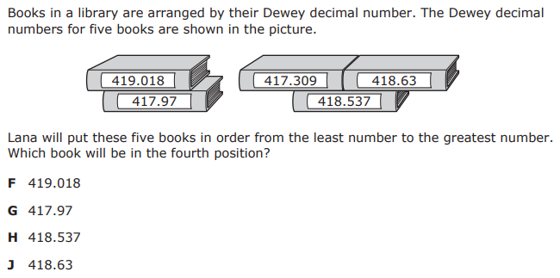
We do - Student 4
<5 min

Slide 11
We do: Student 5 (Same as I Do: Let’s see if you can explain)

Slide 12
Debrief
Write decimals vertically, lining up by decimal point
Use a place value chart if you know it’ll help!
Start from the left (greatest value)
Determine order or <,>, or =
<2 min

Slide 13
You Do
Go back to Intervene to take your quiz!

Slide 14
Answer Key
I Do: G
We Do 1: C
We Do 2: F
We Do 3: D
We Do 4: J
We Do 5: G (Same as I Do)

