Slide 1

5.3 (A)
estimate to determine solutions to mathematical and real-world problems involving addition, subtraction, multiplication, or division

Slide 2
Fluency Practice
How would you round 512 to the nearest hundred?
How would you round 38 to the nearest ten?
Around how much is 489 + 180?
What is an best estimate of 420-105?

Slide 3
Problem Solving Strategies
Intervene’s Problem Solving Strategies:
Step 1: Show what you know
Step 2: Solve and Check
Step 3: Eliminate and Justify

Slide 4
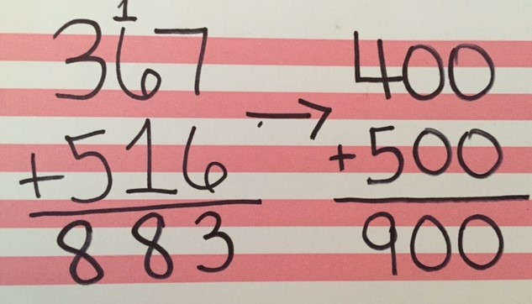
Lesson
Estimate
Round up
Round down

Slide 5
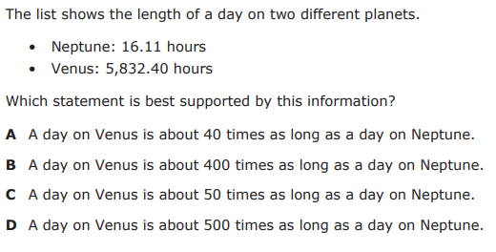
I Do

Slide 6
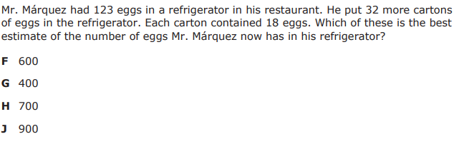
We Do – Student 1

Slide 7
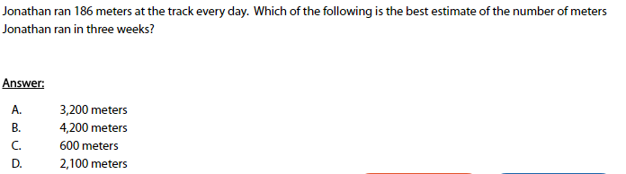
We do - Student 2

Slide 8
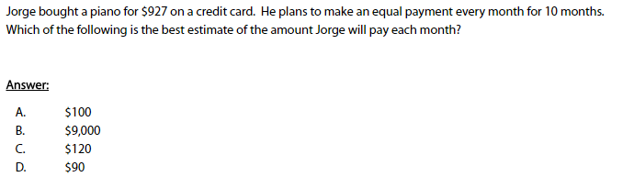
We do - Student 3

Slide 9
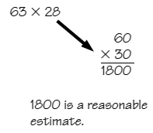

Debrief
Determine +, -, x or $÷$
Round up or down
Solve

Slide 10
You Do
Instructions for Content Dev:
Nothing to do here
Instructions for Tutor:
Have students click on the Quiz tab above (on their screen)
Instruct students to take the quiz on this objective, and remind to use their problem solving strategies

