Slide 1

5.3 (B)
multiply with fluency a three-digit number by a two-digit number using the standard algorithm

Slide 2
Fluency Practice
What is 9 x 7?
What is 11 x 2?
How do we solve 14 x 6?
How do we solve 14 x 14?
How do we solve 144 x 14?

Slide 3
Problem Solving Strategies
Intervene’s Problem Solving Strategies:
Step 1: Show what you know
Step 2: Solve and Check
Step 3: Eliminate and Justify

Slide 4
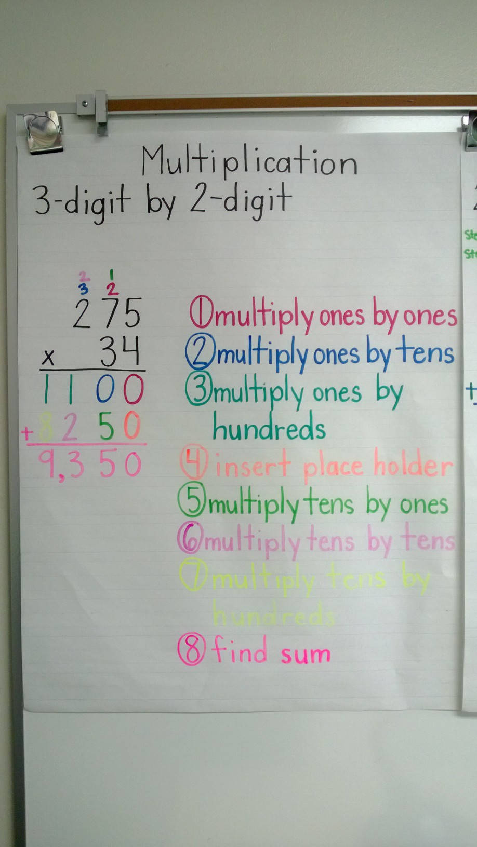
Lesson
Words that tell multiplication
“in all”
“how many ….”
Product
Multiply each digit
Line up
Add

Slide 5
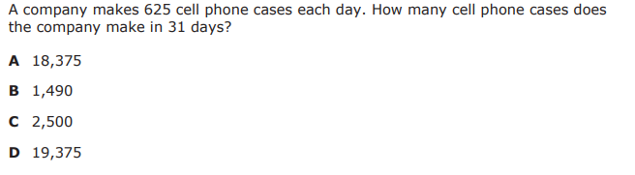
I Do

Slide 6
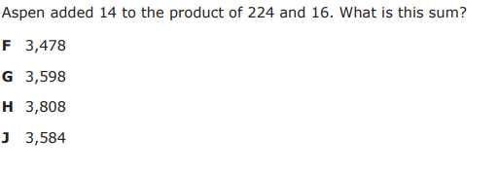
We Do – Student 1

Slide 7
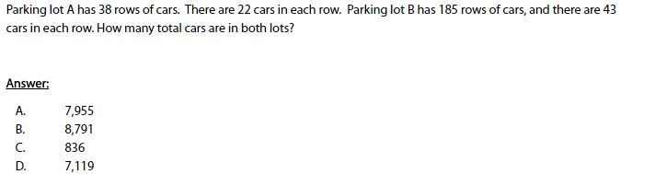
We do - Student 2

Slide 8
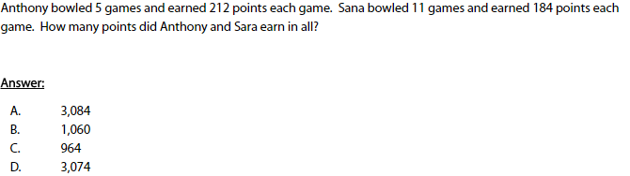
We do - Student 3

Slide 9
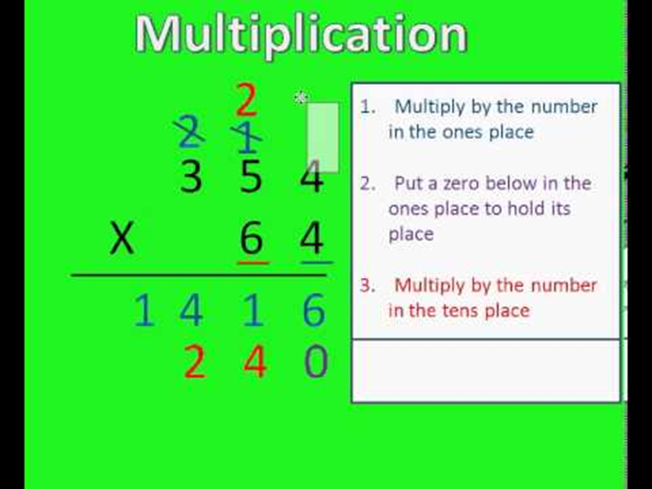
Debrief
Determine steps needed
Multiply
or multiply and add

Slide 10
You Do
Instructions for Content Dev:
Nothing to do here
Instructions for Tutor:
Have students click on the Quiz tab above (on their screen)
Instruct students to take the quiz on this objective, and remind to use their problem solving strategies

