Slide 1

5.3 (C)
solve with proficiency for quotients of up to a four-digit dividend by a two-digit divisor using strategies and the standard algorithm

Slide 2
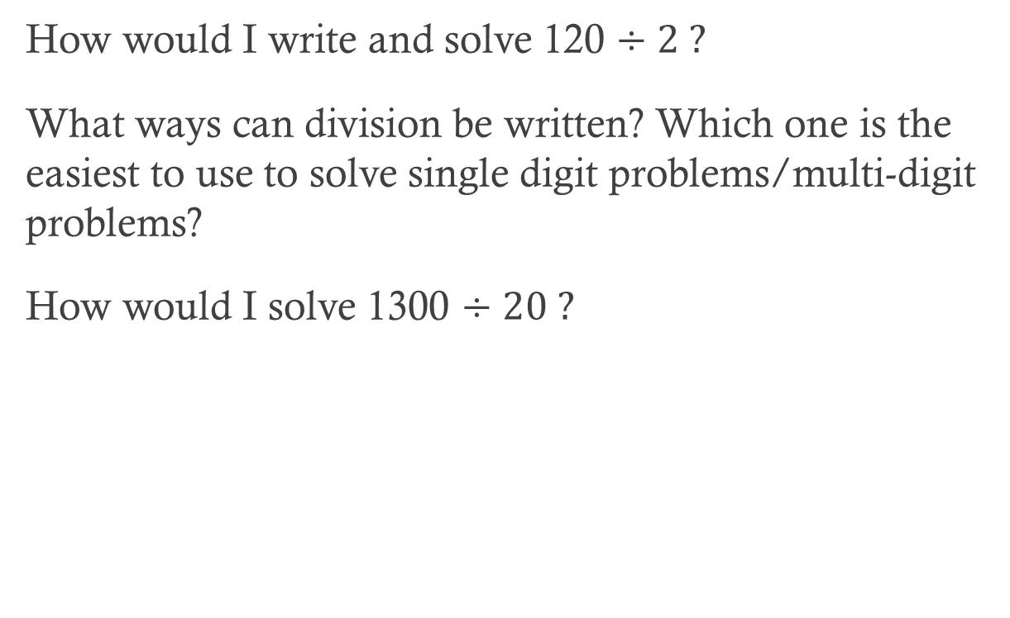
Fluency Practice
How would I write and solve 120 $÷2 ?$
What ways can division be written? Which one is the easiest to use to solve single digit problems/multi-digit problems?
How would I solve 1300 $÷20 ?$

Slide 3
Problem Solving Strategies
Intervene’s Problem Solving Strategies:
Step 1: Show what you know
Step 2: Solve and Check
Step 3: Eliminate and Justify

Slide 4
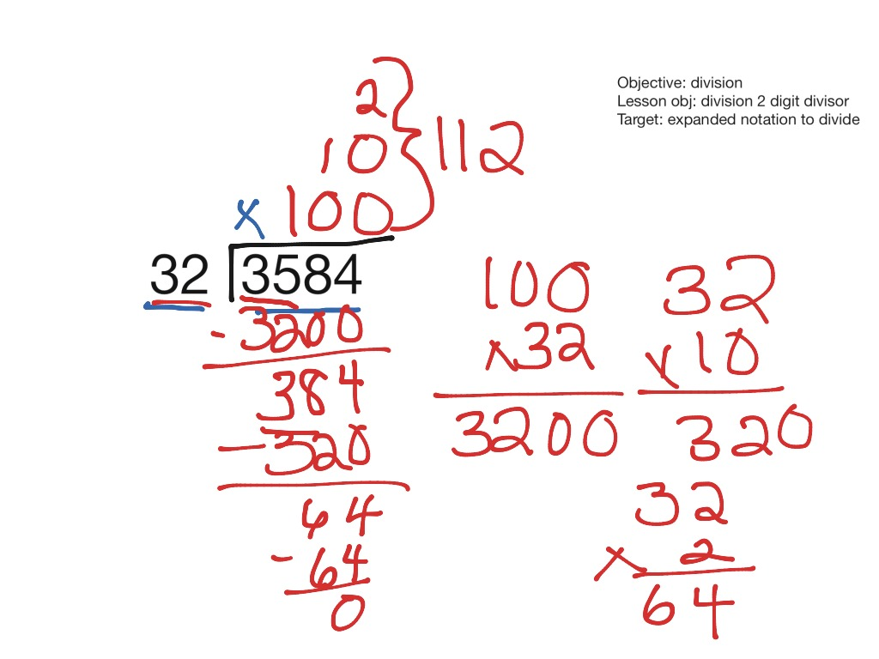
Lesson
Estimate
Multiply
Subtract
Bring down
Other strategies

Slide 5
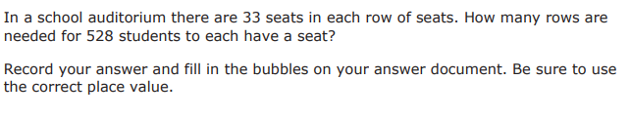
I Do

Slide 6
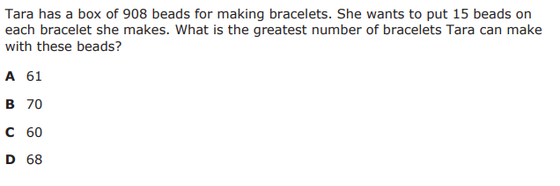
We Do – Student 1

Slide 7
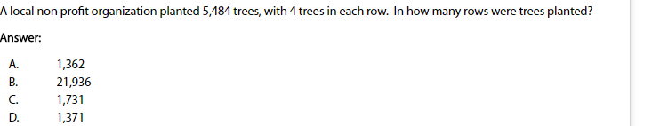
We do - Student 2

Slide 8
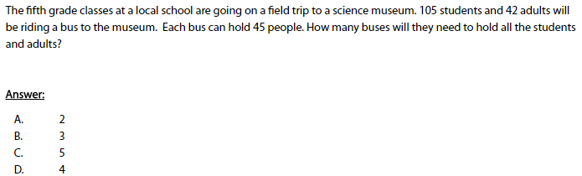
We do - Student 3

Slide 9
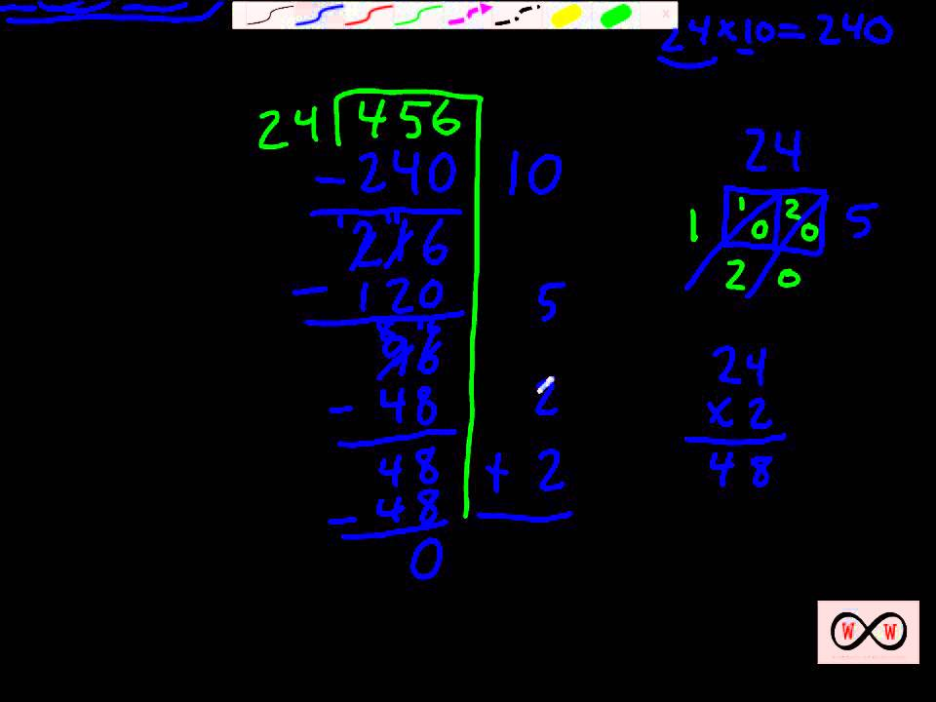
Debrief
Estimate
Multiply
Subtract
Bring down
Continue
Partial quotients

Slide 10
You Do
Instructions for Content Dev:
Nothing to do here
Instructions for Tutor:
Have students click on the Quiz tab above (on their screen)
Instruct students to take the quiz on this objective, and remind to use their problem solving strategies

