Slide 1

5.3 (D)
represent multiplication of decimals with products to the hundredths using objects and pictorial models, including area models

Slide 2
Fluency Practice
How would I solve 4.2 x 2?
How can I solve this with a model?
How can I draw a model to show 2.2 x 4?

Slide 3
Problem Solving Strategies
Intervene’s Problem Solving Strategies:
Step 1: Show what you know
Step 2: Solve and Check
Step 3: Eliminate and Justify

Slide 4
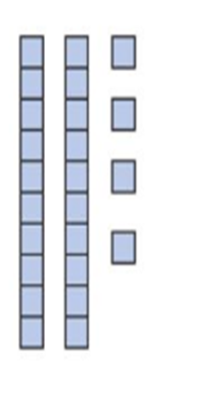
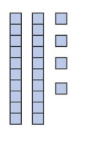
Lesson
Using the key for one whole
Count up whole numbers and decimals

Slide 5
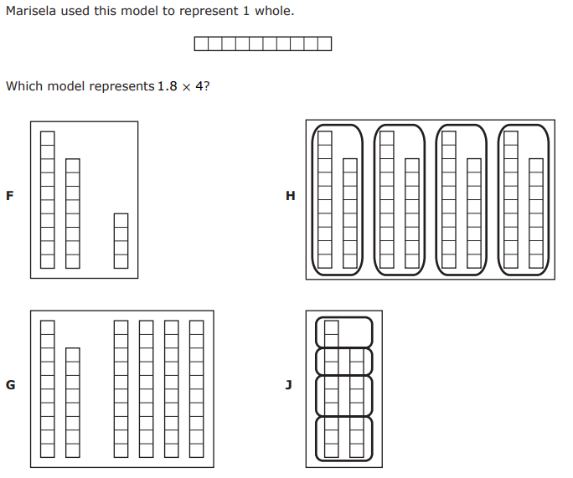
I Do

Slide 6
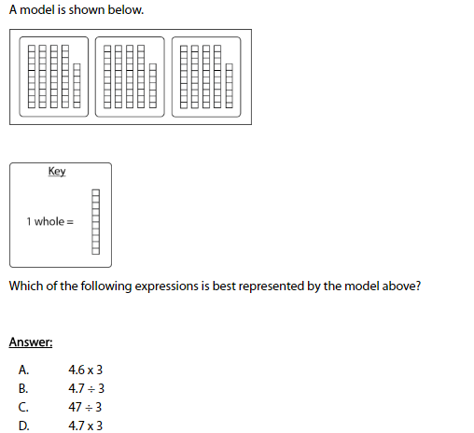
We Do – Student 1

Slide 7
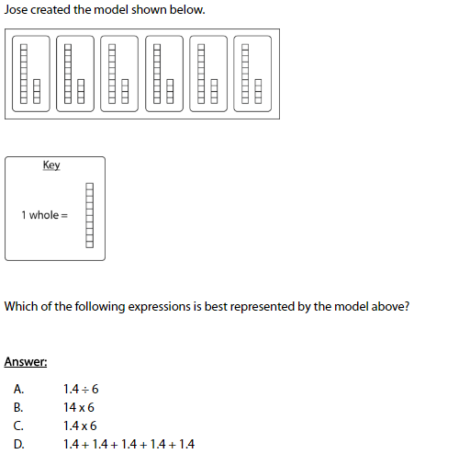
We do - Student 2

Slide 8
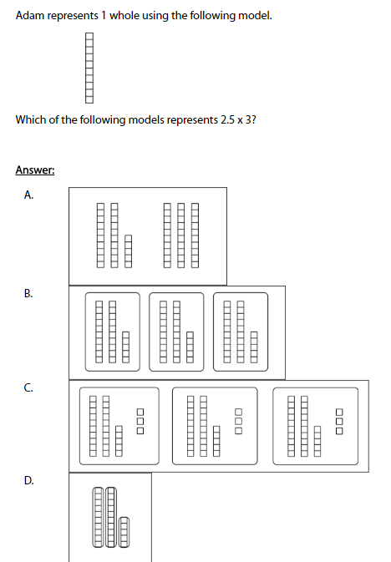
We do - Student 3

Slide 9
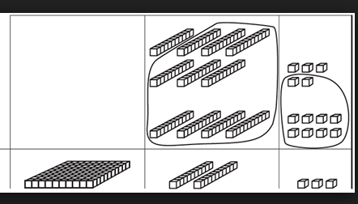
Debrief
Use the key to determine one whole
Count pieces of the whole as decimals
Find the matching equation

Slide 10
You Do
Instructions for Content Dev:
Nothing to do here
Instructions for Tutor:
Have students click on the Quiz tab above (on their screen)
Instruct students to take the quiz on this objective, and remind to use their problem solving strategies

