Slide 1

5.3 (E)
solve for products of decimals to the hundredths, including situations involving money, using strategies based on place-value understandings, properties of operations, and the relationship to the multiplication of whole numbers
<1 min

Slide 2
Fluency Practice
How would I solve 120 x 15?
How do I multiply 12.5 X 13?
What is the number in the tenths and hundredths place in the number 143.28?
How do I know a word problem is asking me to multiply?
<4 min

Slide 3
Problem Solving Strategies
Step 1: Show what you know
If there’s a vocabulary word you know, write or draw something to show you know it.
ex) perimeter (add all sides, goes around, etc)
Step 2: Solve and Check
Add to check your subtraction, etc
Step 3: Eliminate and Justify
Don’t just cross answers out and pick your favorite choice.
SHOW why a choice is wrong.
<3 min

Slide 4
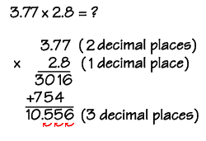
Lesson
Words that show multiplication:
Each
As much
Times as much
Process for multiplying decimals
Write vertically
Multiply
Count total decimal places
Locate place for decimal point in answer

Slide 6
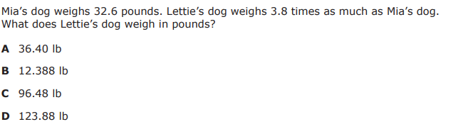
I Do
5 min

Slide 7
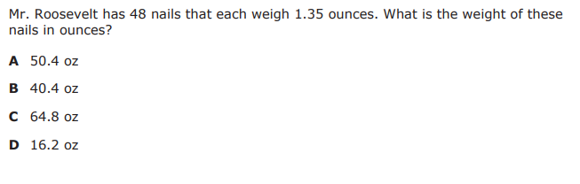
We Do – Student 1
<1 min

Slide 8
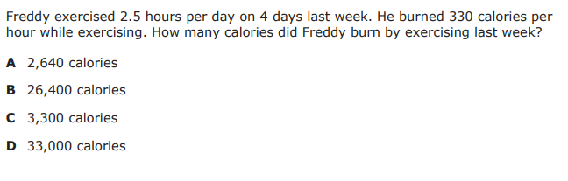
We do - Student 2
<1 min

Slide 9
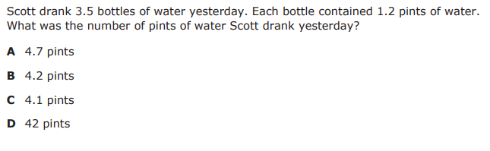
We do - Student 3
<1 min

Slide 10
We Do

Slide 11
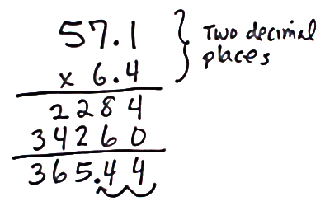
Debrief [2 minutes]
Identify that the problem is asking you to multiply
Identify the two numbers you need to multiply and write them vertically
Multiply
Count decimal places
Place your decimal

Slide 12
You Do [1 minute to explain]
Instructions for Content Dev:
Nothing to do here
Instructions for Tutor:
Have students click on the Quiz tab above (on their screen)
Instruct students to take the quiz on this objective, and remind to use their problem solving strategies

