Slide 1

5.3 (F)
represent quotients of decimals to the hundredths, up to four-digit dividends and two-digit whole number divisors, using objects and pictorial models, including area models

Slide 2
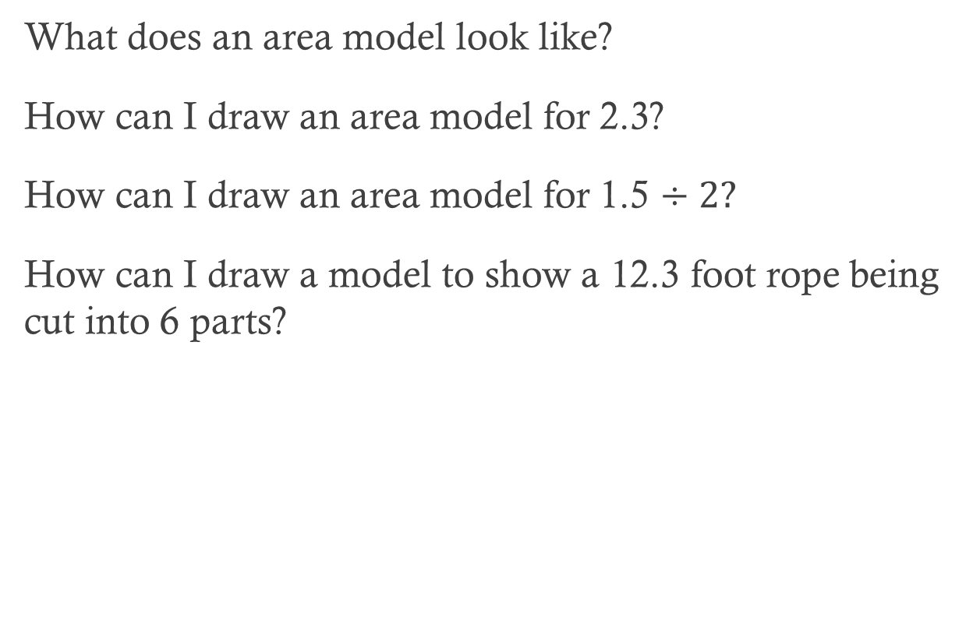
Fluency Practice
What does an area model look like?
How can I draw an area model for 2.3?
How can I draw an area model for 1.5 $÷2?$
How can I draw a model to show a 12.3 foot rope being cut into 6 parts?

Slide 3
Problem Solving Strategies
Intervene’s Problem Solving Strategies:
Step 1: Show what you know
Step 2: Solve and Check
Step 3: Eliminate and Justify

Slide 4
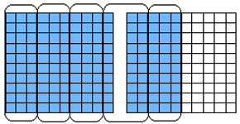
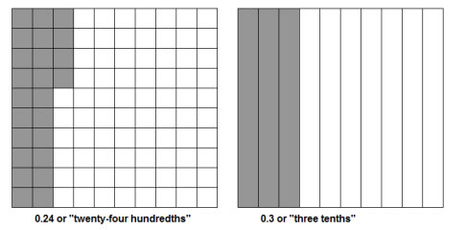
Lesson
Area model
Tenths
Hundredths

Slide 5
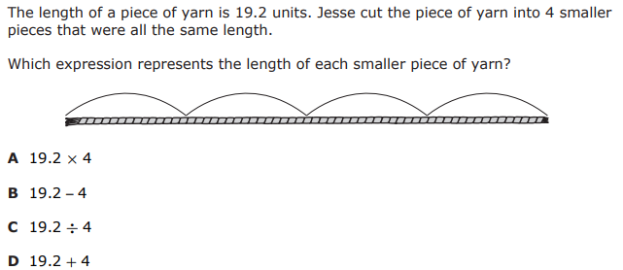
I Do

Slide 6
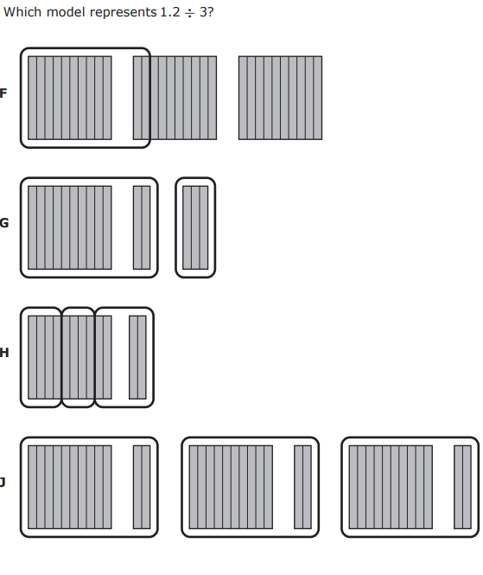
We Do – Student 1

Slide 7
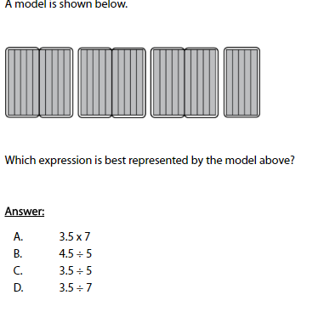
We do - Student 2

Slide 8
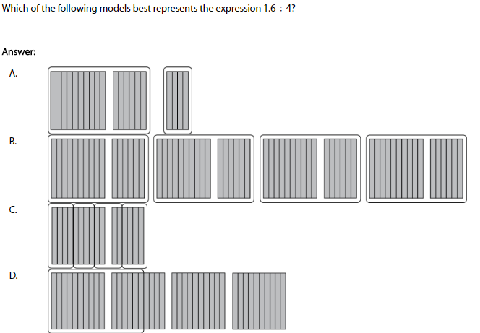
We do - Student 3

Slide 9
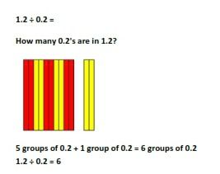
Debrief
Count and verify expression

Slide 10
You Do
Instructions for Content Dev:
Nothing to do here
Instructions for Tutor:
Have students click on the Quiz tab above (on their screen)
Instruct students to take the quiz on this objective, and remind to use their problem solving strategies

