Slide 1

5.3 (G)
solve for quotients of decimals to the hundredths, up to four-digit dividends and two-digit whole number divisors, using strategies and algorithms, including the standard algorithm
<1 min

Slide 2

Fluency Practice
Long Division Review
<5 min

Slide 3
Problem Solving Strategies
Step 1: Show what you know
If there’s a vocabulary word you know, write or draw something to show you know it.
ex) perimeter (add all sides, goes around, etc)
Step 2: Solve and Check
Add to check your subtraction, etc
Step 3: Eliminate and Justify
Don’t just cross answers out and pick your favorite choice.
SHOW why a choice is wrong.
<3 min

Slide 4
Lesson
Ask 2 questions to know which operation to choose:
Am I looking for a bigger number or a smaller number?
Are there groups?
 | Getting Bigger (in all, total, combined) | Getting Smaller (how many in only 1 jar, how many more)
Yes Groups (each, an, every, per) | Multiply (x) | Divide (÷)
No Groups | Add (+) | Subtract ( - )
<3 min

Slide 5
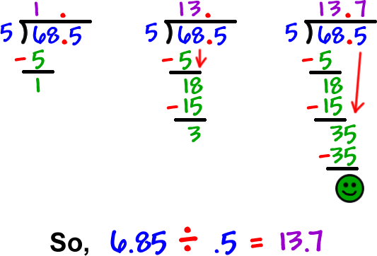
<2 min

Slide 6
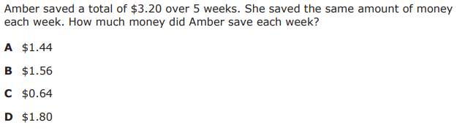
I Do
grouping? each, an, every, per …we’re saving the same amount week after week.
in just 1 week? we’re looking for a smaller number
<5 min

Slide 7
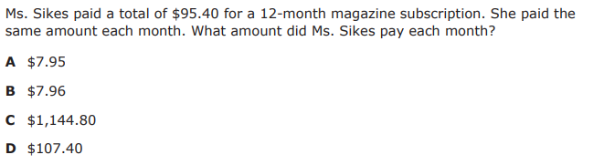
We Do – Student 1
<5 min

Slide 8
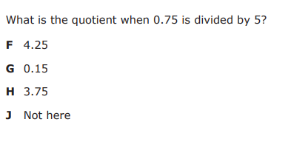
We do - Student 2
<5 min

Slide 9
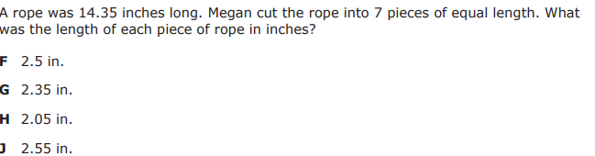
We do - Student 3
<5 min

Slide 10
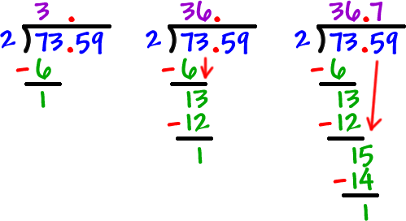
Debrief
Determine that the problem is asking you to divide
Set up the problem
Solve, making sure your decimal is in the correct place
<5 min

Slide 11
You Do
Head back to Intervene for your quiz!

