Slide 1

5.3 (H)
represent and solve addition and subtraction of fractions with unequal denominators referring to the same whole using objects and pictorial models and properties of operations

Slide 2

Fluency Practice
What is ¾ - ¼ ?
How can I show this in a picture?
What is $1/{3 }$+ ¼ ?
How can I show this in a picture?

Slide 3
Problem Solving Strategies
Intervene’s Problem Solving Strategies:
Step 1: Show what you know
Step 2: Solve and Check
Step 3: Eliminate and Justify

Slide 4
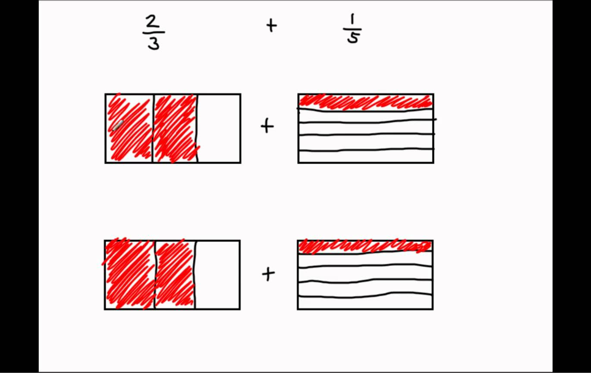
Lesson
Fraction Model
Common denominator

Slide 5
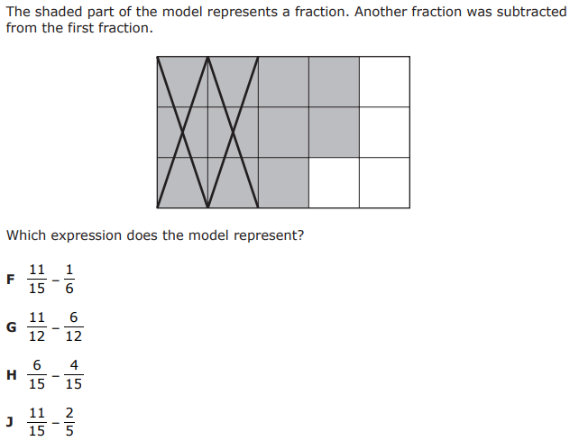
I Do

Slide 6
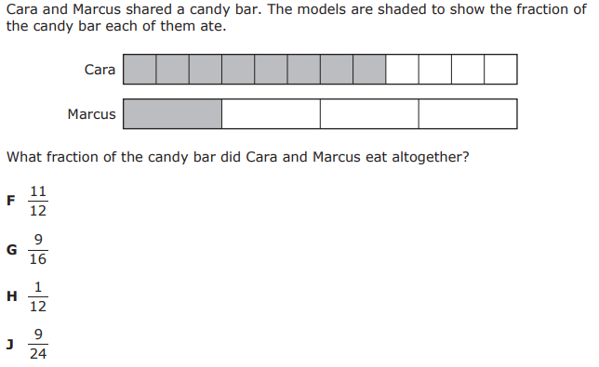
We Do – Student 1

Slide 7
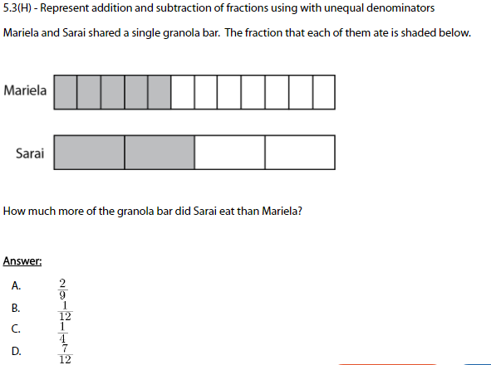
We do - Student 2

Slide 8
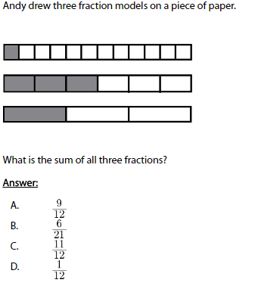
We do - Student 3

Slide 9
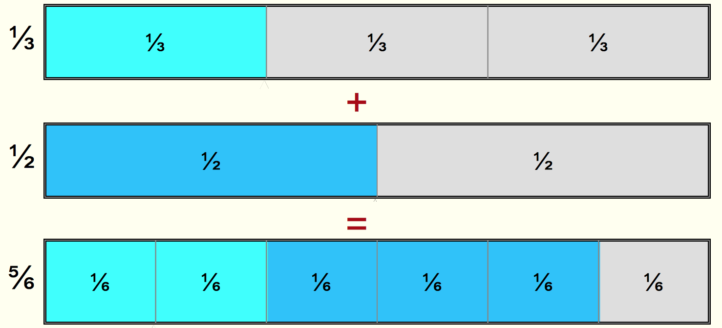
Debrief
Read the fraction model
Use the model to solve the problem

Slide 10
You Do
Instructions for Content Dev:
Nothing to do here
Instructions for Tutor:
Have students click on the Quiz tab above (on their screen)
Instruct students to take the quiz on this objective, and remind to use their problem solving strategies

