Slide 1

5.3 (I)
represent and solve multiplication of a whole number and a fraction that refers to the same whole using objects and pictorial models, including area models

Slide 2
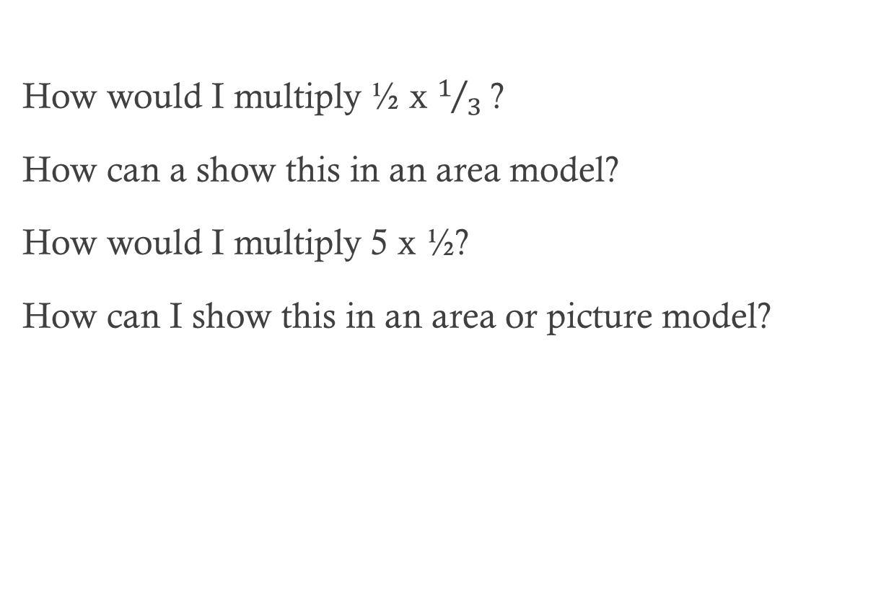
Fluency Practice
How would I multiply ½ x $1/3$ ?
How can a show this in an area model?
How would I multiply 5 x ½?
How can I show this in an area or picture model?

Slide 3
Problem Solving Strategies
Intervene’s Problem Solving Strategies:
Step 1: Show what you know
Step 2: Solve and Check
Step 3: Eliminate and Justify

Slide 4
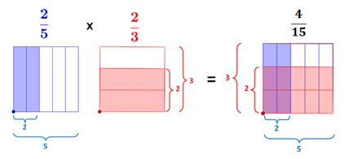
Lesson
Expression
Area model
Using the model to solve

Slide 5
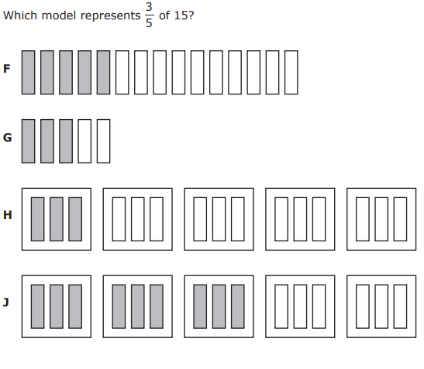
I Do

Slide 6
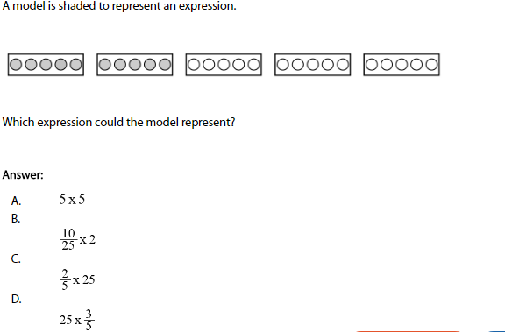
We Do – Student 1

Slide 7
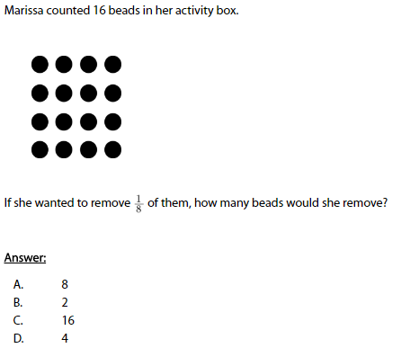
We do - Student 2

Slide 8
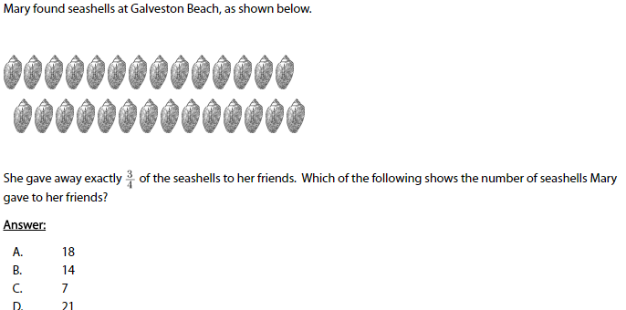
We do - Student 3

Slide 9
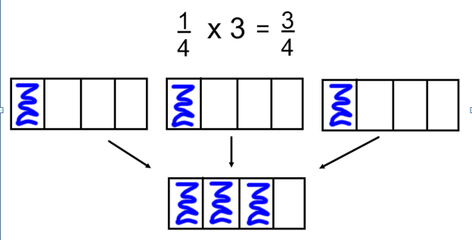
Debrief
Determine that you are multiplying fractions
Use the area model to help solve

Slide 10
You Do
Instructions for Content Dev:
Nothing to do here
Instructions for Tutor:
Have students click on the Quiz tab above (on their screen)
Instruct students to take the quiz on this objective, and remind to use their problem solving strategies

