Slide 1

5.3 (J)
represent division of a unit fraction by a whole number and the division of a whole number by a unit fraction such as 1/3 ÷ 7 and 7 ÷ 1/3 using objects and pictorial models, including area models

Slide 2
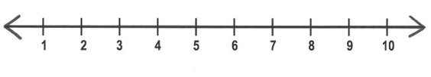
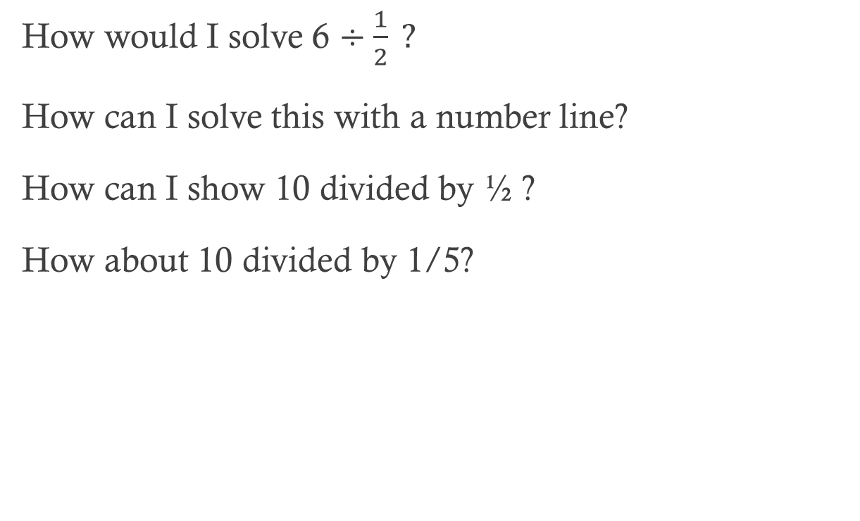
Fluency Practice
How would I solve 6 $÷\frac{1}{2} ?$
How can I solve this with a number line?
How can I show 10 divided by ½ ?
How about 10 divided by 1/5?

Slide 3
Problem Solving Strategies
Intervene’s Problem Solving Strategies:
Step 1: Show what you know
Step 2: Solve and Check
Step 3: Eliminate and Justify

Slide 4
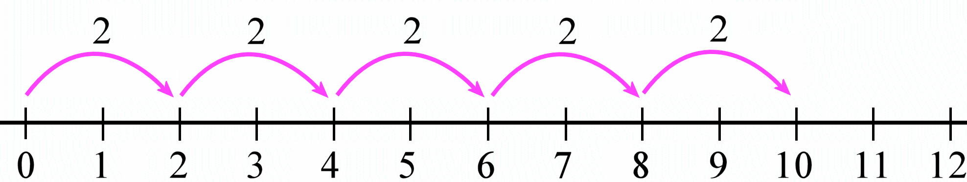
Lesson
Verify division by a fraction.
Determine the fraction the whole number is being divided by.
Write the expression or select the correct number line.

Slide 5
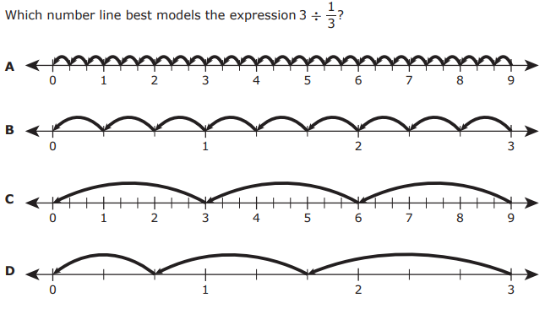
I Do

Slide 6
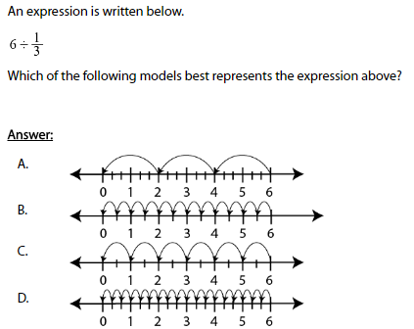
We Do – Student 1

Slide 7
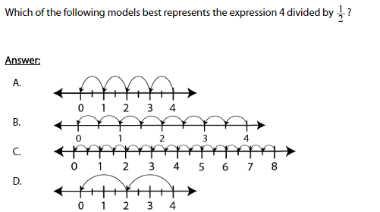
We do - Student 2

Slide 8
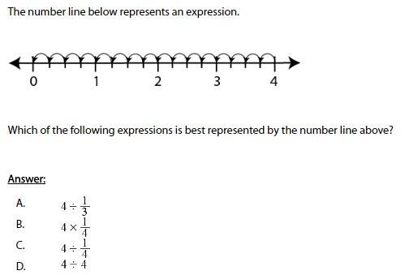
We do - Student 3

Slide 9
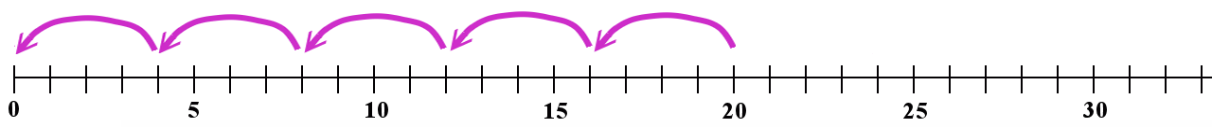
Debrief
Determine division by a fraction.
Determine the “jumps” needed on the number line.

Slide 10
You Do
Instructions for Content Dev:
Nothing to do here
Instructions for Tutor:
Have students click on the Quiz tab above (on their screen)
Instruct students to take the quiz on this objective, and remind to use their problem solving strategies

