Slide 1

5.3 (K)
add and subtract positive rational numbers fluently
Intro: 2 minutes
Explain the TEKS

Slide 2

Fluency Practice [5-10 min]
What words in a problem tell us we should add?
How do I add 3.45 + 6.077?
How do I add 19$\frac{2}{3}$ + 2$\frac{1}{9}$ ?
What is $9.23 + $14.00?

Slide 3
Problem Solving Strategies [explain in 2 minutes]
Intervene’s Problem Solving Strategies:
Step 1: Show what you know
Step 2: Solve and Check
Step 3: Eliminate and Justify

Slide 4
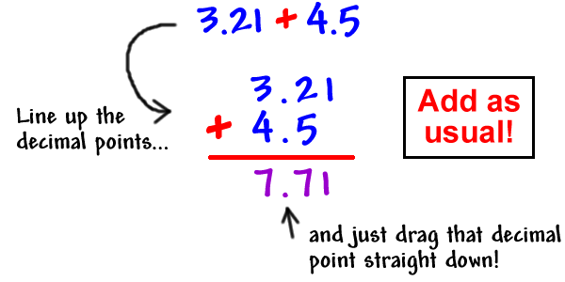
Lesson [2- 5 minutes]
Line up the decimals to add

Slide 5
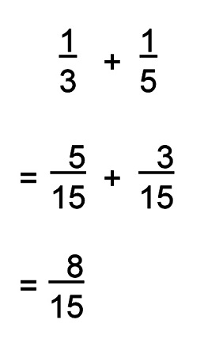
Lesson [2- 5 minutes]
Words that signal addition
Total,
How much
Change
Distance
Find the common denominator
Add and simplify

Slide 6
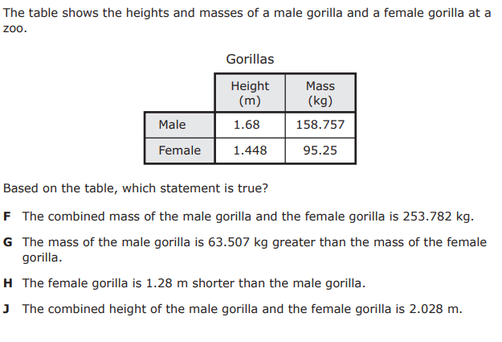
I Do [5 minutes]

Slide 7
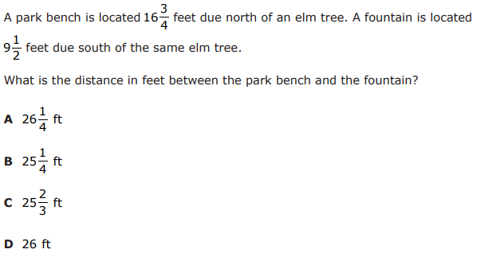
We Do – Student 1 [5 minutes]

Slide 8
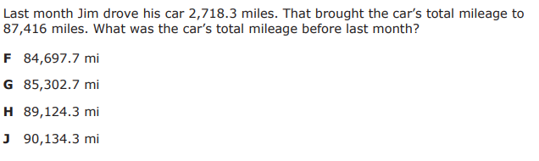
We do - Student 2 [5 minutes]

Slide 9
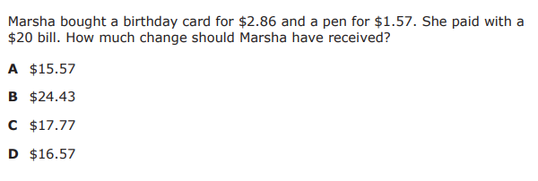
We do - Student 3 [5 minutes]

Slide 10
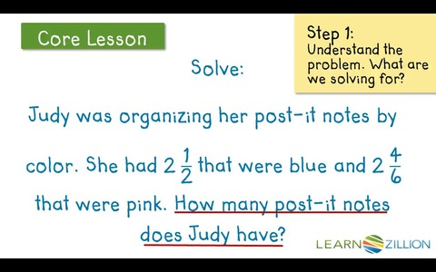
Debrief [2 minutes]
Determine if the problem is asking you to add
Set up the problem
Solve and simplify

Slide 11
You Do [1 minute to explain]
Instructions for Content Dev:
Nothing to do here
Instructions for Tutor:
Have students click on the Quiz tab above (on their screen)
Instruct students to take the quiz on this objective, and remind to use their problem solving strategies

