Slide 1

5.3 (L)
divide whole numbers by unit fractions and unit fractions by whole numbers
Intro: 2 minutes
Explain the TEKS

Slide 2

Fluency Practice [5-10 min]
$\frac{2}{3}$
What is the numerator?
What is the denominator?
What is $\frac{2}{3}$ divided by 3?
What is 3 divided by $\frac{2}{3}$ ?
What words in a word problem tell us that we should divide?

Slide 3
Problem Solving Strategies [explain in 2 minutes]
Intervene’s Problem Solving Strategies:
Step 1: Show what you know
Step 2: Solve and Check
Step 3: Eliminate and Justify

Slide 4
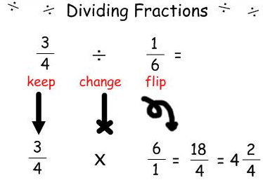

Lesson [2- 5 minutes]
Reciprocal
Change sign and flip
Multiply

Slide 5
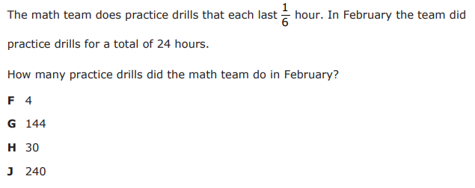
I Do [5 minutes]

Slide 6
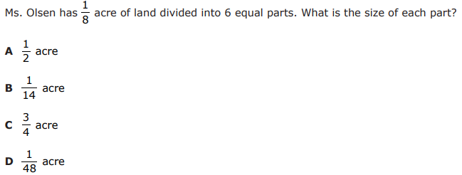
We Do – Student 1 [5 minutes]

Slide 7
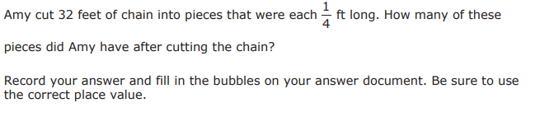
We do - Student 2 [5 minutes]

Slide 8
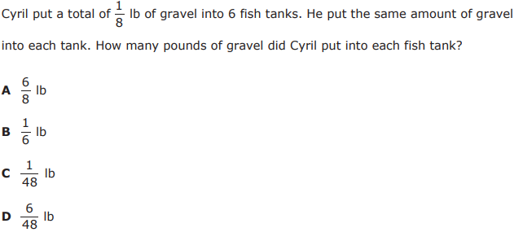
We do - Student 3 [5 minutes]

Slide 9
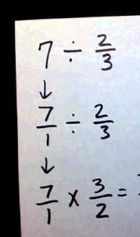
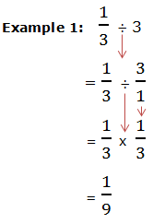
Debrief [2 minutes]
Determine that the problem is asking you to divide
Flip the second fraction
Multiply
Simplify

Slide 10
You Do [1 minute to explain]
Instructions for Content Dev:
Nothing to do here
Instructions for Tutor:
Have students click on the Quiz tab above (on their screen)
Instruct students to take the quiz on this objective, and remind to use their problem solving strategies

