Slide 1

5.3(B)
Multiply with fluency a three-digit number by a two-digit number using the standard algorithm

Slide 2
Fluency Practice
What is 9 x 7?
What is 11 x 2?
How do we solve 14 x 6?
How do we solve 14 x 14?
How do we solve 144 x 14?

Slide 3
Problem Solving Strategies
Intervene’s Problem Solving Strategies:
Step 1: Show what you know
Step 2: Solve and Check
Step 3: Eliminate and Justify

Slide 4
Lesson
Ask 2 questions to know which operation to choose:
Am I looking for a bigger number?
Are there groups?
 | Getting Bigger (in all, total, combined) | Getting Smaller (how many more, difference)
Groups | Multiply (x) | Divide ( / )
No Groups | Add (+) | Subtract ( - )

Slide 5
Mark ate 8 cookies with 291 calories each. Maria ate 2 donuts with 326 calories each. How many calories did Mark and Maria eat in all?
 | Getting Bigger (in all, total, combined) | Getting Smaller (how many more, difference)
Groups | Multiply (x) | Divide ( / )
No Groups | Add (+) | Subtract ( - )

Slide 6
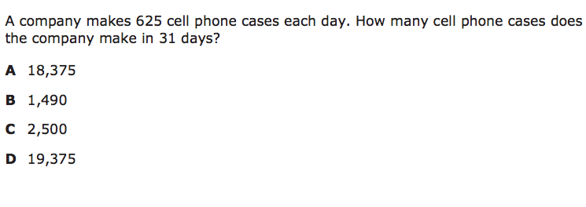
I Do

Slide 7
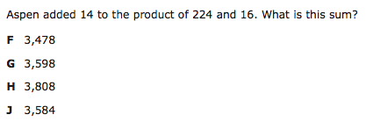
We Do – Student 1

Slide 8
We do - Student 2

Slide 9
We do - Student 3

Slide 10
Debrief [2 minutes]
Look for key words to determine you need to multiply.
Follow the process for multiplying two and three digit numbers.
Finish any additional steps as needed.

Slide 11
You Do [1 minute to explain]
Instructions for Content Dev:
Nothing to do here
Instructions for Tutor:
Have students click on the Quiz tab above (on their screen)
Instruct students to take the quiz on this objective, and remind to use their problem solving strategies

