Slide 1

5.3 (E)
solve for products of decimals to the hundredths, including situations involving money, using strategies based on place-value understandings, properties of operations, and the relationship to the multiplication of whole numbers
Intro: 2 minutes
Explain the TEKS

Slide 2
Fluency Practice [5-10 min]
How would I solve 120 x 15?
How do I multiply 12.5 X 13?
What is the number in the tenths and hundredths place in the number 143.28?
How do I know a word problem is asking me to multiply?

Slide 3
Problem Solving Strategies [explain in 2 minutes]
Intervene’s Problem Solving Strategies:
Step 1: Show what you know
Step 2: Solve and Check
Step 3: Eliminate and Justify

Slide 4
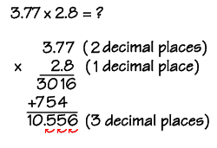
Lesson [2- 5 minutes]
Words that show multiplication:
Each
As much
Times as much
What is the..
How much…
Process for multiplying decimals
Write vertically
Multiply
Count total decimal places
Locate place for decimal point in answer

Slide 5
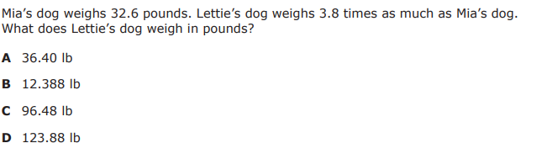
I Do [5 minutes]

Slide 6
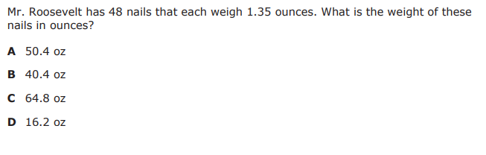
We Do – Student 1 [5 minutes]

Slide 7
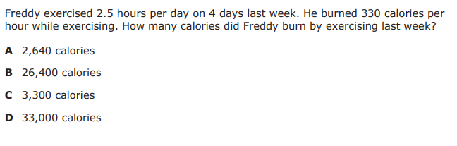
We do - Student 2 [5 minutes]

Slide 8
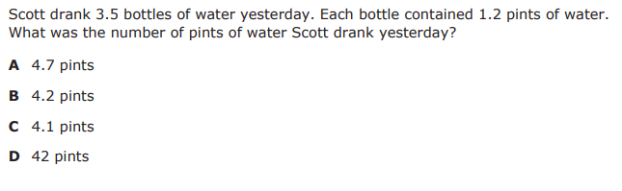
We do - Student 3 [5 minutes]

Slide 9
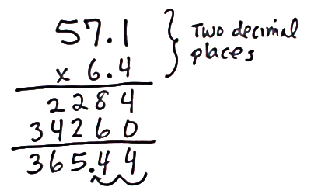
Debrief [2 minutes]
Identify that the problem is asking you to multiply
Identify the two numbers you need to multiply and write them vertically
Multiply
Count decimal places
Place your decimal

Slide 10
You Do [1 minute to explain]
Instructions for Content Dev:
Nothing to do here
Instructions for Tutor:
Have students click on the Quiz tab above (on their screen)
Instruct students to take the quiz on this objective, and remind to use their problem solving strategies

