Slide 1

5.4(A)
Identify prime and composite numbers
Intro: 2 minutes
Explain the TEKS

Slide 2
Fluency Practice [5-10 min]
What are some examples of prime numbers?
What makes them prime?
What are some examples of composite numbers?
What makes them composite?
What type of number is 17? 1? 4?

Slide 3
Problem Solving Strategies [explain in 2 minutes]
Intervene’s Problem Solving Strategies:
Step 1: Show what you know
Step 2: Solve and Check
Step 3: Eliminate and Justify

Slide 4
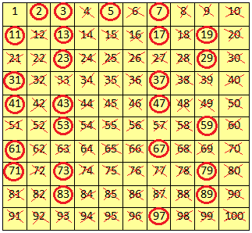
Lesson [2- 5 minutes]
Prime number=has only 2 factors, the number 1 and itself
Composite number=has more than 2 factors

Slide 5
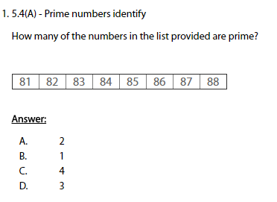
I Do [5 minutes]

Slide 6
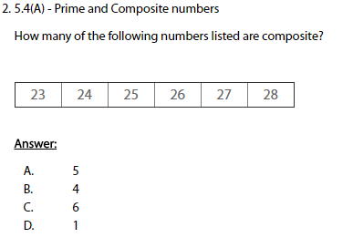
We Do – Student 1 [5 minutes]

Slide 7
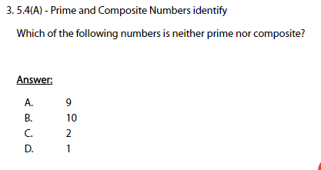
We do - Student 2 [5 minutes]

Slide 8
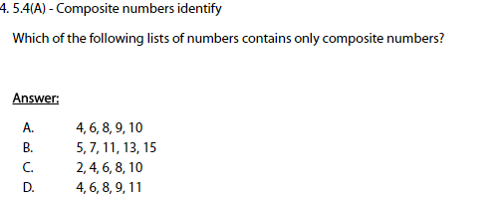
We do - Student 3 [5 minutes]

Slide 9
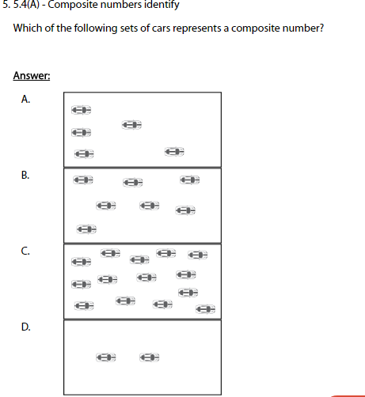
We do - Student 4 [5 minutes]

Slide 10
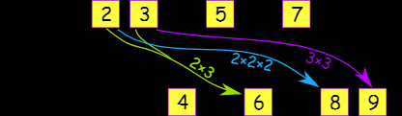
Debrief [2 minutes]
Prime numbers have only two factors, themselves and 1
Composite numbers have more than two factors

Slide 11
You Do [1 minute to explain]
Instructions for Content Dev:
Nothing to do here
Instructions for Tutor:
Have students click on the Quiz tab above (on their screen)
Instruct students to take the quiz on this objective, and remind to use their problem solving strategies

