Slide 1

5.4 (B)
represent and solve multi-step problems involving the four operations with whole numbers using equations with a letter standing for the unknown quantity
<1min

Slide 2
Fluency Practice
564 x 15 =
564 ÷ 3 =
<4 min

Slide 3
Problem Solving Strategies
Step 1: Show what you know
If there’s a vocabulary word you know, write or draw something to show you know it.
ex) perimeter (add all sides, goes around, etc)
Step 2: Solve and Check
Add to check your subtraction, etc
Step 3: Eliminate and Justify
Don’t just cross answers out and pick your favorite choice.
SHOW why a choice is wrong.
<3 min

Slide 4
Lesson
Ask 2 questions to know which operation to choose:
Am I looking for a bigger number or a smaller number?
Are there groups?
 | Getting Bigger (in all, total, combined) | Getting Smaller (how many in only 1 jar, how many more)
Yes Groups (each, an, every, per) | Multiply (x) | Divide (÷)
No Groups | Add (+) | Subtract ( - )
<3 min

Slide 5
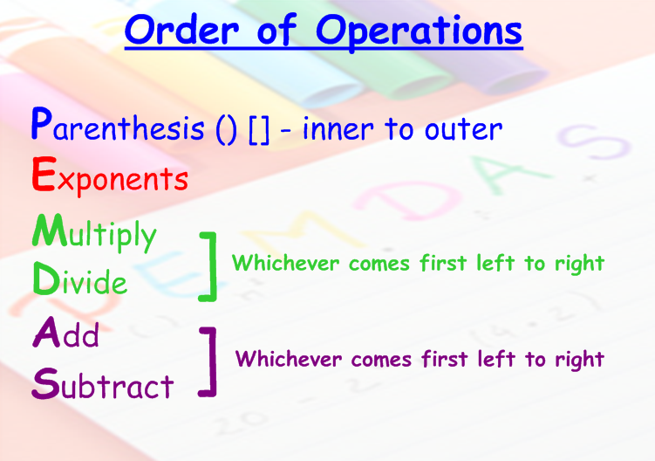

Slide 6
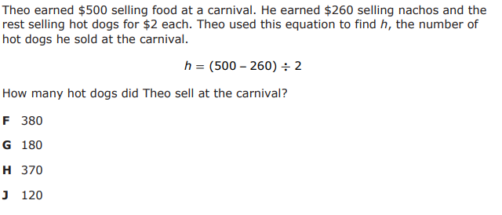
I Do
<5 min

Slide 7
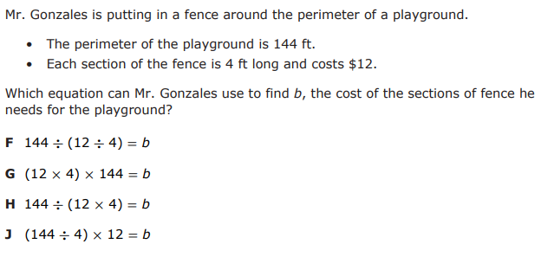
We Do – Student 1
<5 min

Slide 8
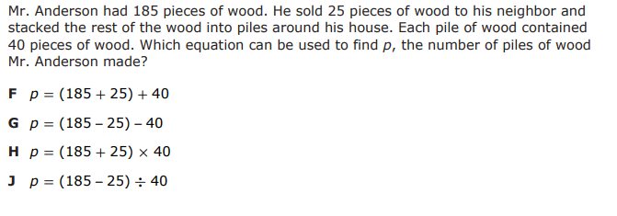
We do - Student 2 [5 minutes]
<5 min

Slide 9
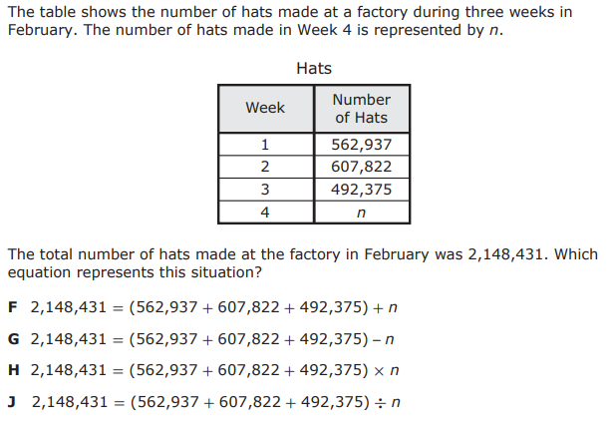
We do - Student 3
<5 min

Slide 10
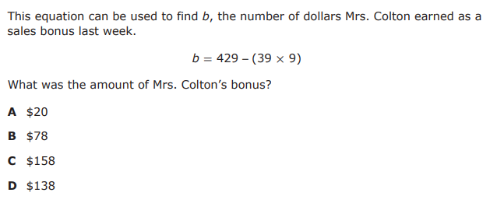
We do - Student 4
<5 min

Slide 11
We Do – Student 5
Let’s try this one again! Can you explain it yourself this time?
<5 min

Slide 12
Debrief
Identify what operation(s) you will use to solve the problem
Set up the equation
Solve using order of operations

Slide 13
You Do
Head back to Intervene for your Quiz!

