Slide 1

5.4 (C)
generate a numerical pattern when given a rule in the form y = ax or y = x + a and graph
Intro: 2 minutes
Explain the TEKS

Slide 2
Fluency Practice [5-10 min]
What is the relationship between the two groups of numbers?
28
48
104
Y=.5X Complete the table
Y=X+21 Complete the table
X | Y
12
48
100
214
X | Y
13
98
108

Slide 3
Problem Solving Strategies [explain in 2 minutes]
Intervene’s Problem Solving Strategies:
Step 1: Show what you know
Step 2: Solve and Check
Step 3: Eliminate and Justify

Slide 4
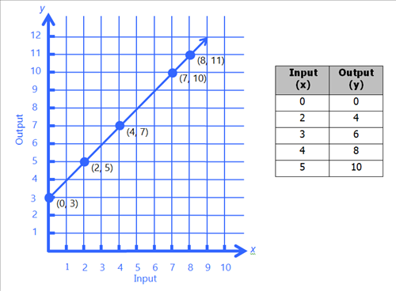
Lesson [2- 5 minutes]
Represent
Relationship
Equation

Slide 5
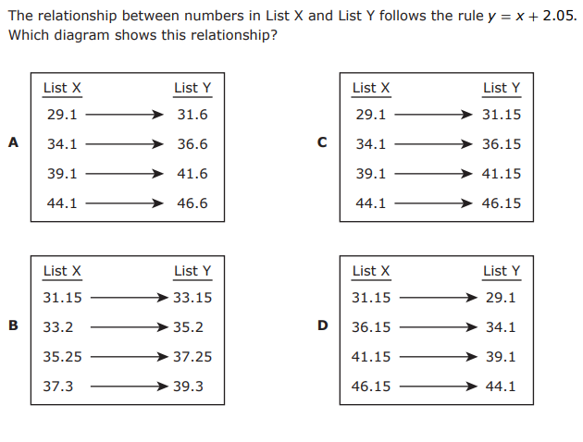
I Do [5 minutes]

Slide 6
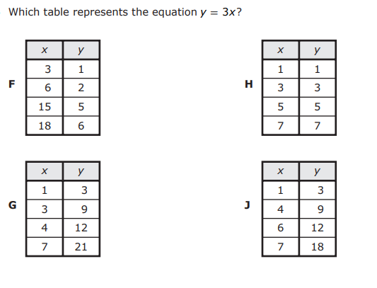
We Do – Student 1 [5 minutes]

Slide 7
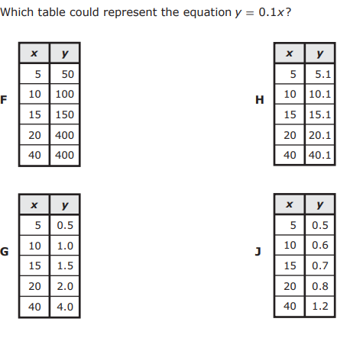
We do - Student 2 [5 minutes]

Slide 8
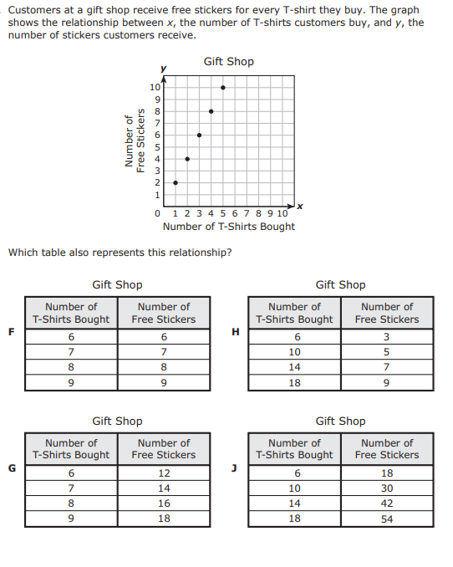
We do - Student 3 [5 minutes]

Slide 9
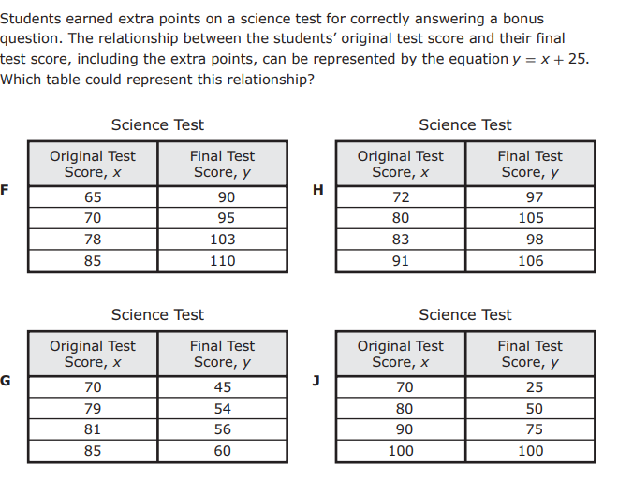
We do - Student 4 [5 minutes]

Slide 10
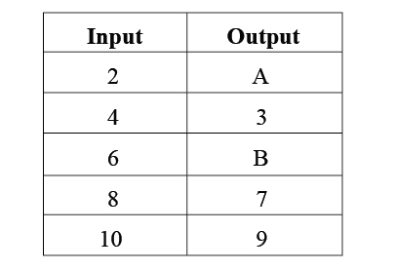
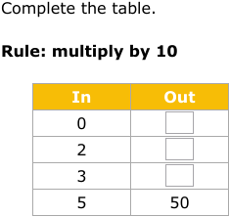
Debrief [2 minutes]
Table
Graph
Equation
Represent
What are possible equations for each table?

Slide 11
You Do [1 minute to explain]
Instructions for Content Dev:
Nothing to do here
Instructions for Tutor:
Have students click on the Quiz tab above (on their screen)
Instruct students to take the quiz on this objective, and remind to use their problem solving strategies

