Slide 1

5.4 (F)
simplify numerical expressions that do not involve exponents, including up to two levels of grouping
<1 min

Slide 2
Fluency Practice
5 x 9 =
2 x 8 =
12 x 9 =
16 x 4 =
36 ÷ 4 =
42 ÷ 6 =
28 ÷ 7 =
144 ÷ 24 =
<4 min

Slide 3
Problem Solving Strategies
Step 1: Show what you know
If there’s a vocabulary word you know, write or draw something to show you know it.
ex) perimeter (add all sides, goes around, etc)
Step 2: Solve and Check
Add to check your subtraction, etc
Step 3: Eliminate and Justify
Don’t just cross answers out and pick your favorite choice.
SHOW why a choice is wrong.
<3 min

Slide 4
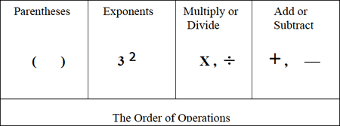
Lesson
Order of operations
Please excuse my dear Aunt Sally
<2 min

Slide 5
Ex) 15 ÷ (3 + 2)
With Order of Operations
Without Order of Operations
15 ÷ (3 + 2) =
15 ÷ 5 = 3
15 ÷ (3 + 2) =
15 ÷ 3 + 2 =
5 + 2 = 7
<2 min

Slide 6
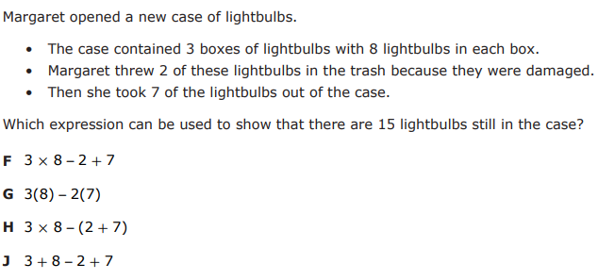
I Do
<5 min

Slide 7
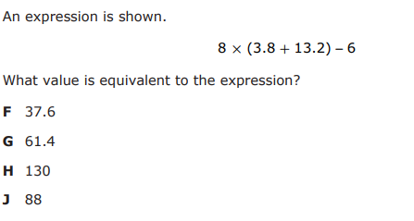
We Do – Student 1
<5 min

Slide 8
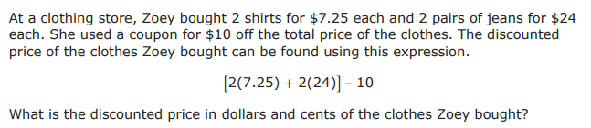
We do - Student 2
<5 min

Slide 9
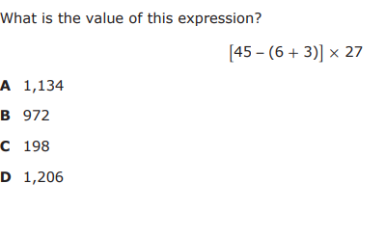
We do - Student 3
<5 min

Slide 10
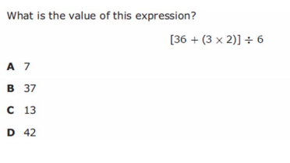
We do - Student 4
<5 min

Slide 11
We Do – Student 5
<2 min
Let’s see if you can explain it again! But this time on your own

Slide 12
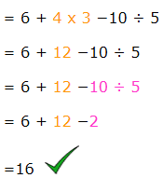
Debrief
Follow the order of operations
Parentheses, Exponents, Mult/Div, Add/Sub
Please excuse my dear Aunt Sally
<2 min

Slide 13
You Do
Head back to Intervene for your quiz!

Slide 14
Answer Key
I Do: H
We Do 1: H
We Do 2: 52.5
We Do 3: B
We Do 4: A
We Do 5: H (Same as I Do)

