Slide 1

5.4 (H)
represent and solve problems related to perimeter and/or area and related to volume
Intro: 2 minutes
Explain the TEKS

Slide 2
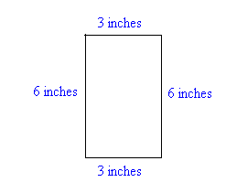
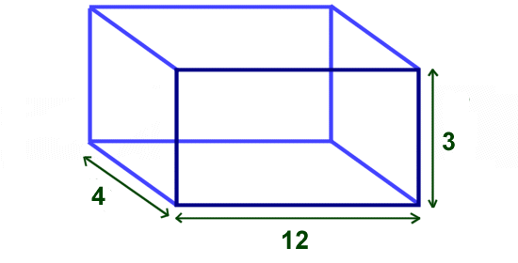
Fluency Practice [5-10 min]
What is the process to find perimeter?
What is the process to find volume?
How do we know if we need to find perimeter or volume?
Which image goes with which?

Slide 3
Problem Solving Strategies [explain in 2 minutes]
Intervene’s Problem Solving Strategies:
Step 1: Show what you know
Step 2: Solve and Check
Step 3: Eliminate and Justify

Slide 4
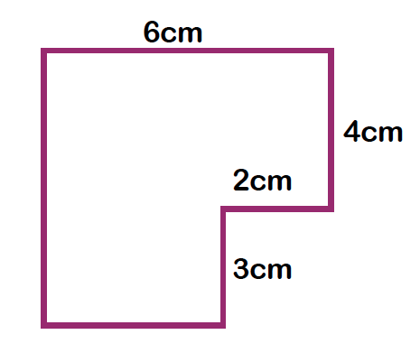
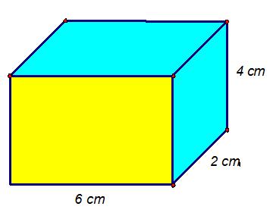
Lesson [2- 5 minutes]
Volume=Length x width x height
Perimeter=add up each side

Slide 5
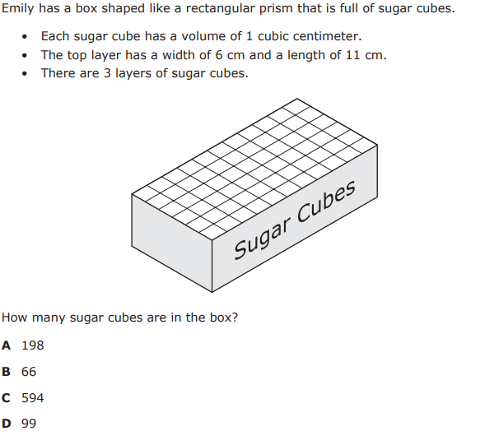
I Do [5 minutes]

Slide 6
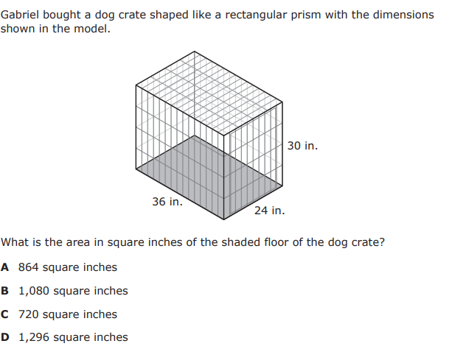
We Do – Student 1 [5 minutes]

Slide 7
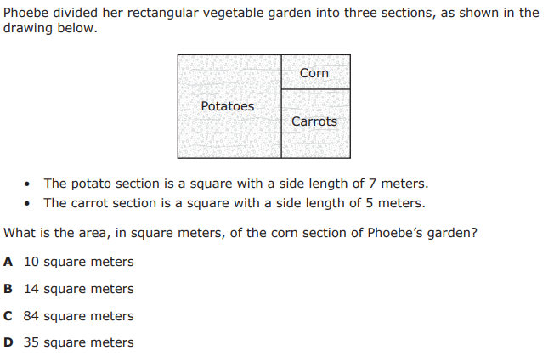
We do - Student 2 [5 minutes]

Slide 8
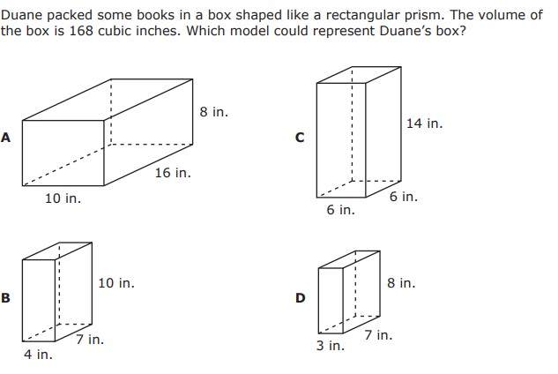
We do-Student 3 [5 minutes]

Slide 9
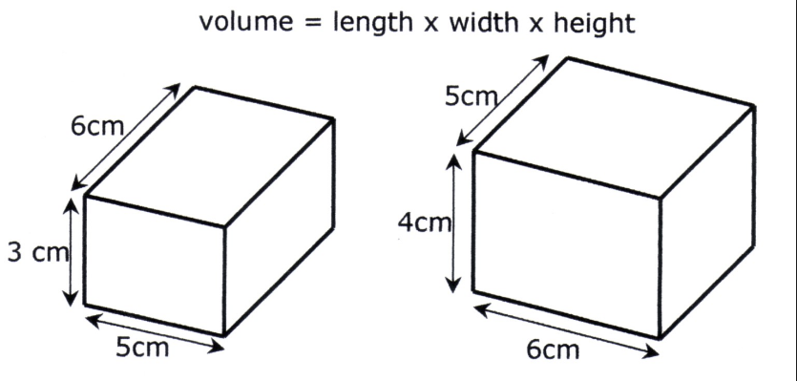
Debrief [2 minutes]
Determine that the problem is asking you to find perimeter or volume
Solve by adding up each side for perimeter
Solve by multiplying L x W x H for volume

Slide 10
You Do [1 minute to explain]
Instructions for Content Dev:
Nothing to do here
Instructions for Tutor:
Have students click on the Quiz tab above (on their screen)
Instruct students to take the quiz on this objective, and remind to use their problem solving strategies

