Slide 1

5.5 (A)
The student applies mathematical process standards to classify two-dimensional figures by attributes and properties. The student is expected to classify two-dimensional figures in a hierarchy of sets and subsets using graphic organizers based on their attributes and properties.
Intro: 2 minutes
Explain the TEKS

Slide 2
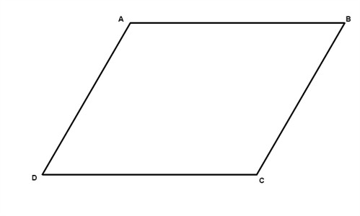
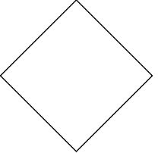
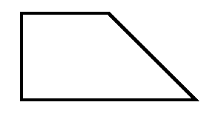
Fluency Practice [5-10 min]
Identify the following shapes and discuss the qualities of each.
What are acute and obtuse angles?
What other shapes have you studies not here? What are the qualities of those shapes?

Slide 3
Problem Solving Strategies [explain in 2 minutes]
Intervene’s Problem Solving Strategies:
Step 1: Show what you know
Step 2: Solve and Check
Step 3: Eliminate and Justify

Slide 4
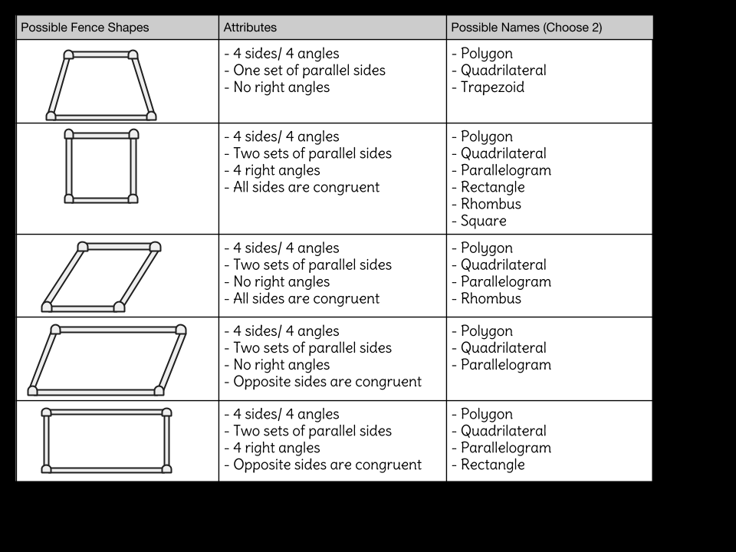
Lesson [2- 5 minutes]
Polygon
Parallelogram
Rhombus
Square
Rectangle
Trapezoid
Triangle
Pentagon/octagon
Congruent
Right angles
Obtuse angles/ acute angles

Slide 5
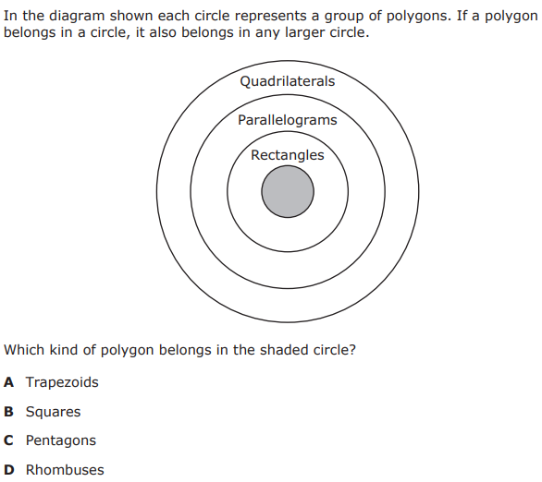
I Do [5 minutes]

Slide 6
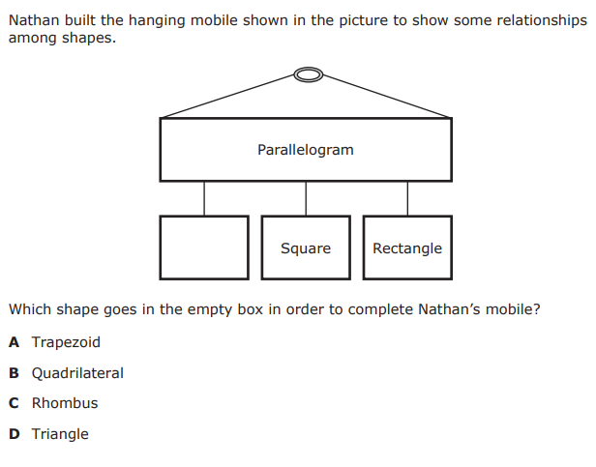
We Do – Student 1 [5 minutes]

Slide 7
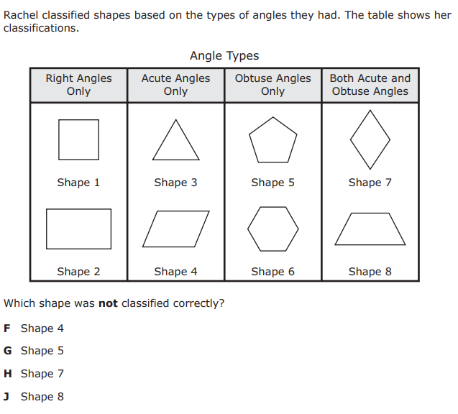
We do - Student 2 [5 minutes]

Slide 8
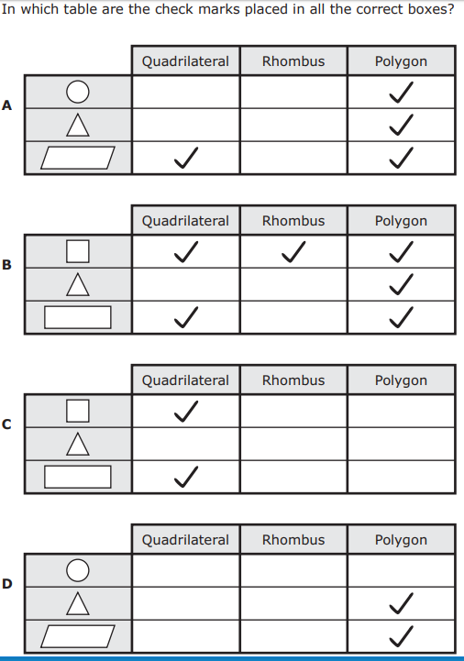
We do - Student 3 [5 minutes]

Slide 9
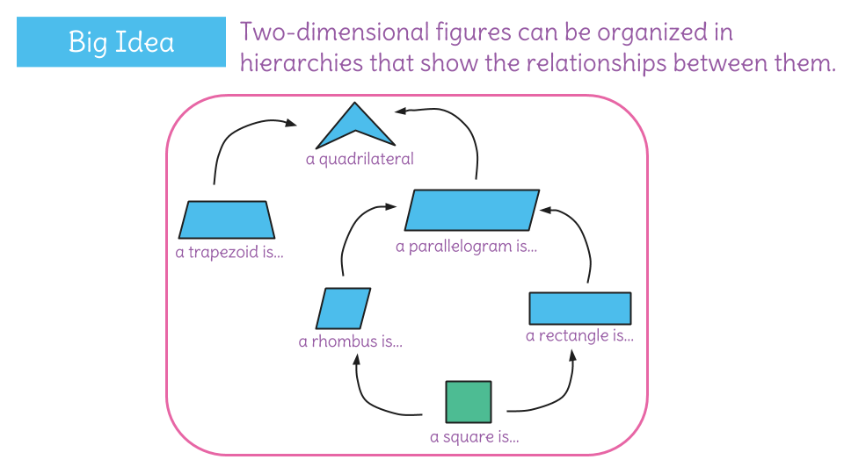
Debrief [2 minutes]
Determine all possible shape categories of each
Justify categories by attributes of the shape

Slide 10
You Do [1 minute to explain]
Instructions for Content Dev:
Nothing to do here
Instructions for Tutor:
Have students click on the Quiz tab above (on their screen)
Instruct students to take the quiz on this objective, and remind to use their problem solving strategies

