Slide 1

5.8 (C)
graph in the first quadrant of the coordinate plane ordered pairs of numbers arising from mathematical and real-world problems, including those generated by number patterns or found in an input-output table
Intro: 2 minutes
Explain the TEKS

Slide 2
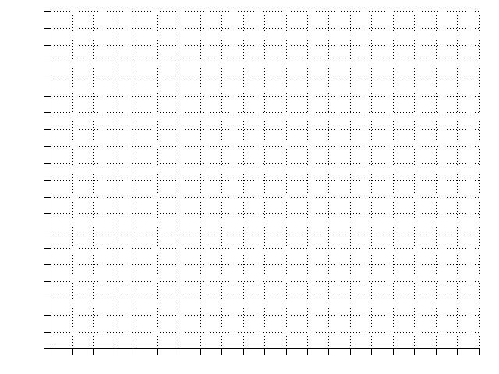
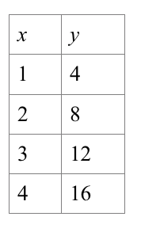
Fluency Practice [5-10 min]
Which is the x axis?
Which is the y axis?
Let’s plot some points:
(2, 3) (0,4) (4,0) (5 ½ , 2 ¾ )
Let’s plot the numbers from the table:

Slide 3
Problem Solving Strategies [explain in 2 minutes]
Intervene’s Problem Solving Strategies:
Step 1: Show what you know
Step 2: Solve and Check
Step 3: Eliminate and Justify

Slide 4
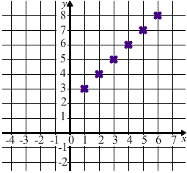
Lesson [2- 5 minutes]
Ordered pair
Coordinate grid
Plotted
Table of ordered pairs
(X and Y)
Notes:
What are the ordered pairs for each point?
Let’s organize them into an x and y table

Slide 5
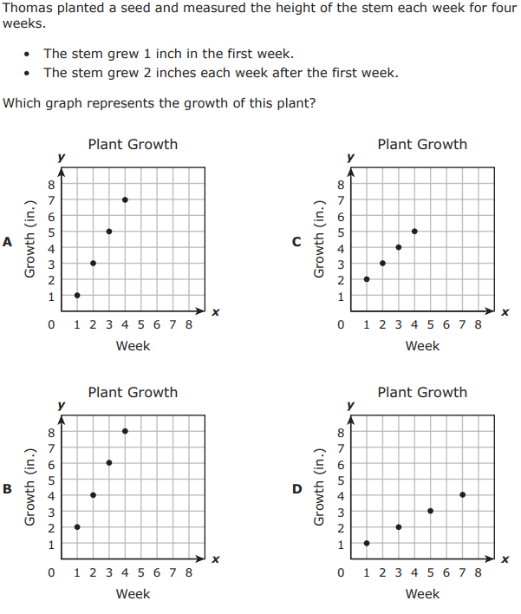
I Do [5 minutes]

Slide 6
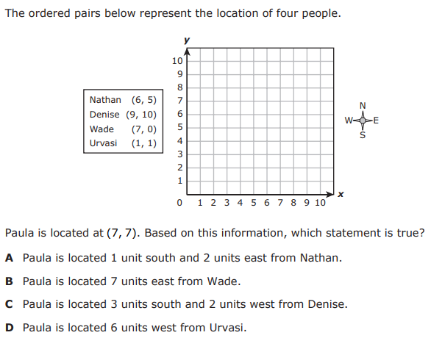
We Do – Student 1 [5 minutes]

Slide 7
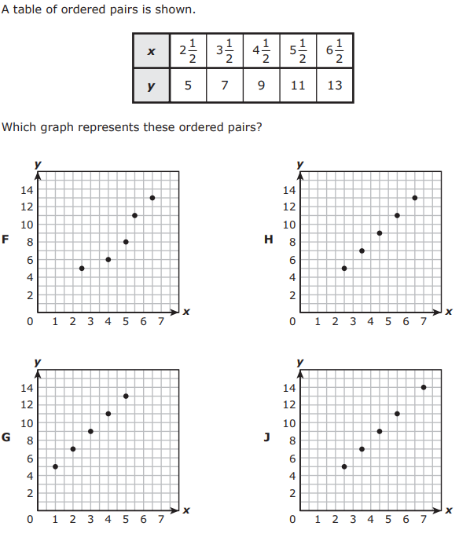
We do - Student 2 [5 minutes]

Slide 8
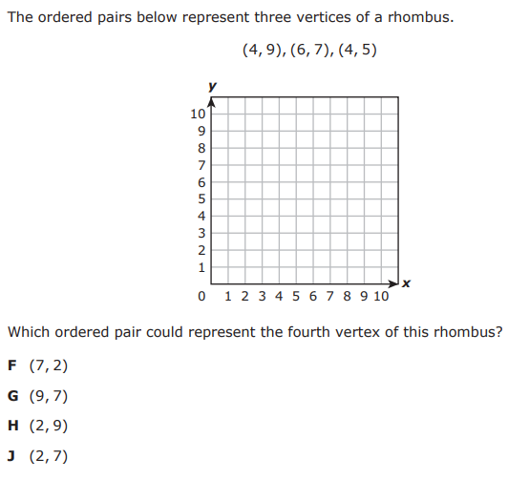
We do - Student 3 [5 minutes]

Slide 9
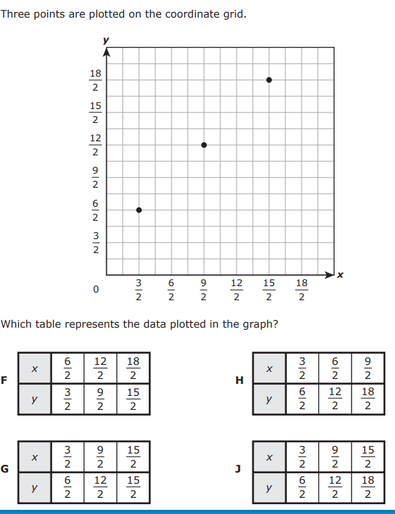
We do - Student 4 [5 minutes]

Slide 10
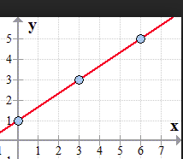
Debrief [2 minutes]
Determine if you need to plot points or verify points per answer choices.
Plot or verify.

Slide 11
You Do [1 minute to explain]
Instructions for Content Dev:
Nothing to do here
Instructions for Tutor:
Have students click on the Quiz tab above (on their screen)
Instruct students to take the quiz on this objective, and remind to use their problem solving strategies

