Slide 1

5.9(A)
represent categorical data with bar graphs or frequency tables and numerical data, including data sets of measurements in fractions or decimals, with dot plots or stem-and-leaf plots
<1 min

Slide 2

Reading Fractions on Number Lines
Find A and B
A
0
1
B
0
1
2

Slide 3
Problem Solving Strategies
Step 1: Show what you know
If there’s a graph that isn’t labeled with numbers, write the value next to it
ex) take notes on the graph
Step 2: Solve and Check
“Add” to check your subtraction, etc
Step 3: Eliminate and Justify
Don’t just cross answers out and pick your favorite choice.
SHOW why a choice is wrong.
<3 min

Slide 4
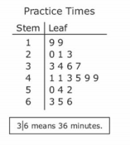
Stem and Leaf Plot
Which number below is not represented in the Stem and Leaf Plot on the right?
19,19,20,21,23,33,34,36,37,41,41,43,45,49,49,50,53,54,52,63,65,66
The key is very important
2 min

Slide 5
Stem and Leaf Plot
What’s the greatest number of minutes represented on the stem and leaf plot?
What’s the least number of minutes represented on the stem and leaf plot?
2 min

Slide 6
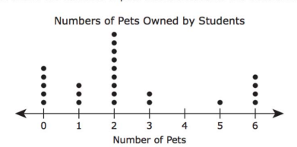
Dot Plots
How many students own 1 pet?
How many students own 4 pets?
Always look at the labels for axes

Slide 7
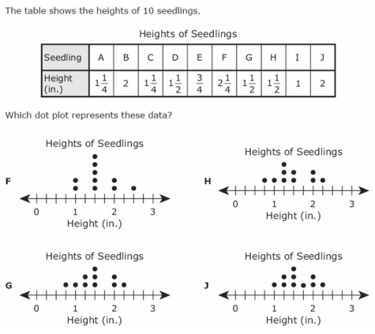
I Do
5 min

Slide 8
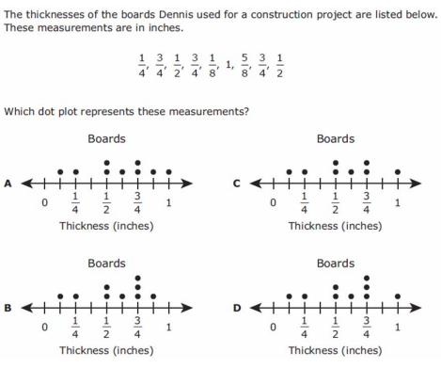
We Do Q1
5 min

Slide 9
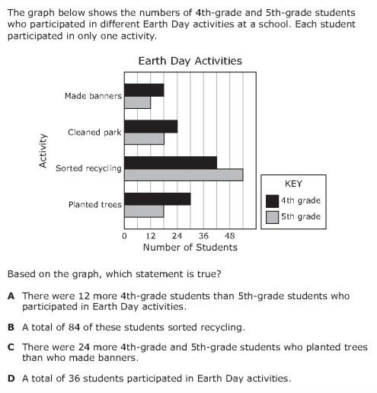
We do - Student 2
write out the numbers you see in the graph
5 min

Slide 10
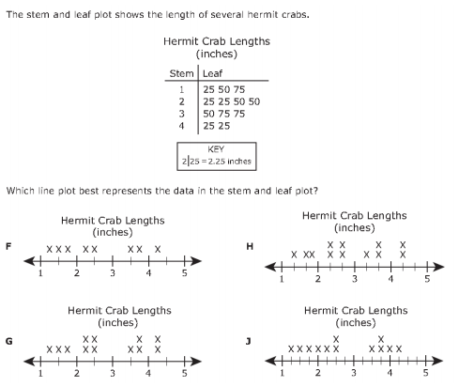
We do - Student 3
5 min

Slide 11
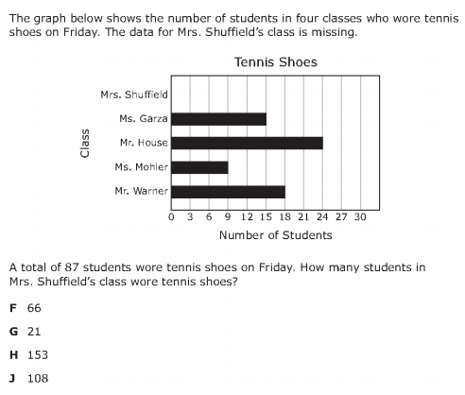
We do – Student 4
5 min

Slide 12
Debrief
Always show numbers next to charts.
Look at the key and the Axes when working on graphs. They’ll help you understand the visualization

Slide 13
You Do
Go back to Intervene for your quiz!

